Slide 1
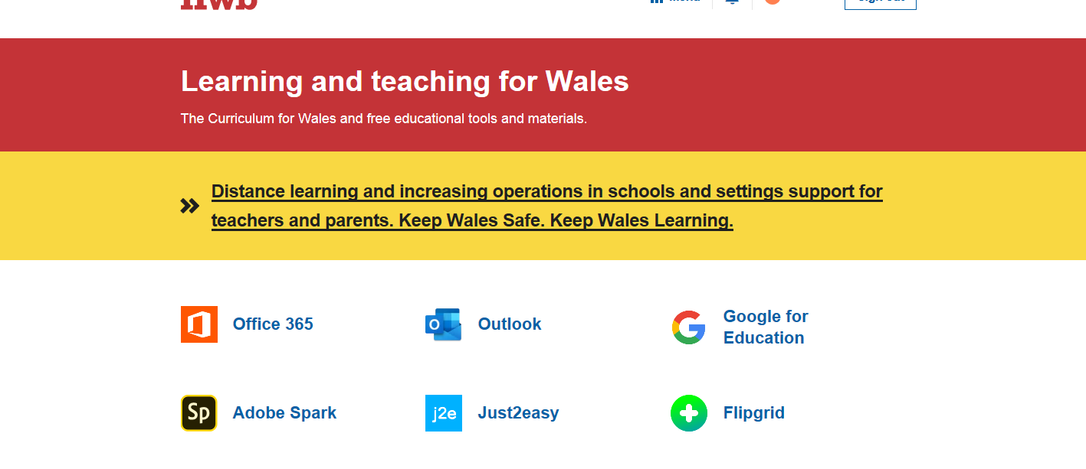
Lanlwytho gwaith a lluniau i Hwb
Uploading work and photos to Hwb.

Slide 2
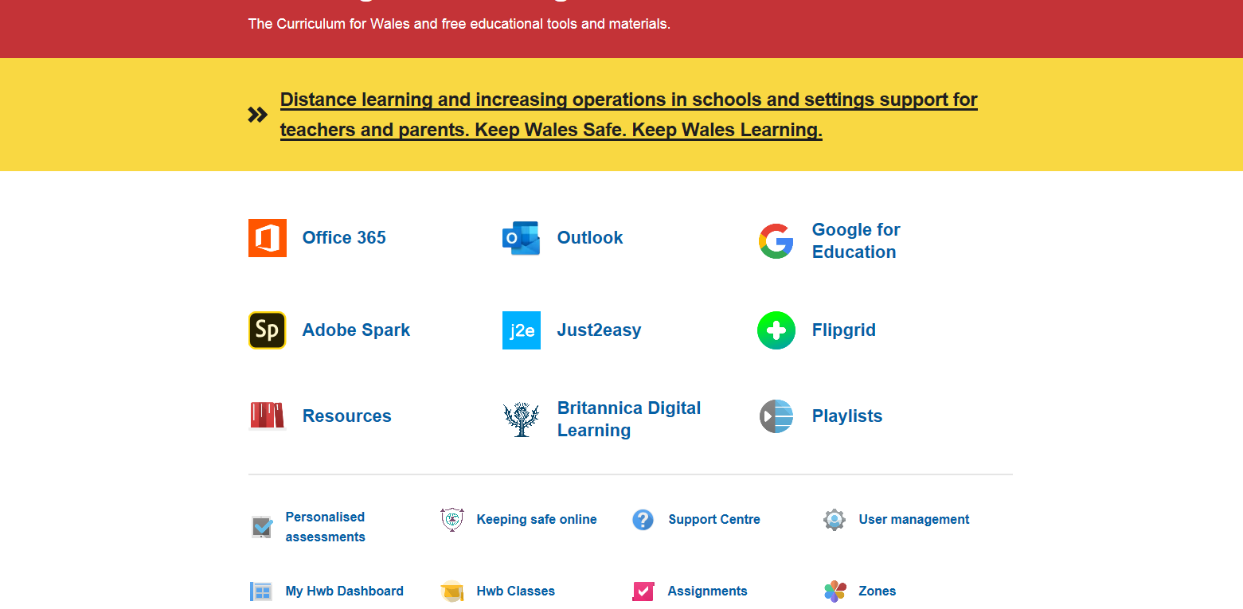
Mewngofnodwch i Hwb a gwasgwch y botwm ‘Just2easy’.
Sign in to Hwb and press the ‘Just2easy’ button.

Slide 3
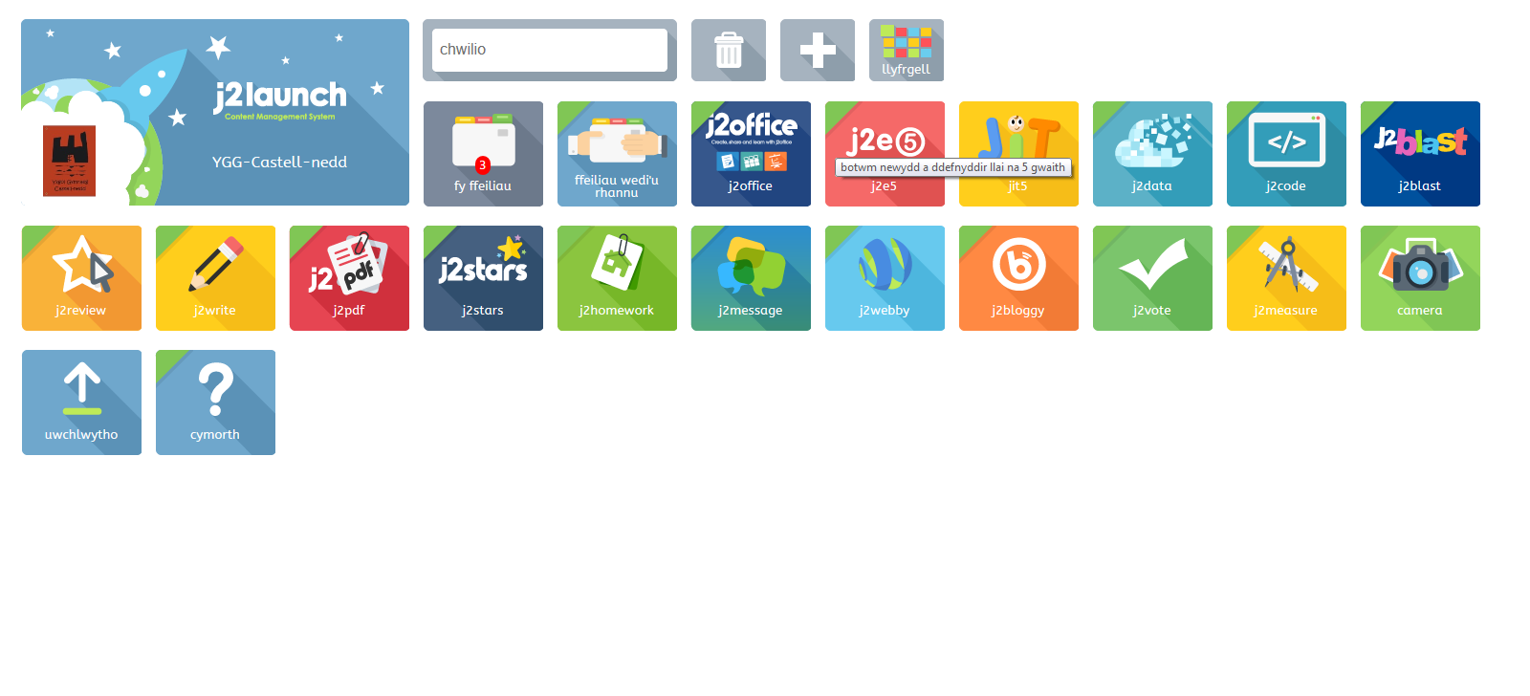

Nesaf, gwasgwch y botwm ‘Uwchlwytho’.
Next press the ‘Upload’ button.

Slide 4
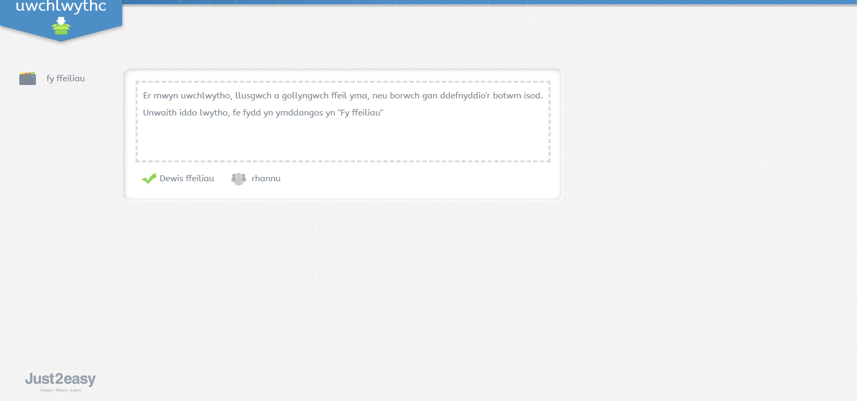

Dyma ble fyddwch yn medru lanlwytho lluniau neu gwaith i ddangos athro/athrawes eich plentyn.
Here you can upload any pictures or work you would like your child’s teacher to see.

