Slide 1

Noson ddarllen
Uned 5 a 6
YGG Castell-nedd
2022

Slide 2
Darllen yn yr uned / Reading in the department
Darllen ar y cyd / Reading as a class
Clywed straeon / Listening to stories
Darllen grŵp / Group reading
Darllen yn unigol gydag oedolyn / Reading individually with an adult
Cefnogaeth / Support
Llyfrau adref / Books at home
Darllen a deall / Comprehension

Slide 3
Yr 8 ymddygiad darllen/ The 8 reading behaviours
Gwneud Cysylltiadau / Making Connections.
Casglu / Inferring
Delweddu / Visualising
Crynhoi / Summarising
Cwestiynu / Questioning
Rhagfynegi / Predicting
Ysgogi Gwybodaeth Flaenorol / Activating Prior Knowledge
Gwerthuso / Evaluating

Slide 4
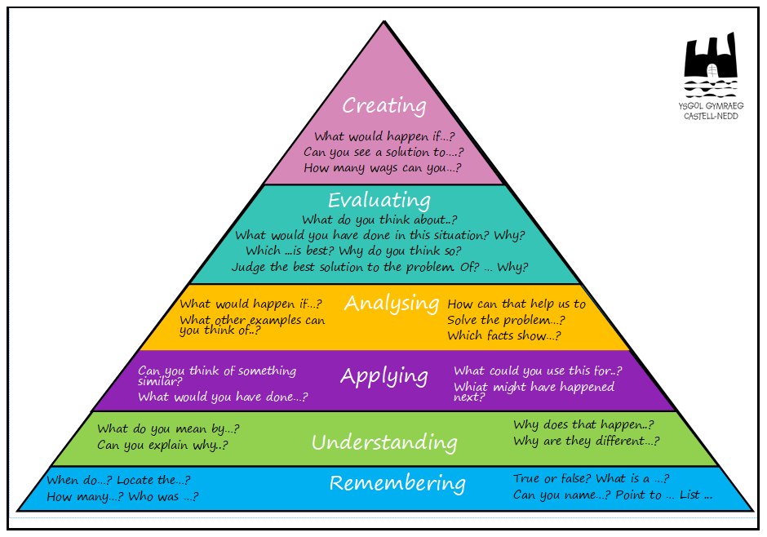
Cwestiynau Tacsonomeg Bloom / Bloom’s taxonomy questions

Slide 5
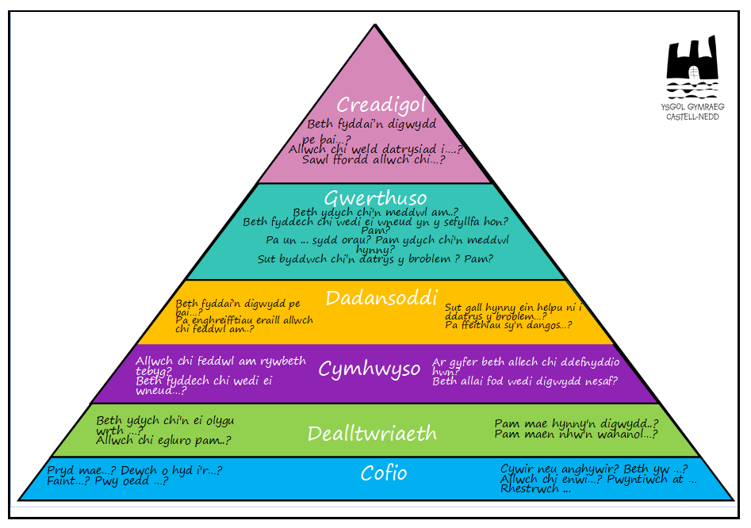
Cwestiynau Tacsonomeg Bloom / Bloom’s taxonomy questions

