Slide 1
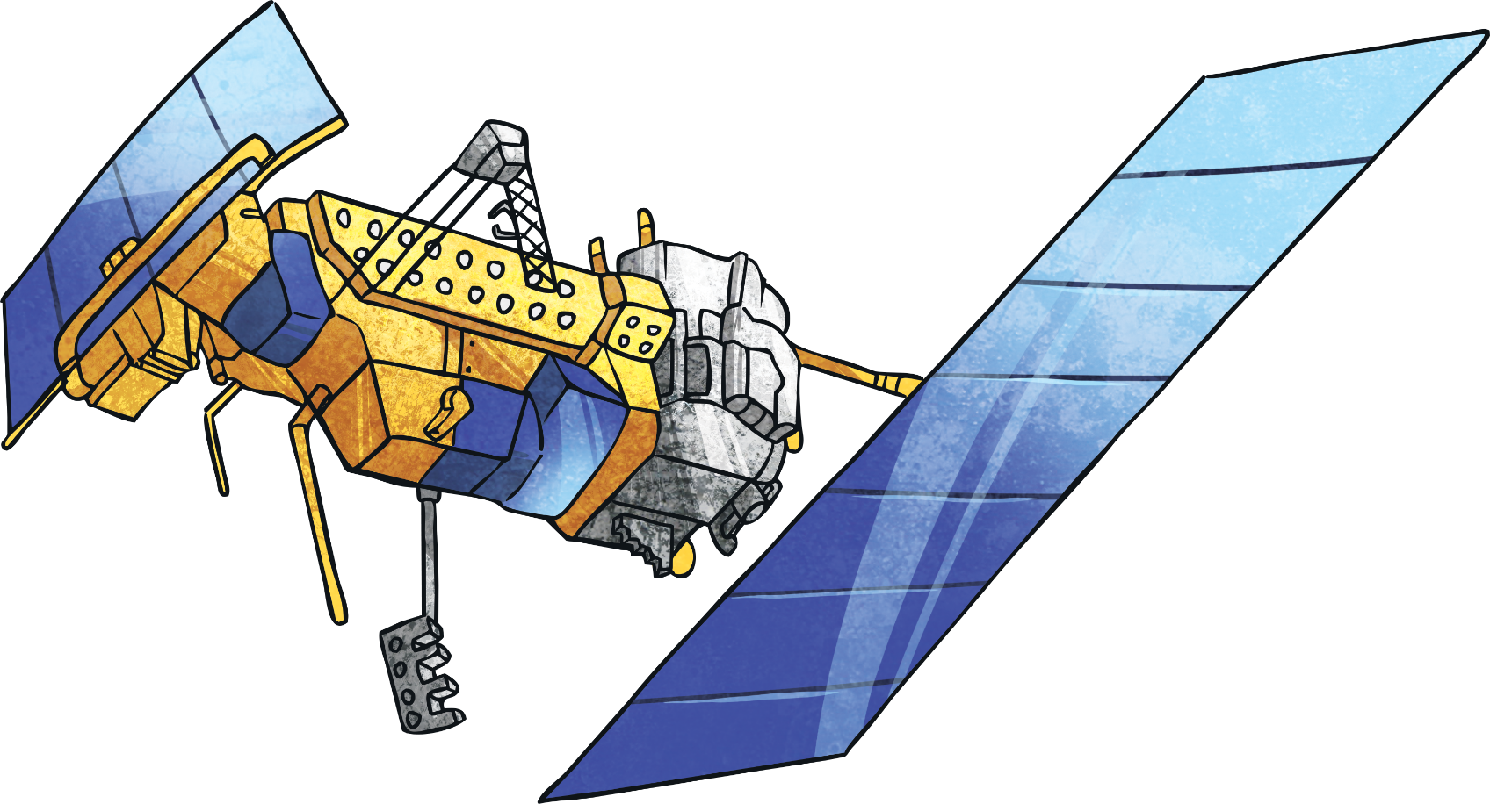
Satellites

Slide 2
What Do We Already know about Satellites?

Slide 3
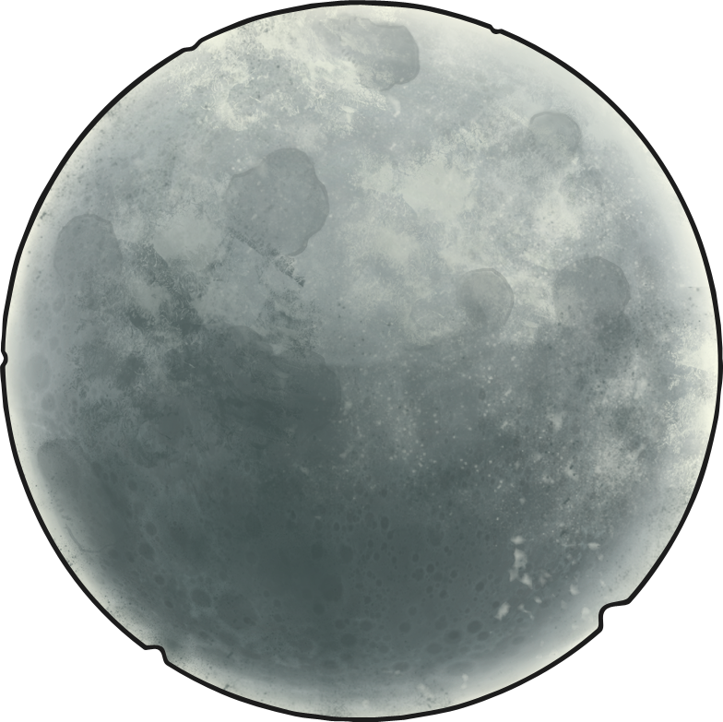
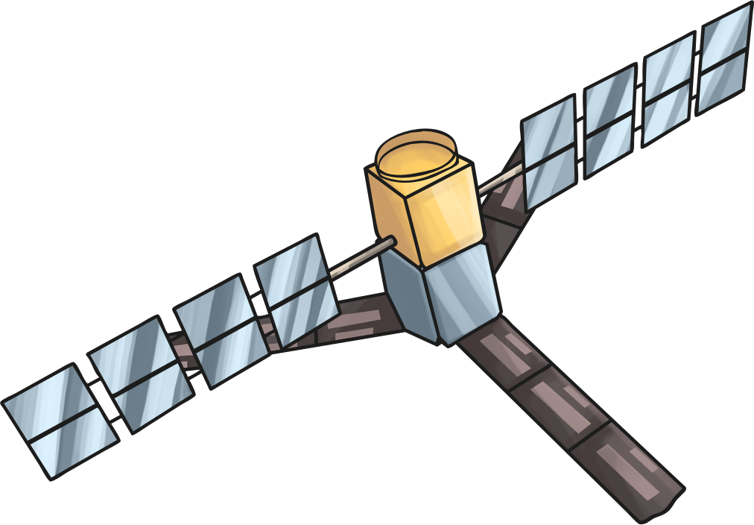
What Is a Satellite?
A satellite is a planet, moon or machine, which orbits (travels around) a planet or star. This presentation will help you learn more about the type of satellite which is launched into space.

Slide 4
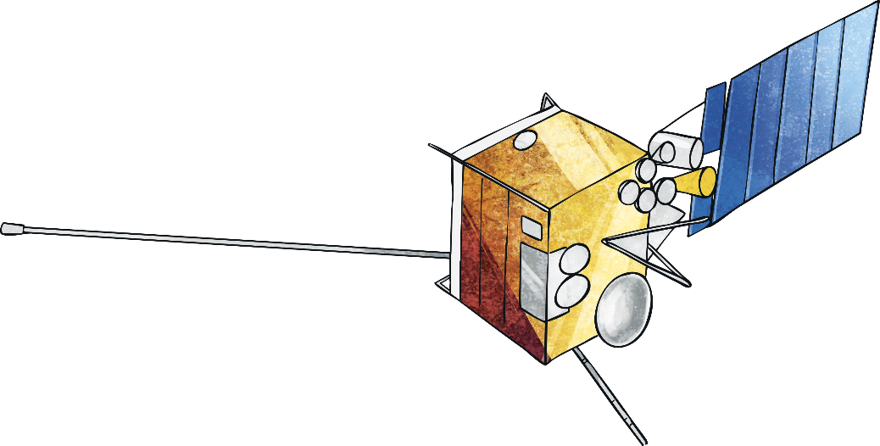
What Do Satellites Do?
Some satellites take pictures of Earth to help predict the weather. They can also provide information about our climate. Satellites can measure gases in the atmosphere too. Some satellites take pictures of other planets or distant galaxies, helping scientists to understand more about our universe.
Other satellites are used for communication. TV signals and telephone calls travel to a satellite, then the satellite sends them back down to different places around the world.
A geostationary satellite travels from west to east,
moving in the same direction and at the same speed as the
Earth. Polar-orbiting satellites travel from pole to pole.

Slide 5
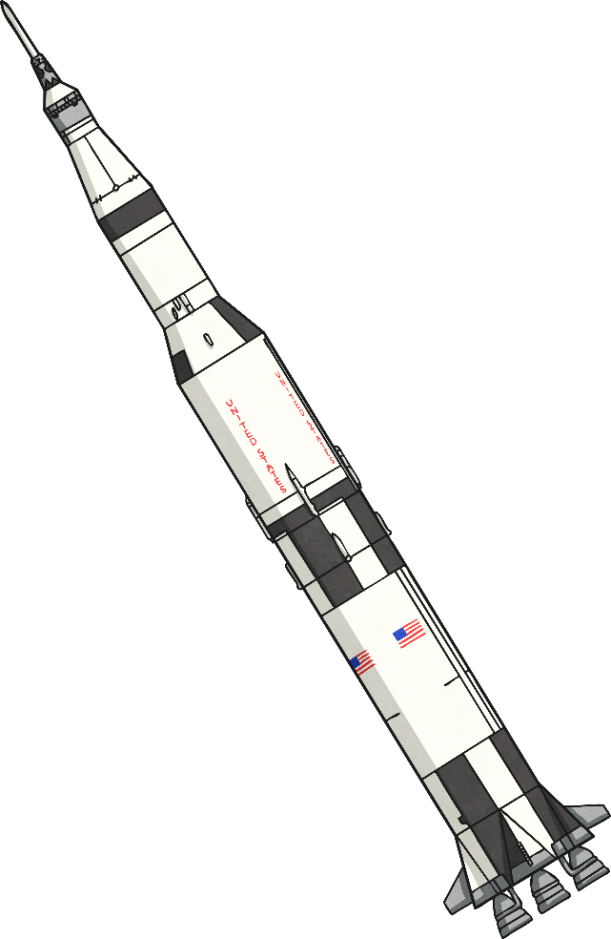
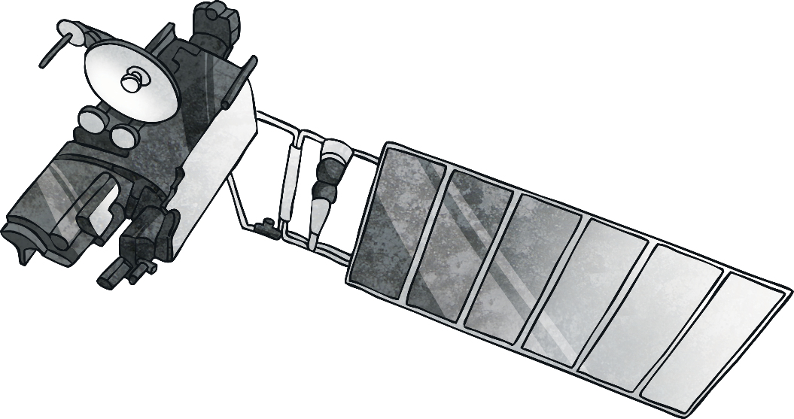
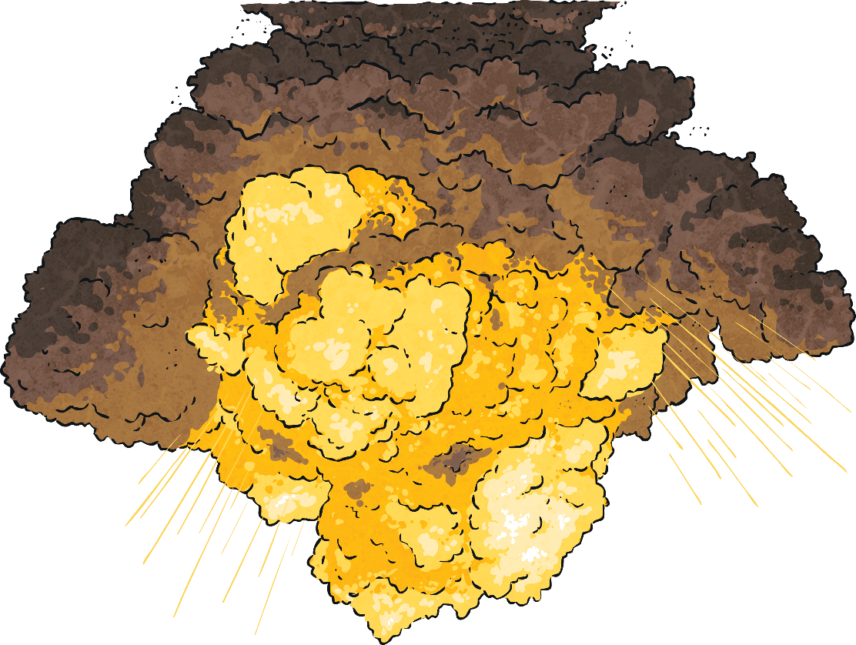
How Do They Get Up There?
Satellites travel into space using rockets. They orbit Earth at different heights, speeds and along different pathways in order to avoid collisions. Although it doesn’t happen very often, in 2009, two communication satellites crashed while in orbit. Satellites are carefully tracked to try and avoid this happening.

Slide 6
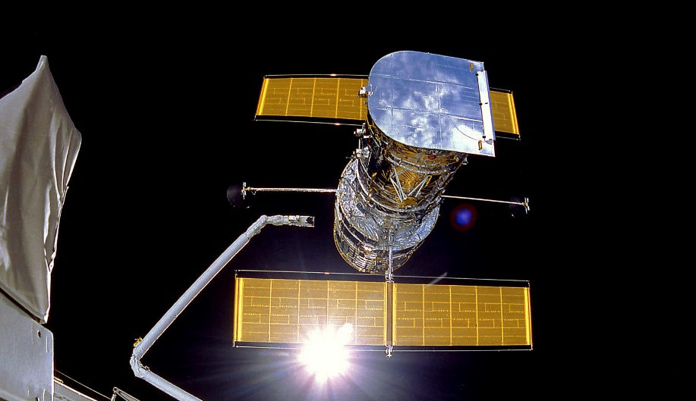
What Do Satellites Look Like?
Satellites can vary in shape and size. All satellites have a power source and an antenna.
Power source – This can be a battery or solar panels. Solar panels power the satellite by converting sunlight into electricity.
Antenna – This sends and receives information to and from Earth.
Many satellites have cameras. They also have sensors, such as heat sensors, which measure temperature.

Slide 7
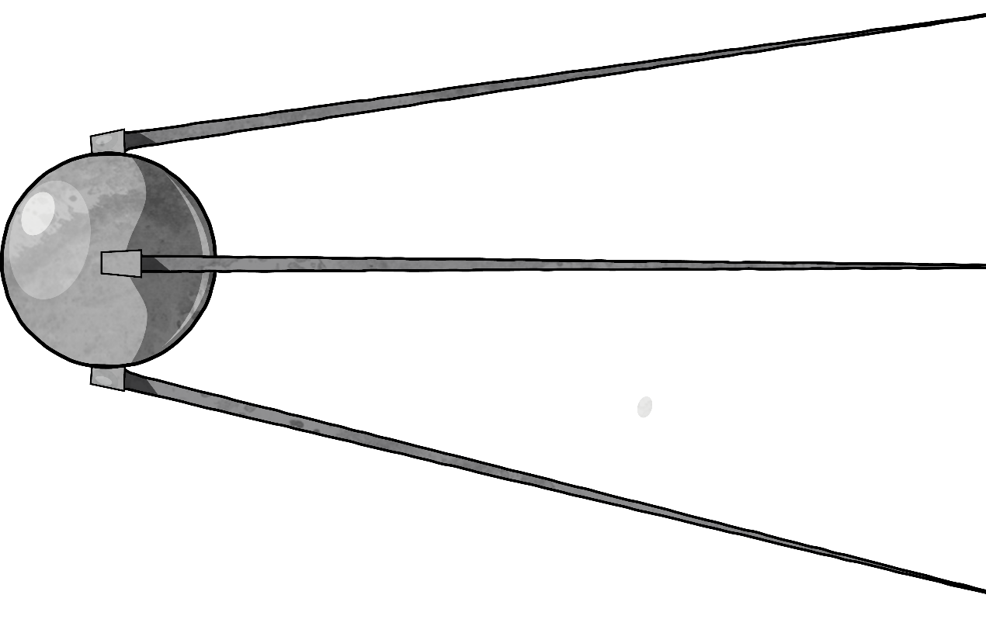
The First Satellite
The first ever artificial satellite sent into space was called Sputnik 1. It was launched in 1957 by the Soviet Union.

Slide 8
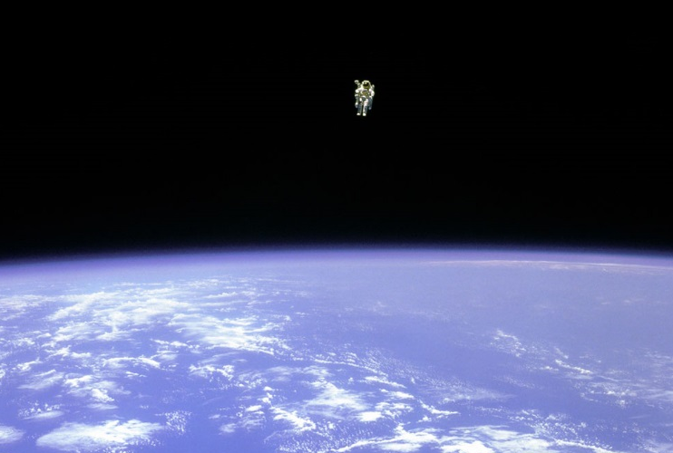
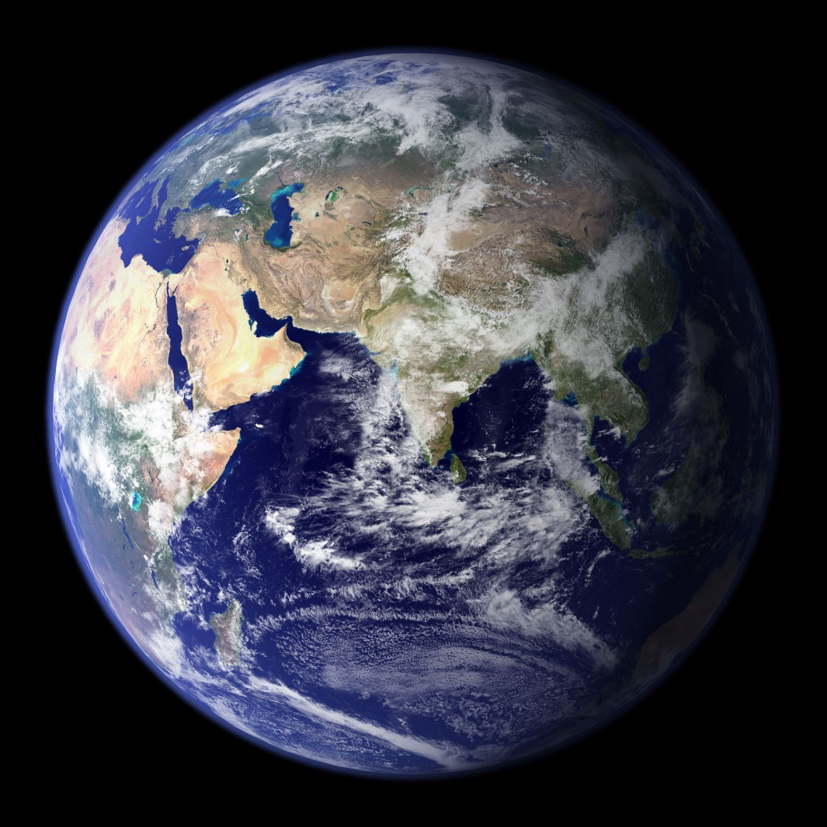
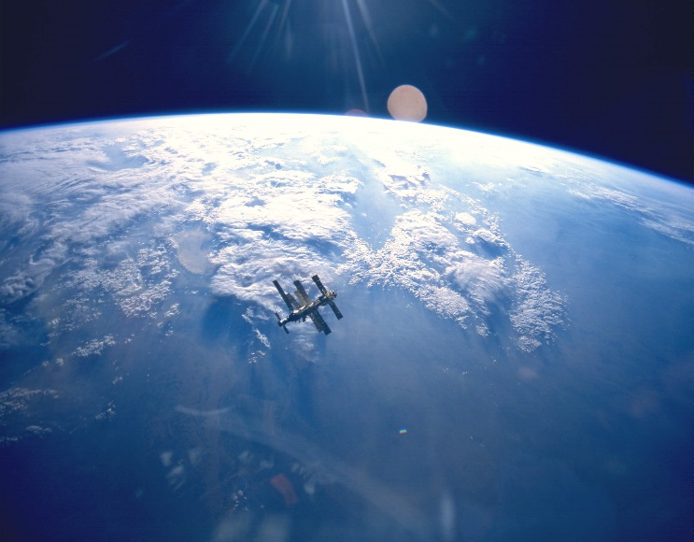
Images From Space

Slide 9

POES Facts
POES is a polar-orbiting weather satellite.
This satellite orbits 500 miles above Earth, around 14 times every day.
It passes close to the North and South Poles.
Heat sensors measure the temperature of the land, air, oceans and clouds.
Search and rescue antenna
Batteries
Imager
Sensors
Antenna
Solar Array

Slide 10
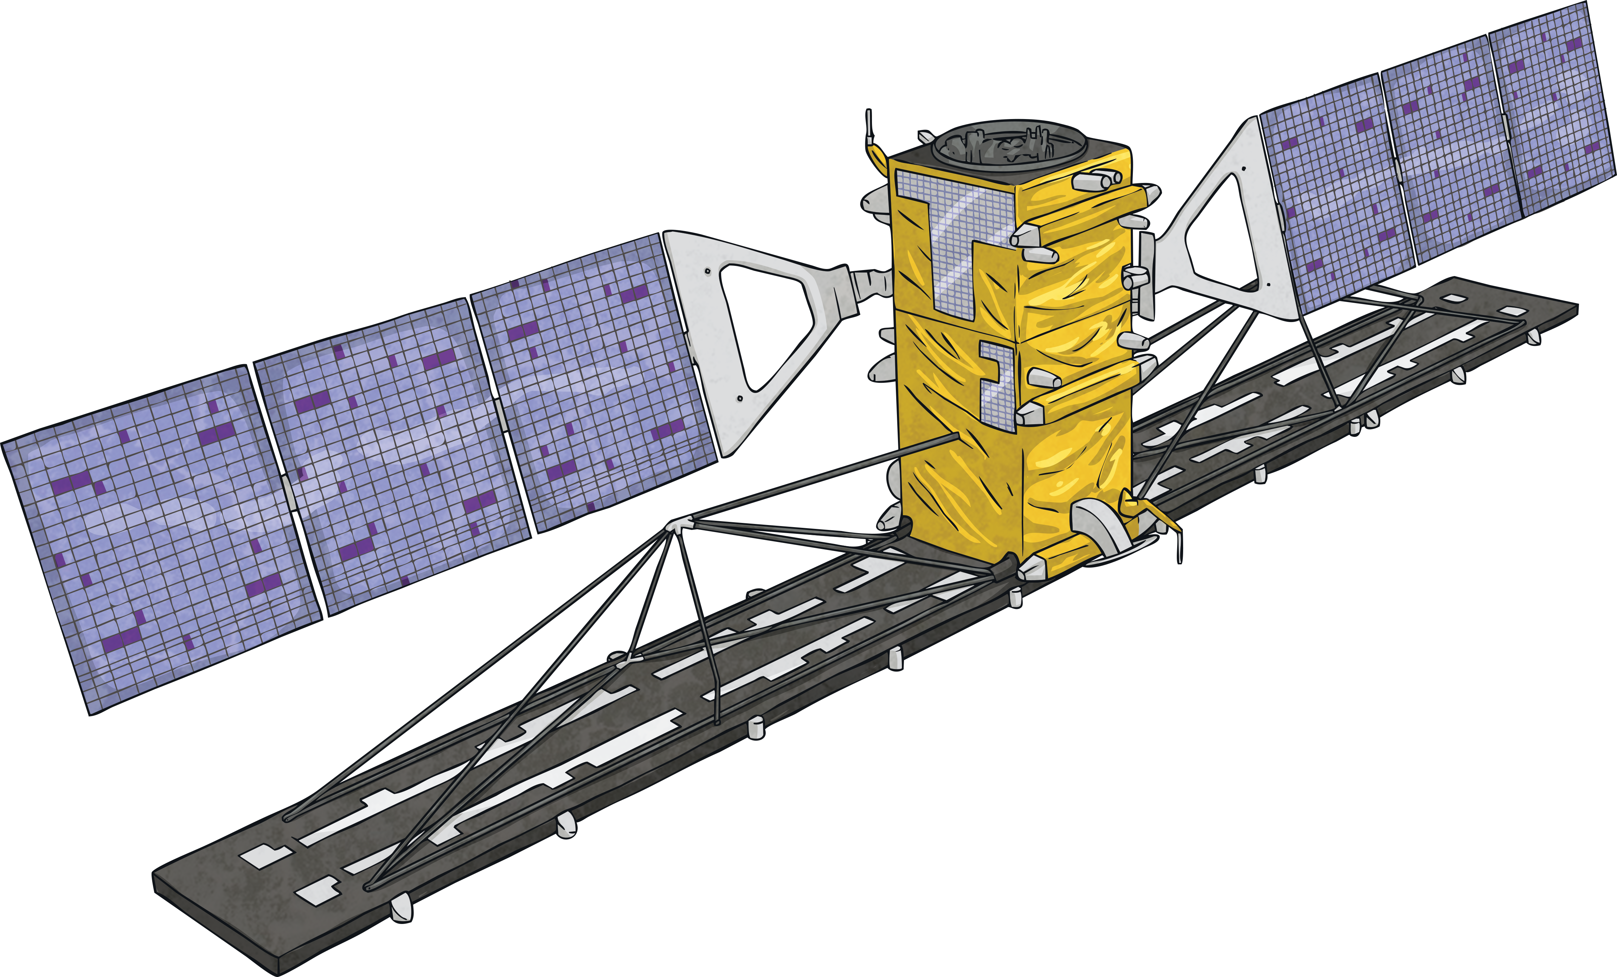
Sentinel Facts
Sentinel satellites monitor the Earth’s land, oceans and atmosphere as well as provide information for emergency services.
They were launched by the European Space Agency (ESA)
Currently, there are 4 groups (or ‘constellations’) of Sentinel satellites in orbit, with a further 3 planned to be launched in the future.
The first Sentinel satellites were launched in 2014.

Slide 11

GOES Facts
GOES stands for Geostationary Operational Environmental Satellite.
It orbits Earth over 22 000 miles above the Earth’s equator.
It completes one full orbit every day.
This type of satellite monitors storms.
Imager
Solar
Array
Sounder
Antenna

Slide 12

GOES-16 and GOES-17 Facts
Launch date – 19th November 2016 (GOES-16) and 1st March 2018 (GOES-17)
High-resolution visible and infrared imaging
Maps lightning from around more than half of the Earth
Predicts weather more accurately
Space Weather Sensor
Antenna
Advanced
Imager
Solar Imager
Solar Array
Lightning Mapper
Solar Sensors

Slide 13
Future Launches
Two further weather satellites are planned to launch in the next few years:
GOES-T (December 2021)
GOES-U (2024)
Both of these satellites have more up-to-date technology for observing weather patterns and give real-time updates. They also have improved cooling systems on board to prevent malfunctions in the instruments as has happened in previous models.
Alongside monitoring the weather on Earth, GOES-U will monitor solar winds in space.

Slide 14
Your task today
Create a fact sheet, presenting information about different satellites. You must include their name, when they were launched? What are their purpose? How they work? And any other relevant information. You may include some of the satellites that have been mentioned.
Famous satellites:
Sputnik Starlink
POES Explorer 1
Sentinel Echo 1
GOES Galileo
Useful links:
https://www.esa.int/kids/en/learn/Technology/Useful_space/Galileo_satellites_launched_into_orbit
https://www.funkidslive.com/learn/deep-space-high/marvellous-missions/satellites/
https://www.businessinsider.com/size-of-most-famous-satellites-2017-2?r=US&IR=T

