Slide 1

The Space Race

Slide 2



COLD WAR = Never broke into a full war involving weapons. A war of beliefs and pride.
vs
USA
USSR

Slide 3
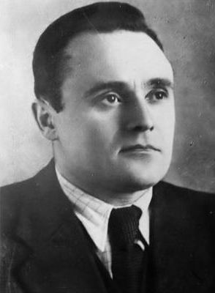
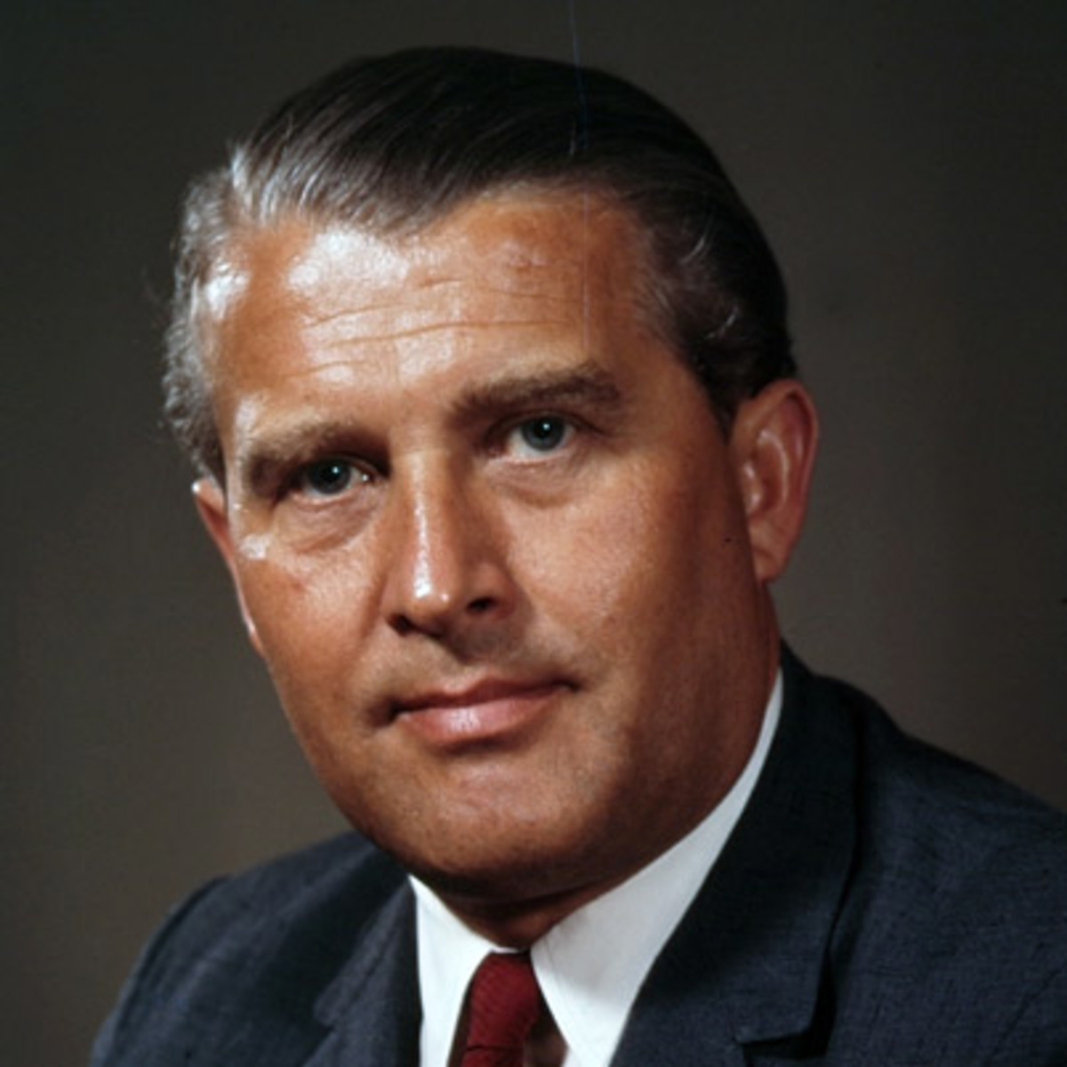
Sergei Korolev
Wernher Von Braun

Slide 4
1955
Both sides announce they will launch an artificial satellite
We will be first!
No! We will!

Slide 5
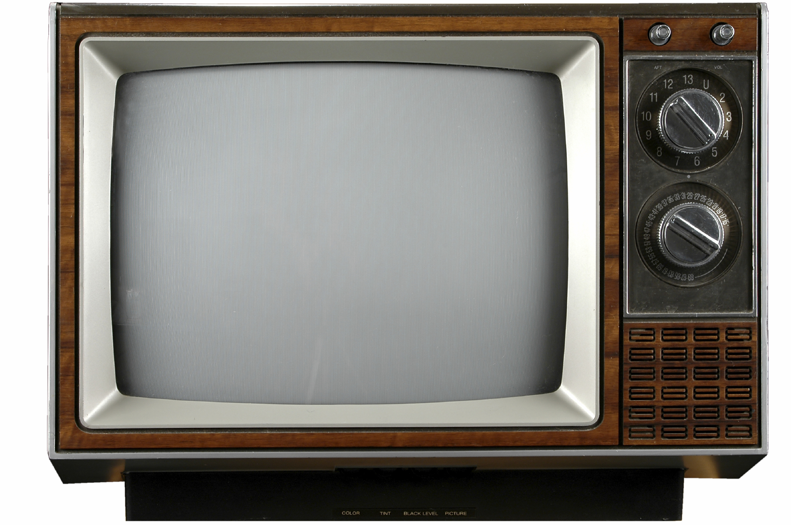

4th October 1957
USSR launch Sputnik 1 into orbit
+1
https://www.youtube.com/watch?v=oWR70ngPYbc

Slide 6
4th November 1957
USSR get the first living creature into orbit – Laika the dog
+1
+1
https://www.youtube.com/watch?time_continue=27&v=Pz63twfoW3c

Slide 7
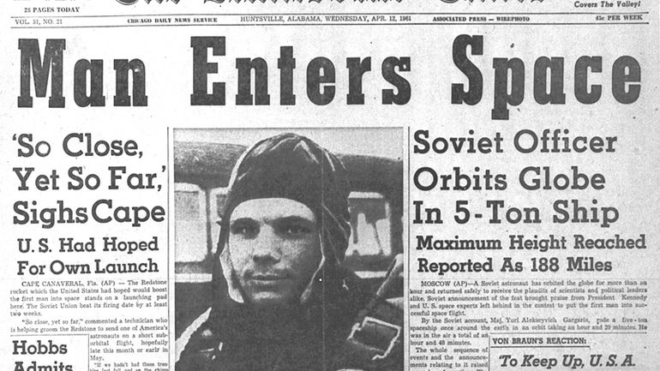
12th April 1961
USSR launch the first human into Space
+1
+1
+1

Slide 8
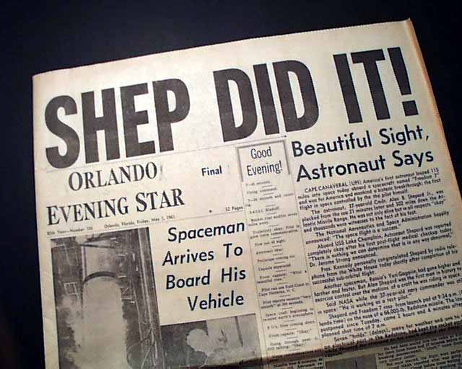
5th May 1961
Less than a month later, USA launch Alan Shepard into space
+1
+1
+1
+1

Slide 9
20th February 1962
USA Astronaut John Glenn orbits the Earth 3 times
+1
+1
+1
+1
+1
https://www.youtube.com/watch?time_continue=17&v=vcGizTdsXIM

Slide 10
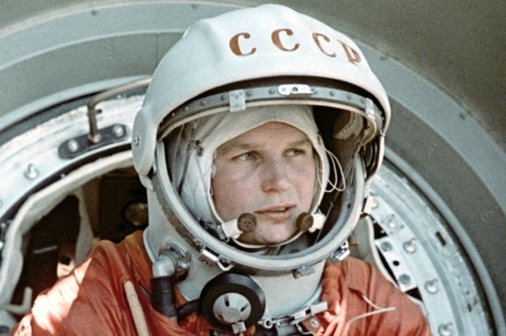
16th June 1963
USSR launches the first woman, Valentina Tereshkova, into space
+1
+1
+1
+1
+1
+1

Slide 11
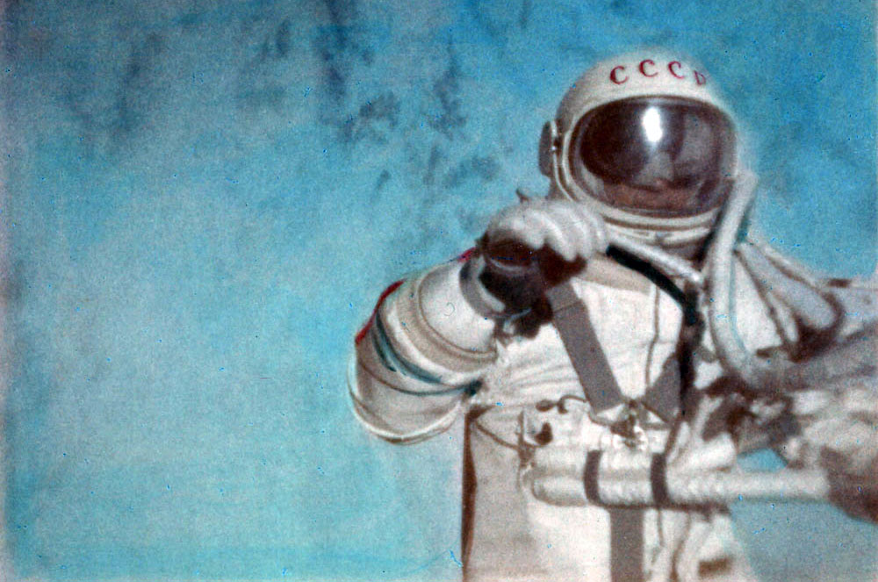
18th March 1965
USSR Cosmonaut Alexei Leonov performs the first space walk
+1
+1
+1
+1
+1
+1
+1

Slide 12
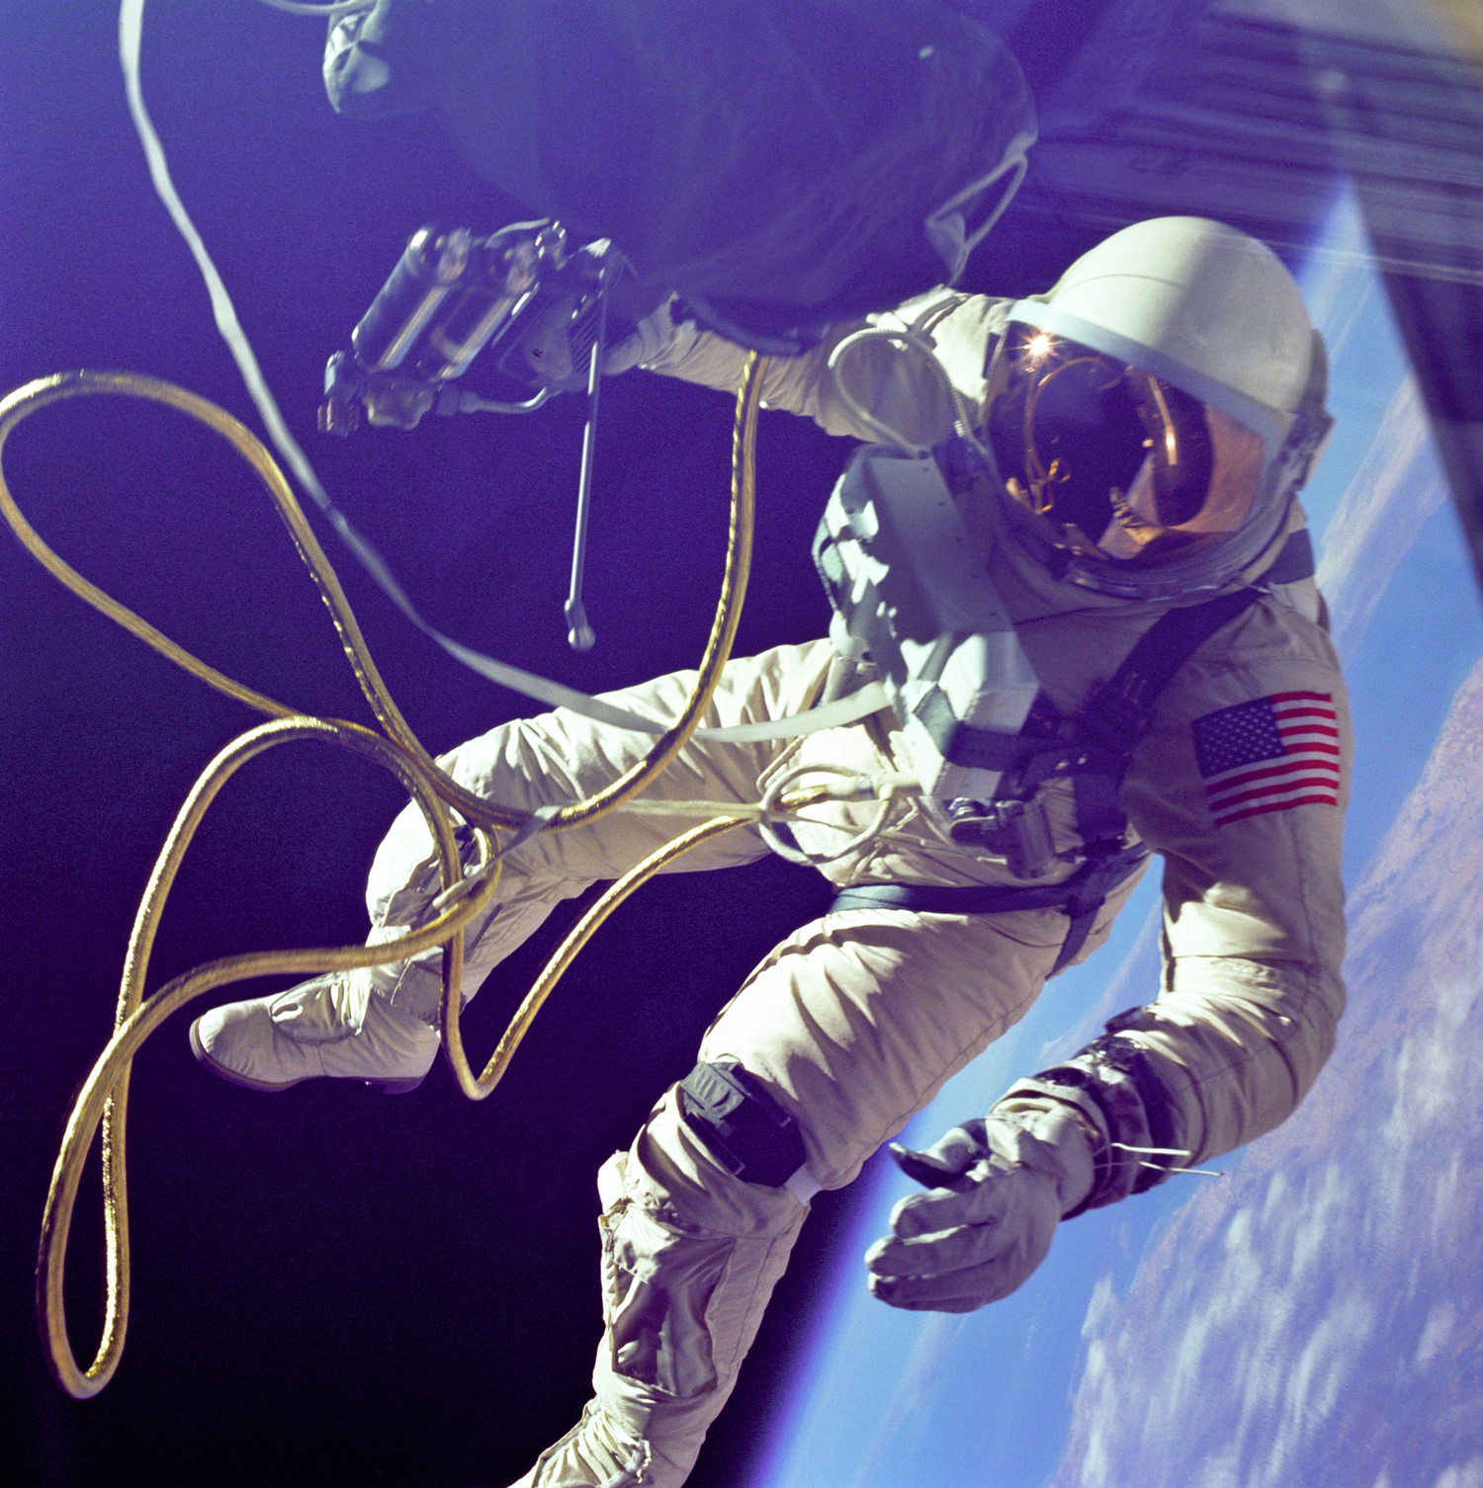
3rd June 1965
Ed white performs the USA’s first space walk
+1
+1
+1
+1
+1
+1
+1
+1

Slide 13
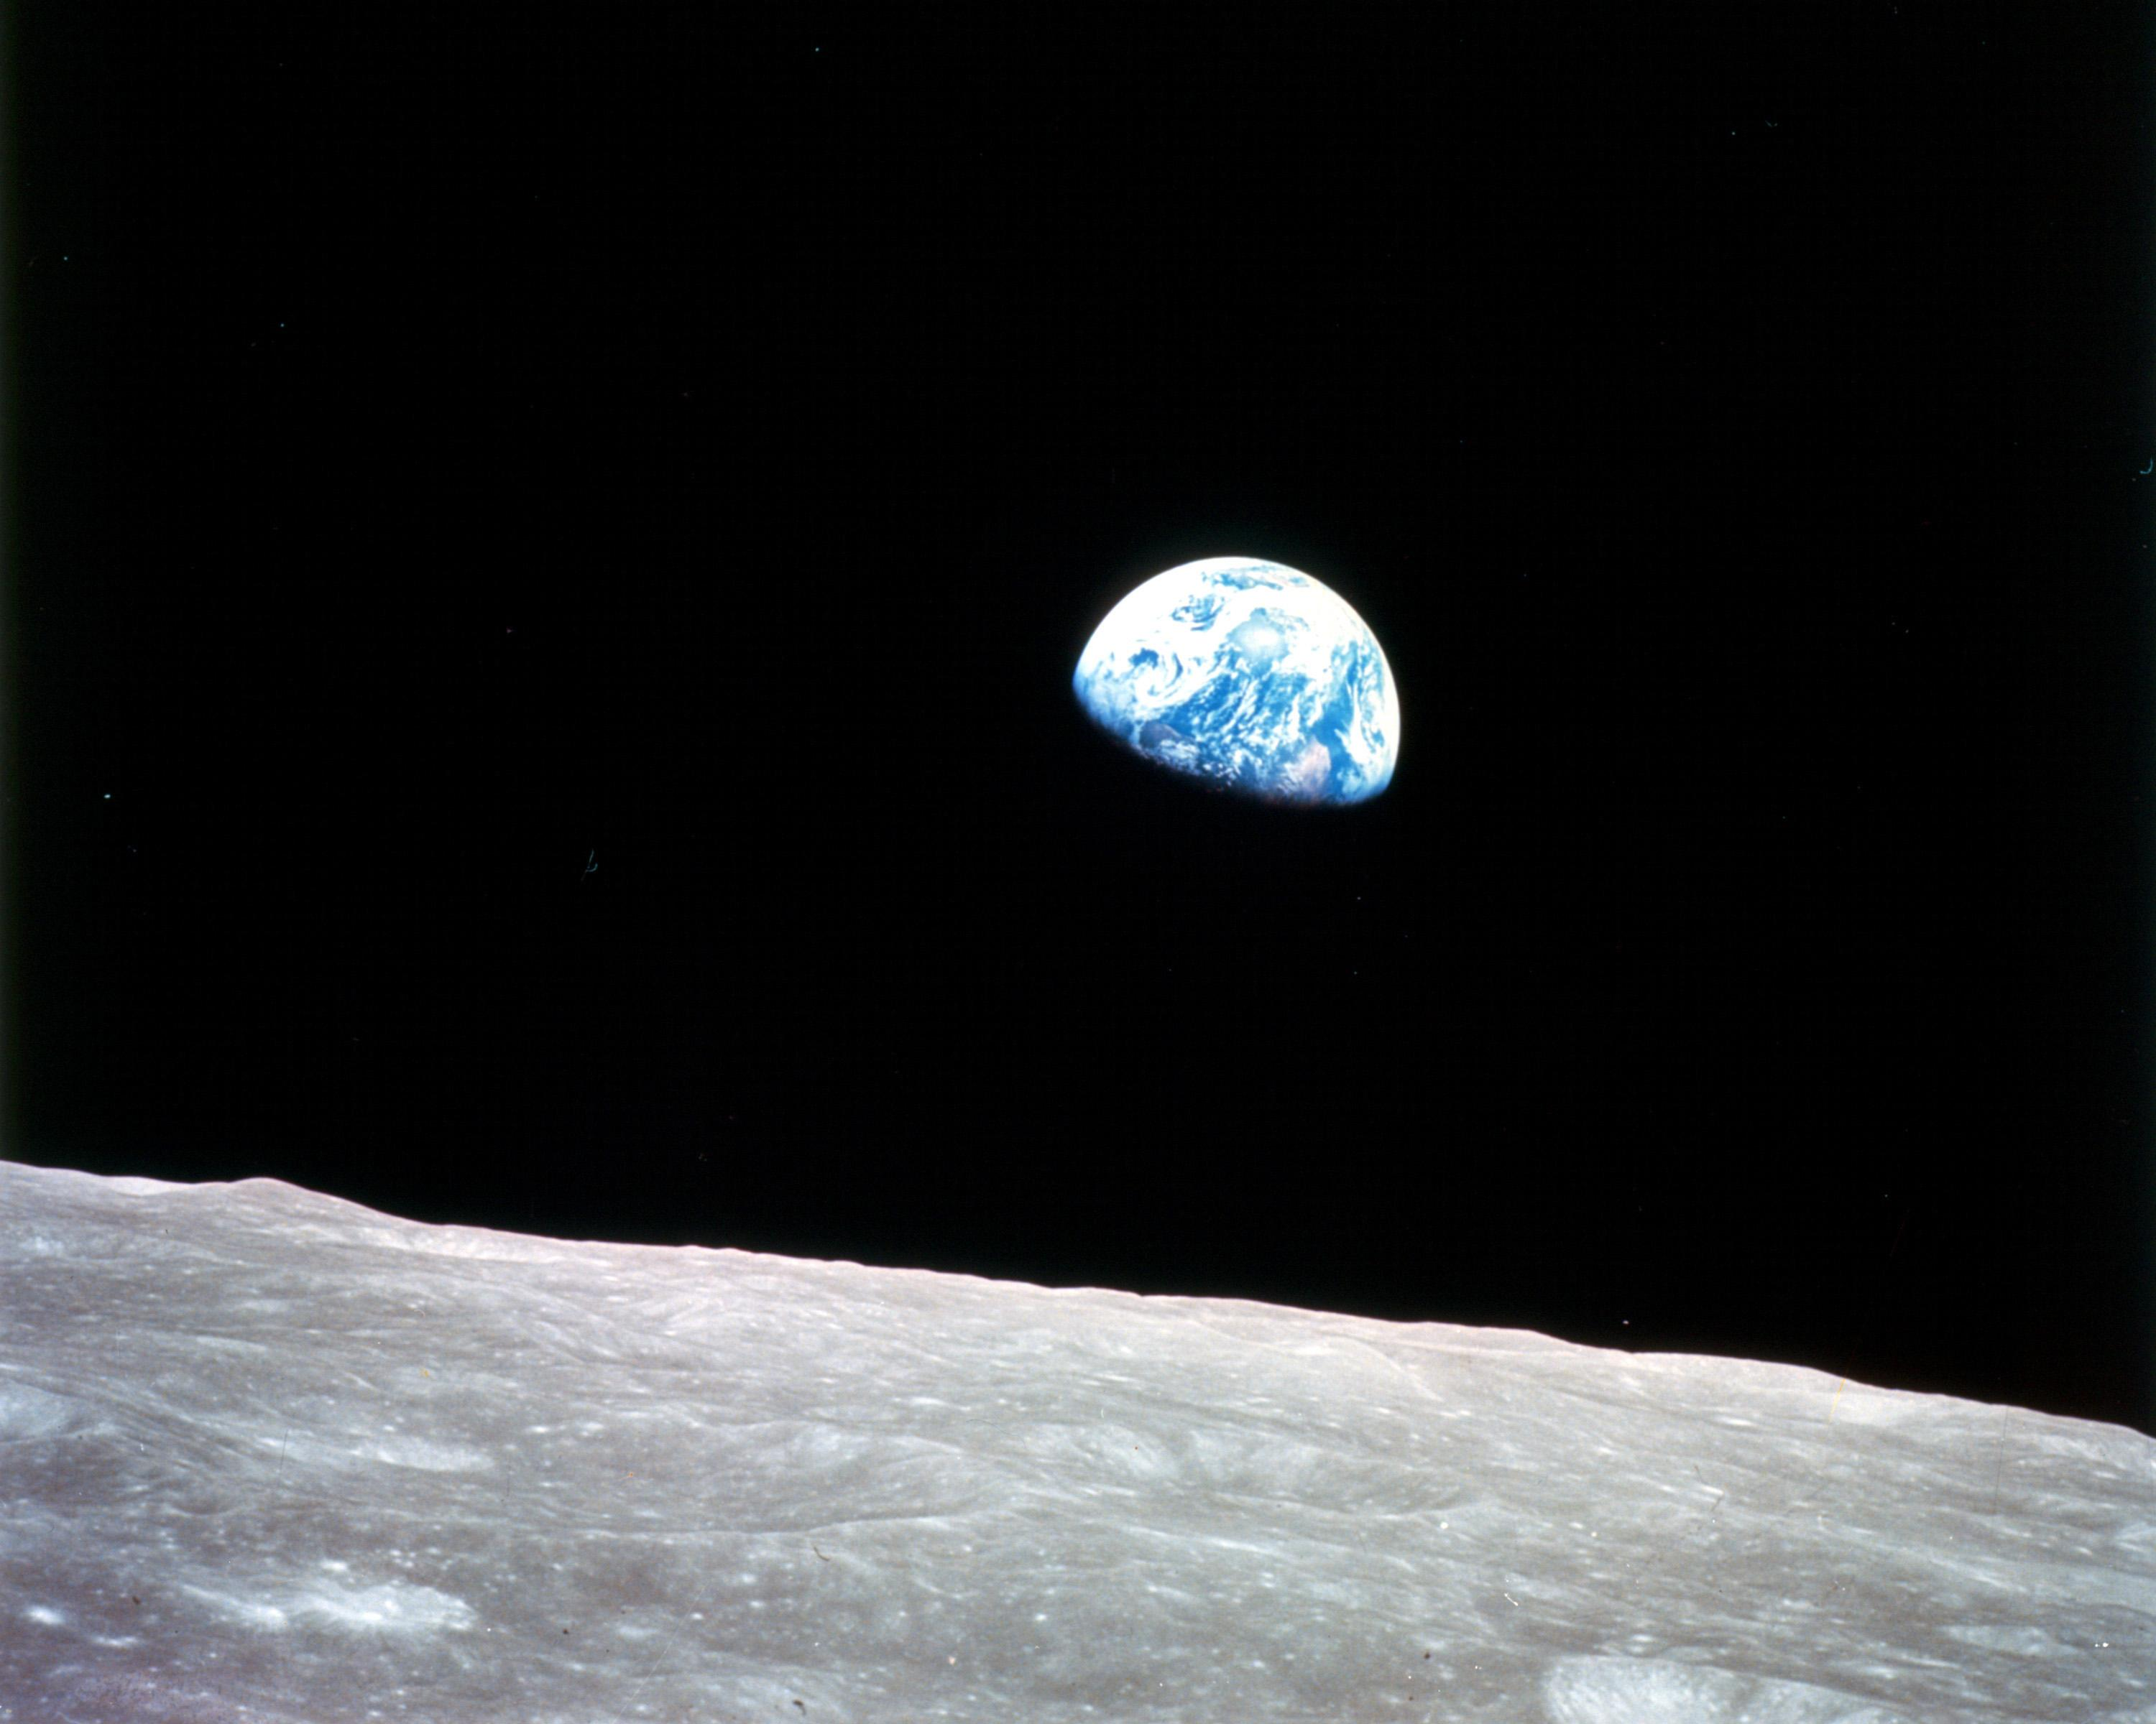
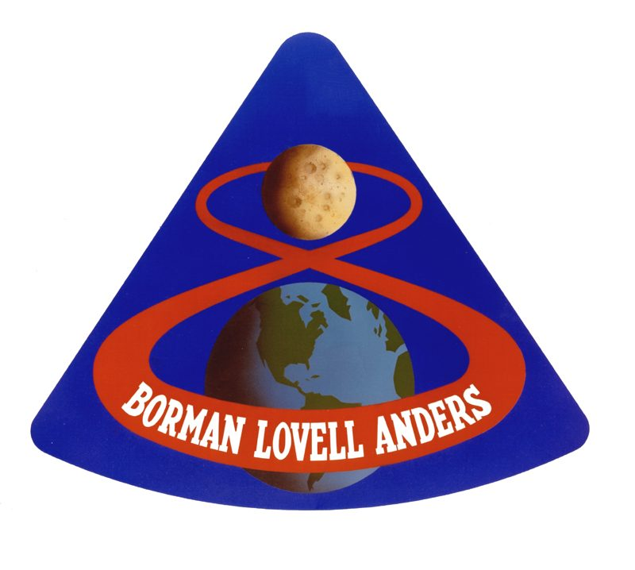
24th December 1968
USA’s Apollo 8 becomes the first manned craft to orbit the Moon, taking this picture of the Earth
+1
+1
+1
+1
+1
+1
+1
+1
+1

Slide 14
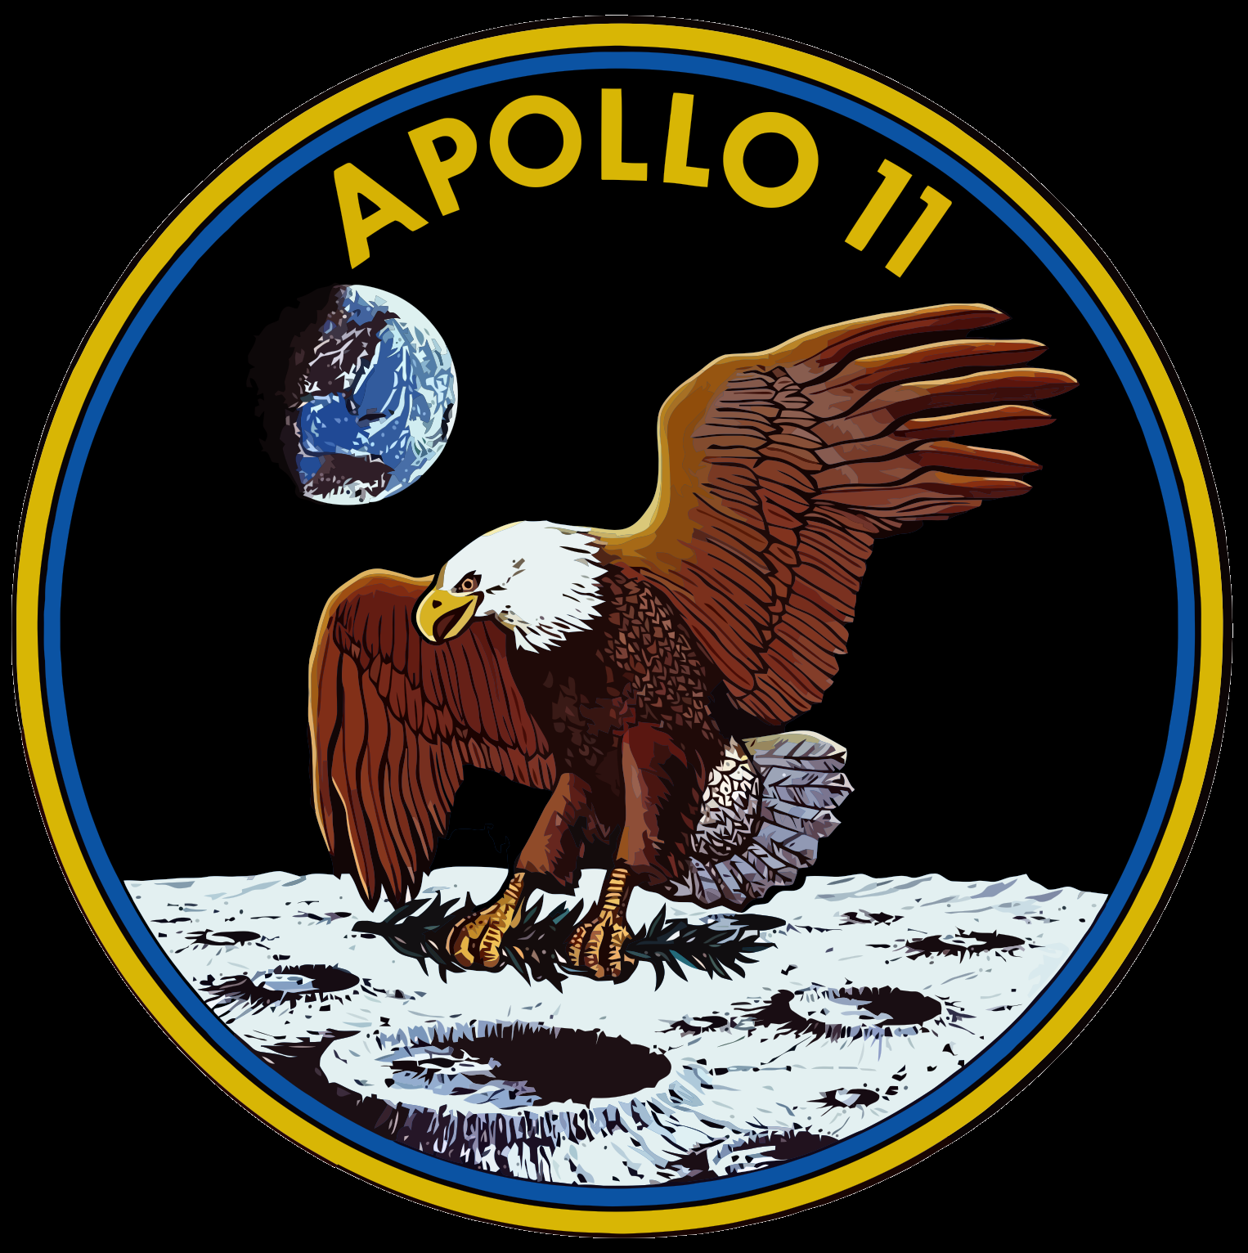
20th July 1969
USA’s Neil Armstrong and Buzz Aldrin become the first people to walk on the Moon
+1
+1
+1
+1
+1
+1
+1
+1
+1
+1
https://www.youtube.com/watch?time_continue=17&v=cwZb2mqId0A

Slide 15
So who do you think won the Space Race?

Slide 16

Today’s task
Today, you will need to show the timeline of the Space Race between the USA and the Soviet Union. You will need to organize the events chronologically.

