Slide 1
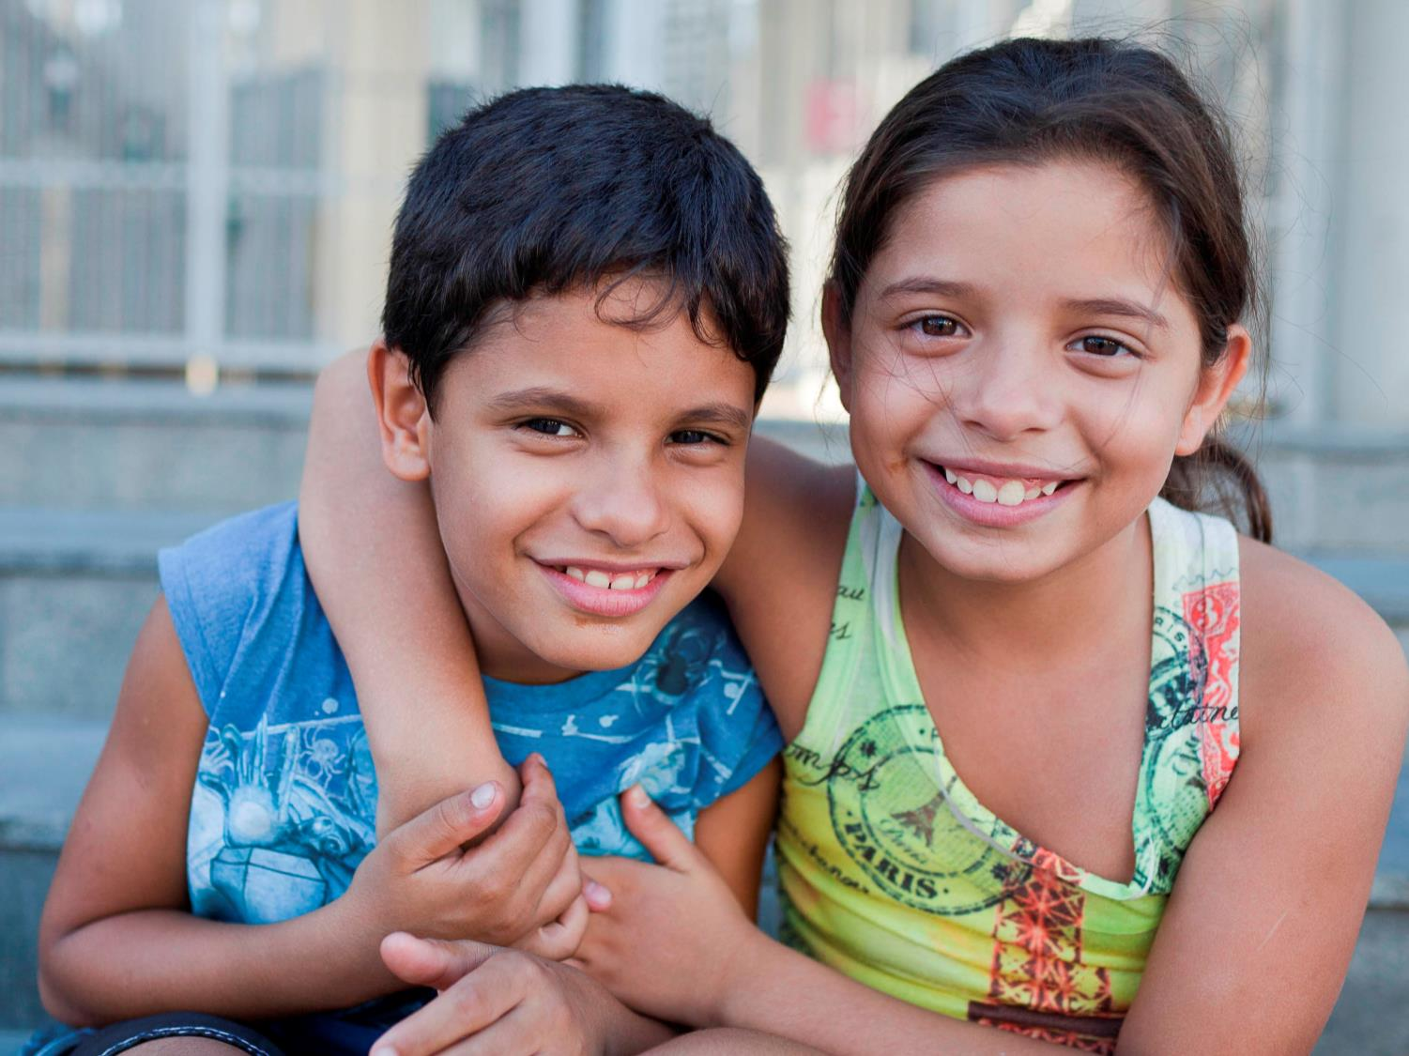

Life in Rio de Janeiro: Samir and Samira
www.actionaid.org.uk/schools - May 2016
Notes:
Meet Samir and Samira:
Samir and Samira are eight-year-old twins from Maré. Their names both mean “cool gentle breeze” or “entertaining friend” and originate from ancient mythology.
Samira: “My name is Samira and I am eight-years-old. I live in Maré favela in Rio de Janeiro. My twin brother and I live with our mum, older sister, step-brother and step-dad. I like my brother, but he doesn’t like cuddles or kisses or anything like that!”
Photo Credit: Lianne Milton/Panos/ActionAid

Slide 2
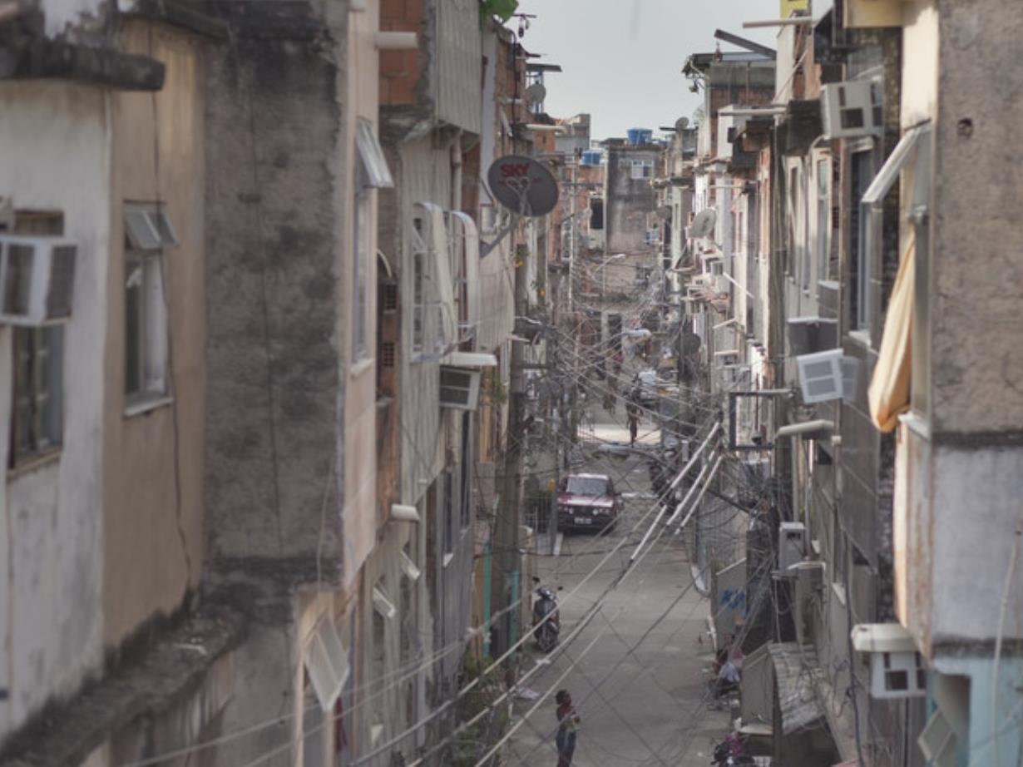
Notes:
Maré Favela
Samir and Samira live in an area of Rio de Janeiro called Maré which means ‘tide’. Maré is a favela which is also known as a ‘shanty town’ or ‘slum’. There are lots of favelas in cities in Brazil. Maré favela is home to 132,000 people and is bigger than 74 football pitches.
Samira: “Our house is made from concrete, wood and metal. It’s tall and narrow, with 22 steps at the entrance that we have to climb up!”
Maré is one of the largest slums in Rio. Growing up here is tough and many young people are pulled into drug related crime. 12% of people living in Maré cannot read or write and 71% of students aged 10-18 are behind in school. Residents live under constant threat of violence caused by drug trafficking, police raids and gang fights, making going outside to play impossible for children whose parents want to keep them safe and out of trouble.
Photo Credit: Lianne Milton/Panos/ActionAid

Slide 3
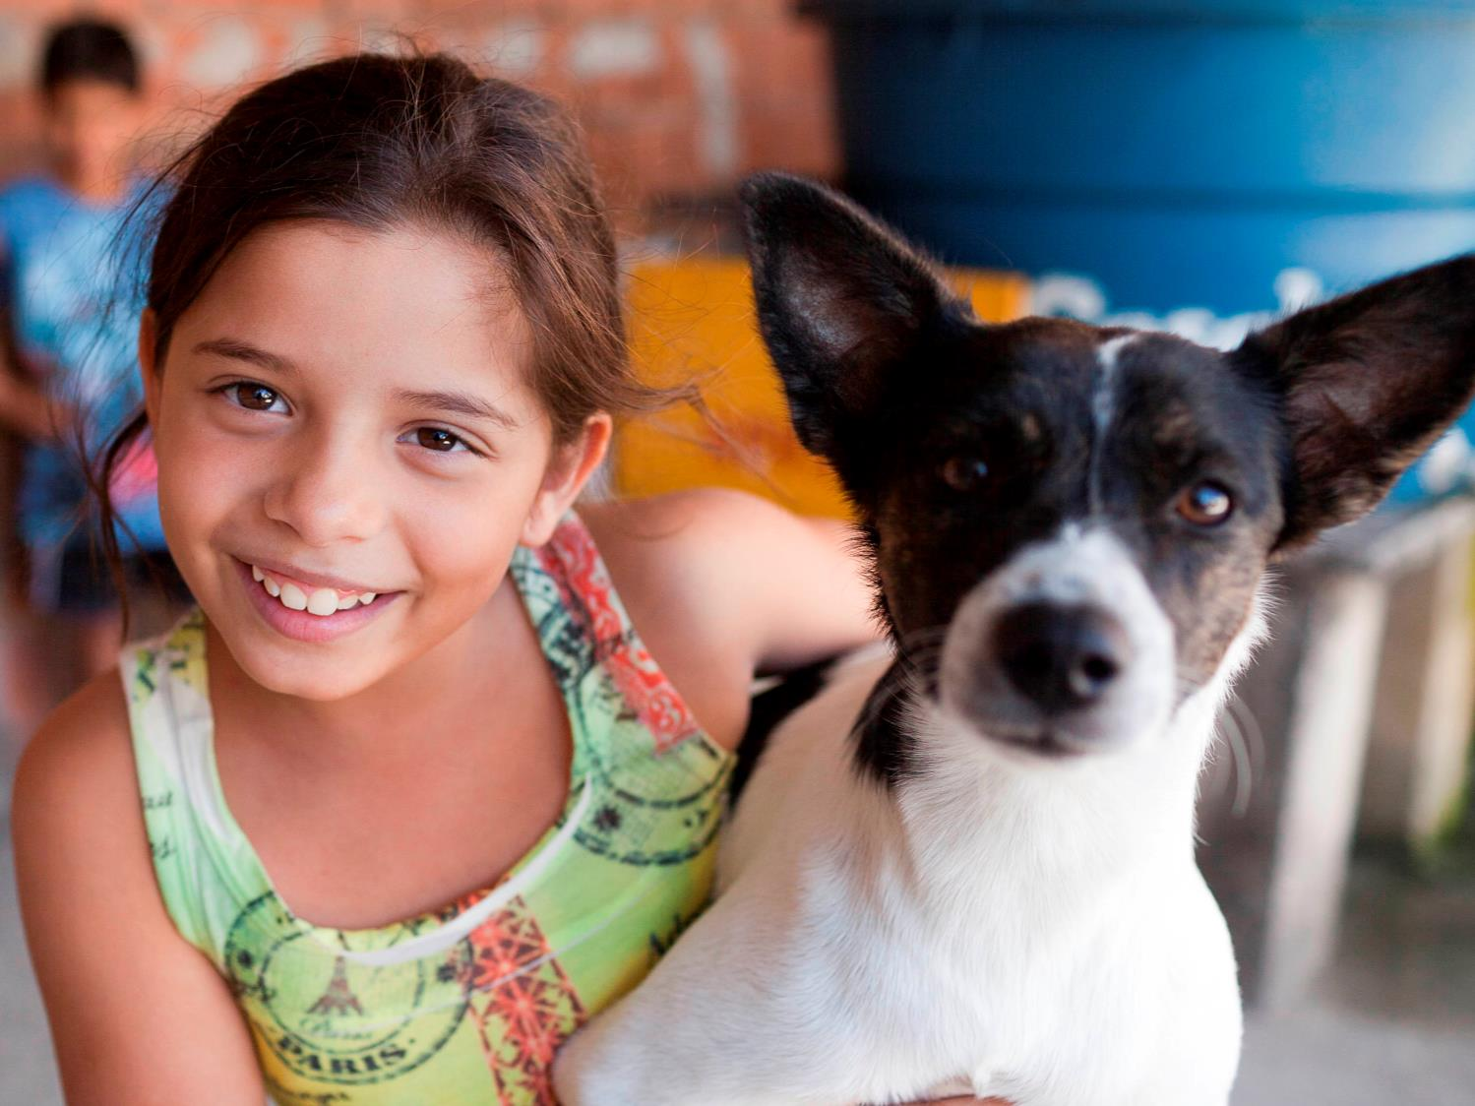
Notes:
Feeding Princess
This is Samira and her dog Princess.
Samira: “Our dog Princess lives on the roof. She has her kennel up there. I feed her every morning with my brother Samir before we go to school.”
Samir: “Princess is usually kept on the roof upstairs but sometimes she escapes! She catches mice and plays with me and my sister.”
Photo Credit: Lianne Milton/Panos/ActionAid

Slide 4
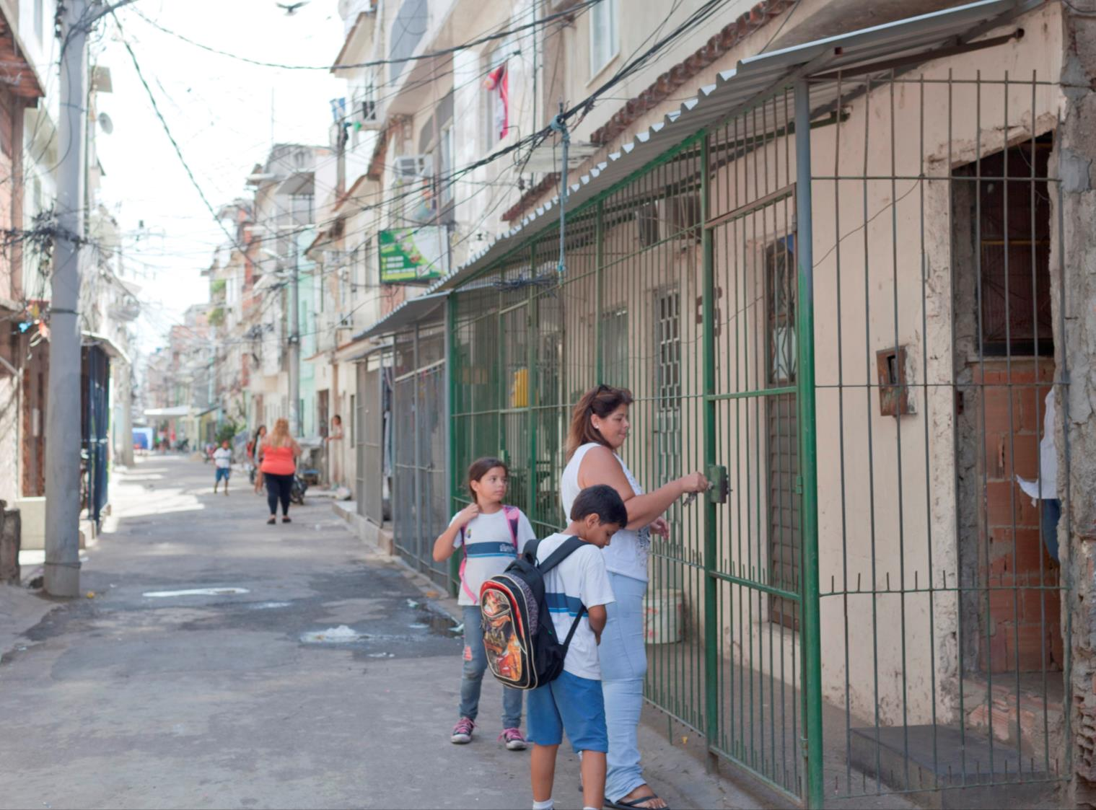
Notes:
Walking to School
Samir and Samira are setting off for school with their mum. She is locking the iron gates that protect their home as Maré can be a dangerous place. All the houses on their street have similar locked iron gates.
Photo Credit: Lianne Milton/Panos/ActionAid

Slide 5
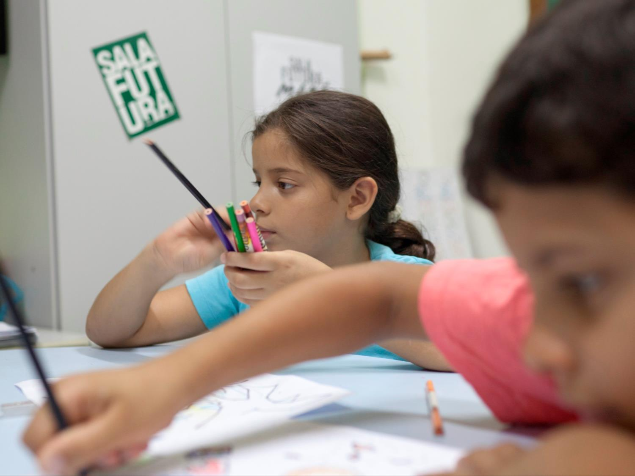
Notes:
Lesson time
Samir and Samira go to school inside the favela.
Samira: “There are about 31 students in my class. I have a lot of friends at school but my best friend is called Rafaela. She plays a lot of games with me. We play tag, hide and seek, skipping and Cinco Marias.” (Cinco Marias is a game with five flat stones, similar to tiddlywinks.)
Samir: “My favourite subjects at school are maths and English. I don’t really like any other subjects.”
Photo Credit: Lianne Milton/Panos/ActionAid

Slide 6
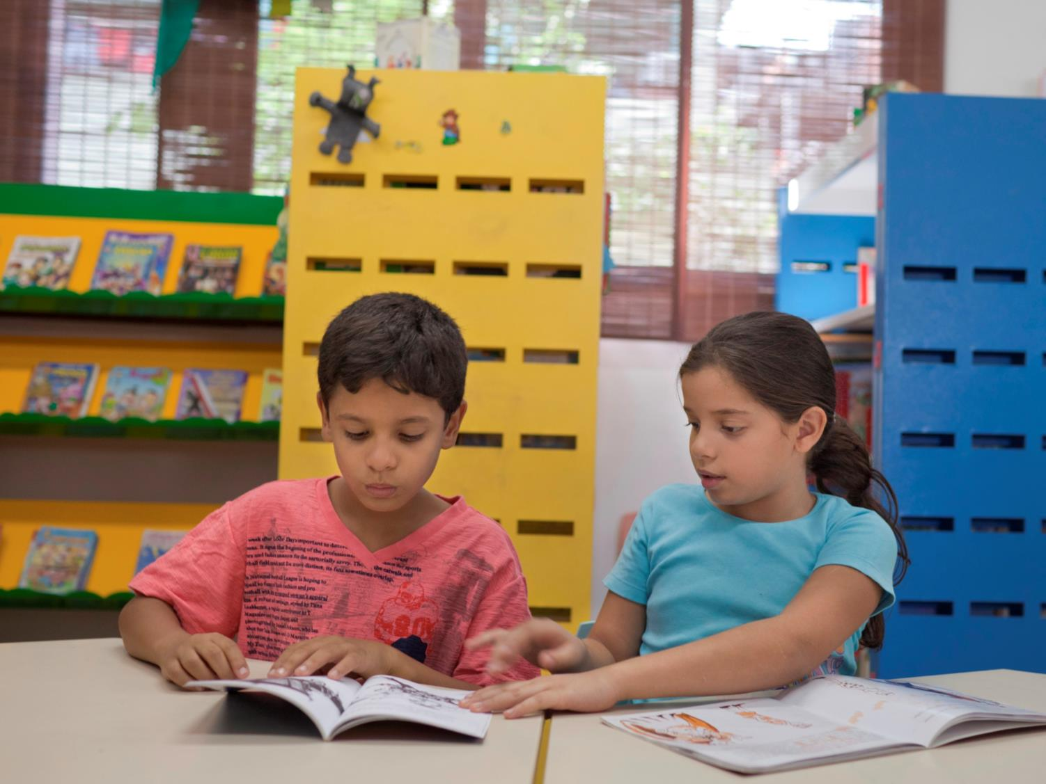
Notes:
Reading in the library
Samir and Samira also go to the library. More than 1,000 children from the slum use this library. The library is run by a local organisation to provide safe places for children in the favela.
Samira: “We go to the library when Mum goes to the shops. She leaves us there while she’s shopping because she knows it’s safe.”
12% of the residents in the favela cannot read or write and the library runs classes to help them.
Photo Credit: Lianne Milton/Panos/ActionAid

Slide 7
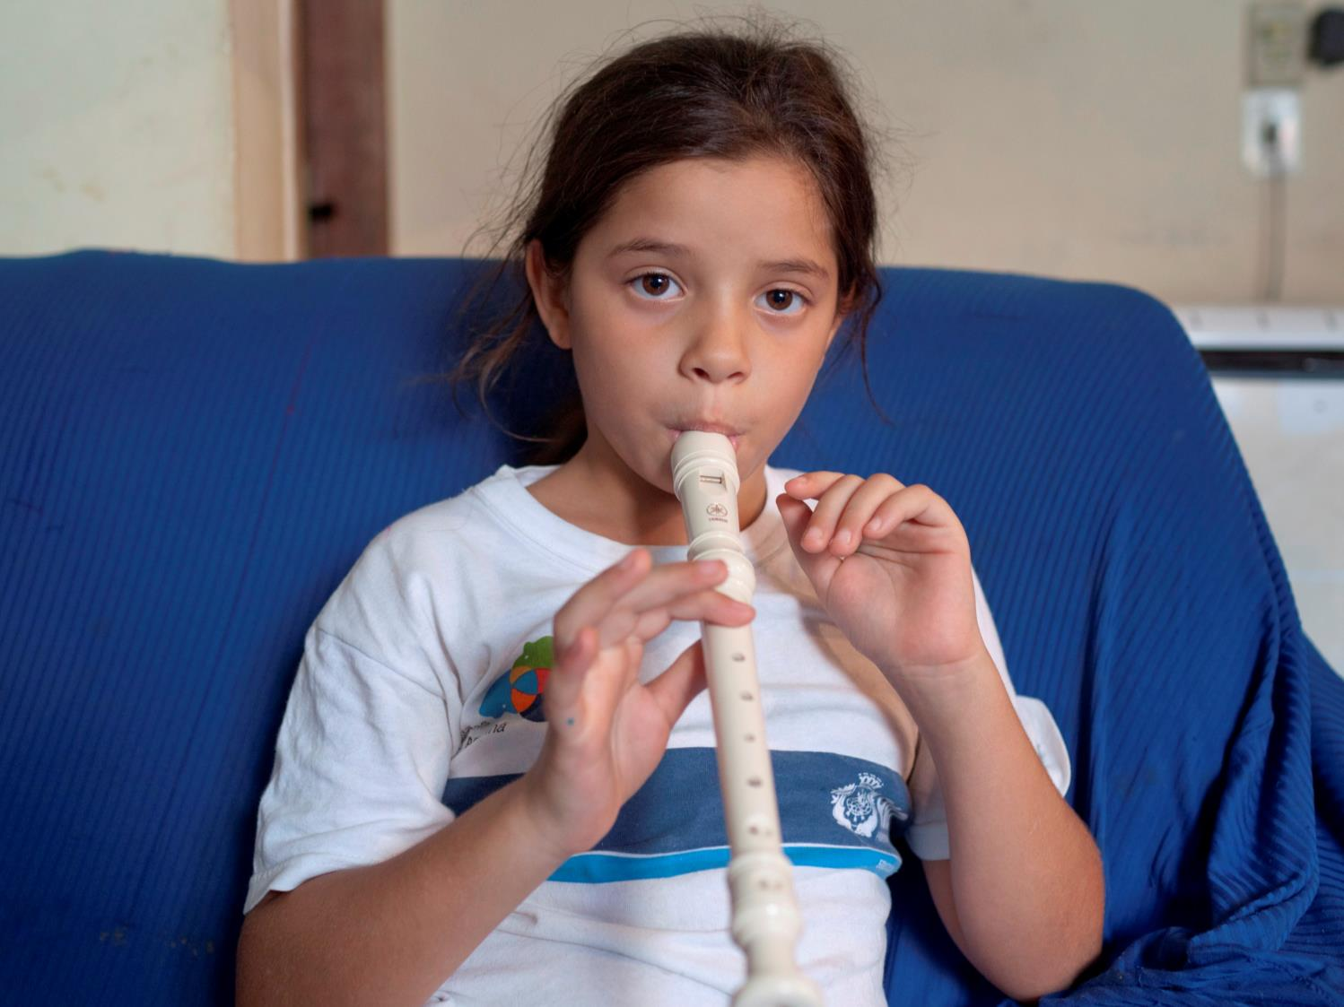
Notes:
Playing the recorder
Samira: “Sometimes after school my brother Samir and I go to the Redes project. We are learning to play the recorder there. We’re both trying to teach our big sister Sara too.”
Samir: “I’m learning to play the recorder too, but Samira is the best player out of the both of us.”
Redes is a local project funded by ActionAid that provides safe spaces for children to enjoy their childhood inside the favela.
Photo Credit: Lianne Milton/Panos/ActionAid

Slide 8
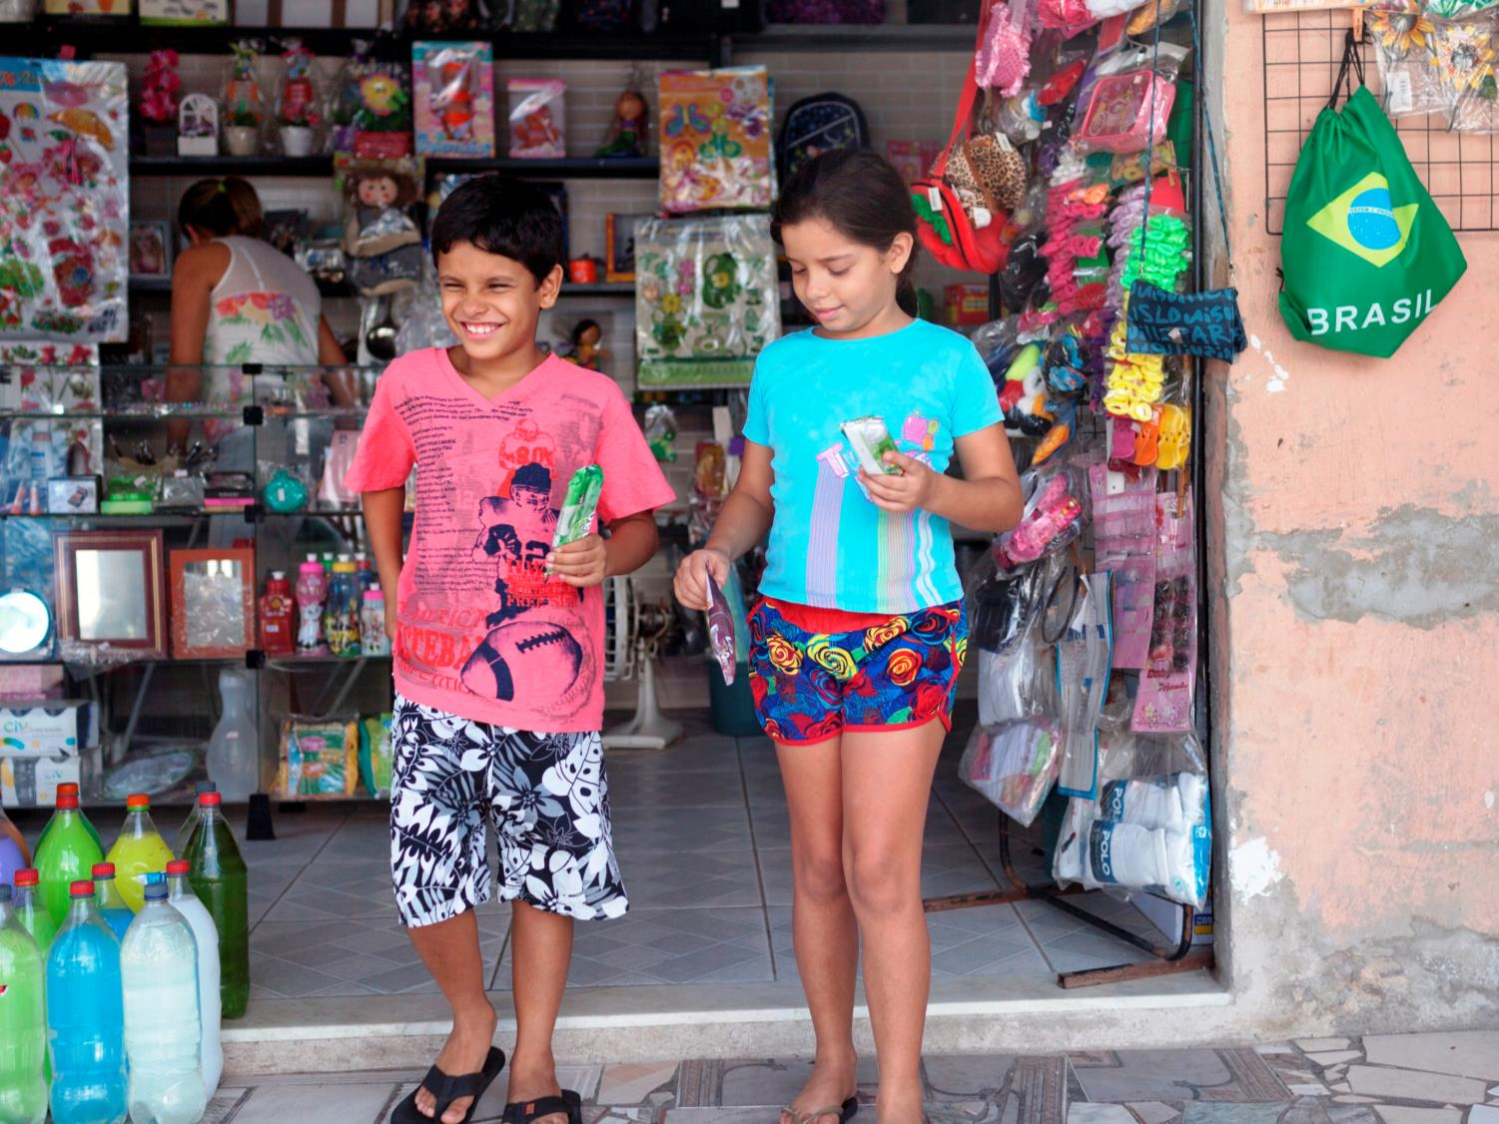
Notes:
Buying an ice-cream
Samir and Samira buy an ice-cream from their local shop. Most people living in Maré favela buy their food daily at small stores within the favela.
Photo Credit: Lianne Milton/Panos/ActionAid

Slide 9
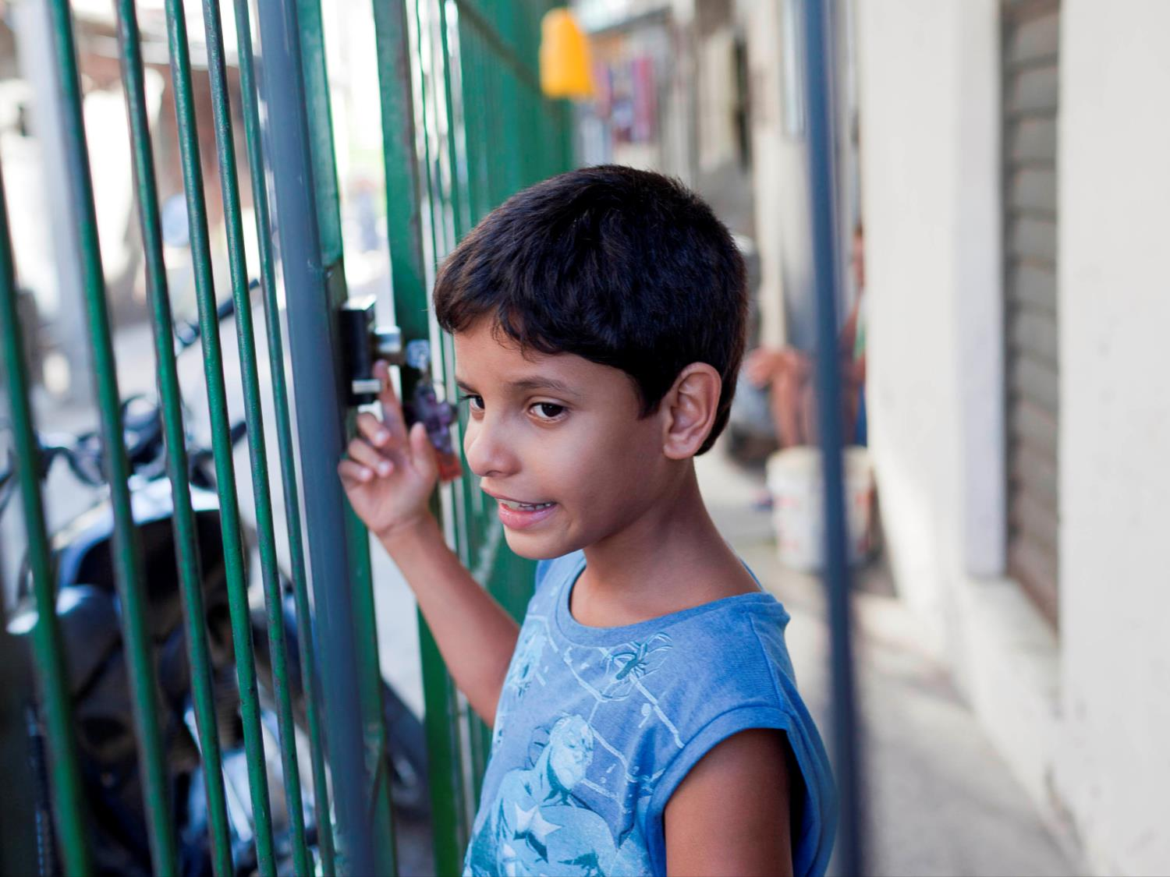
Notes:
Home from school
Samir closes the iron gate outside his house after returning home from his day at school. Every home on Samir’s street is locked behind iron gates.
Samira: “Mum is very strict about us going outside, but we understand why. It’s serious. a lot of men here carry weapons and drive really fast.”
Photo Credit: Lianne Milton/Panos/ActionAid

Slide 10
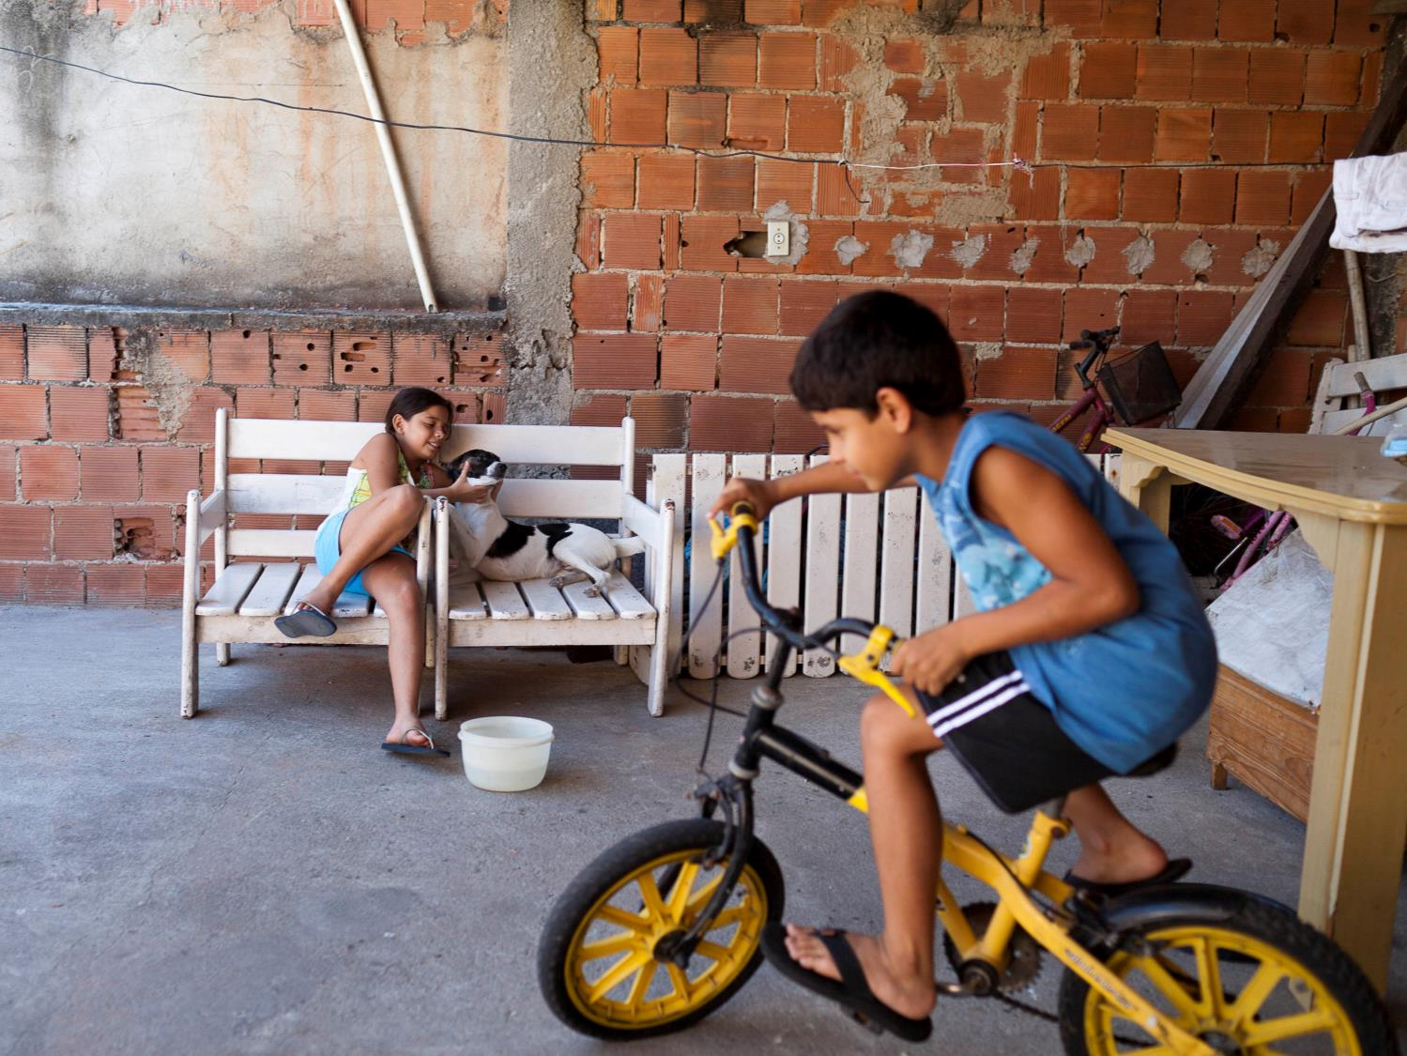
Notes:
Riding my bike
Samir rides his bike in circles on the roof of his house – his only playground in Maré favela. The roof is just 3.5 metres by 2.5 metres. This is where he keeps his dog, plays with his sisters and his mum hangs out their washing.
Samir: “I have to cycle my bike in circles on the roof. Mum won’t let us ride our bikes in the street because of the motorcycles the gangs drive around on. My sister Samira got hit by a motorbike once. It’s so dangerous outside.”
Photo Credit: Lianne Milton/Panos/ActionAid

Slide 11
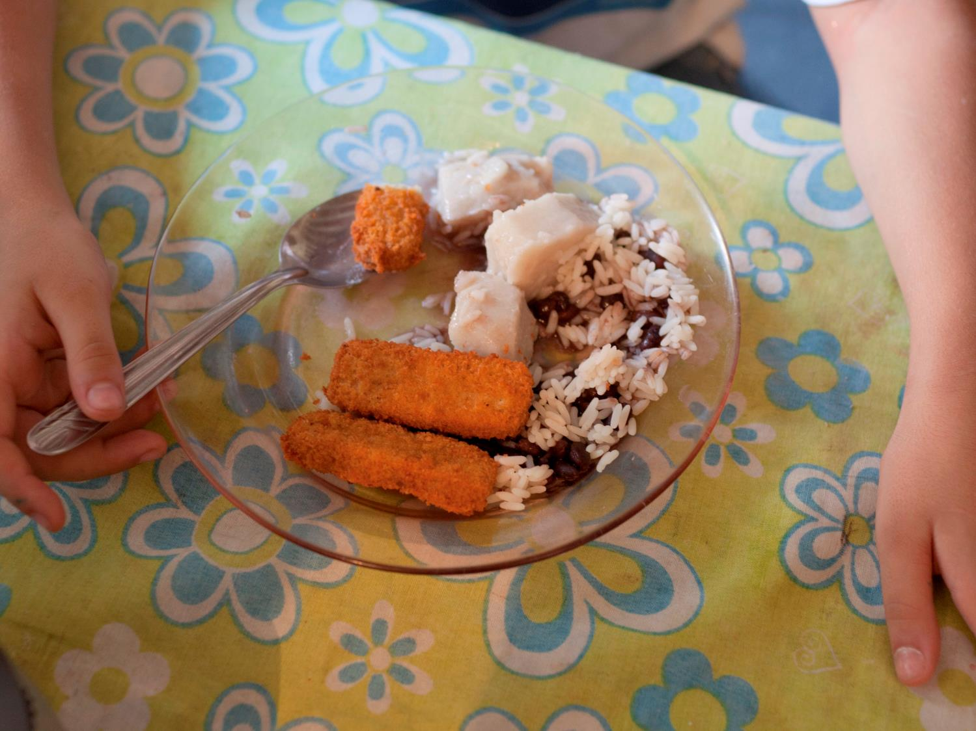
Notes:
Dinner
Samira is sitting at the table eating her dinner.
Samira: “Our kitchen is a small room off the front room, with a stove, microwave and fridge in it. My favourite dinner is stroganoff! We eat that a lot. I like chicken and fish, but not red meat. I hate boiled meat.”
Samir: “We have dinner at home around five to six o’clock. Usually we’ll have vegetables and salad and beans, with some kind of meat like chicken or sausage or fish. My favourite food is sausage, or mashed potatoes, beef, rice and beans. I don’t like carrot. We normally eat at home and at school. But I don’t like school food. My mum’s cooking is much better.”
Photo Credit: Lianne Milton/Panos/ActionAid

Slide 12
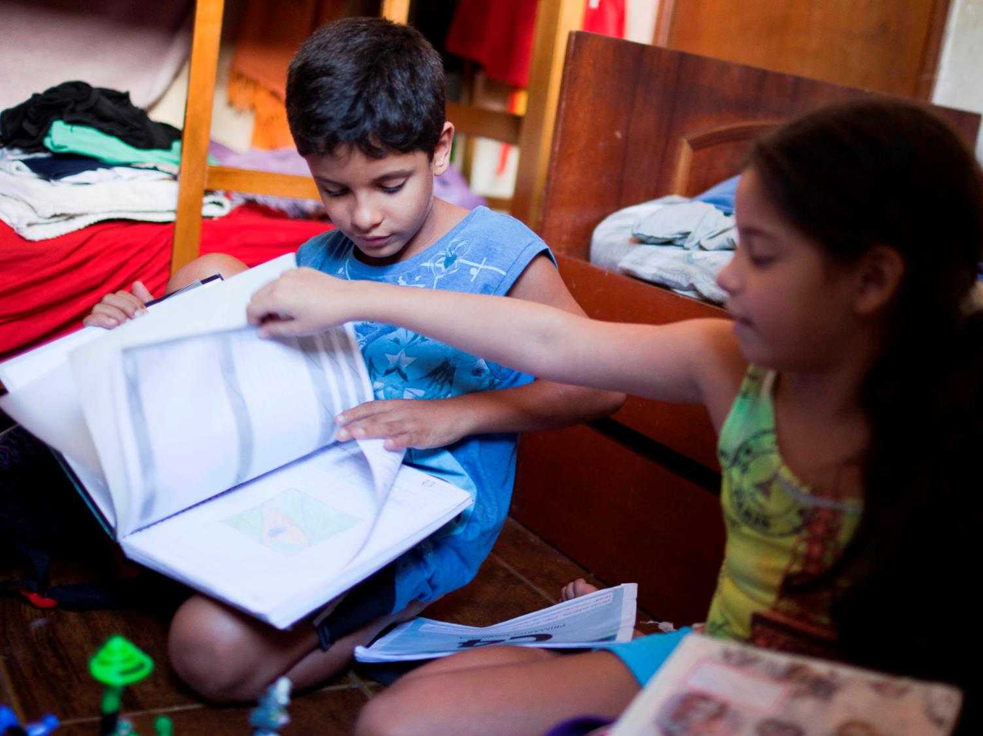
Notes:
Homework
Samir and Samira are doing their homework.
Samira: “I have to do at least two pieces of homework when I get home from school. And I have to do chores. I have to help my mum clean the house, clean the furniture, that kind of thing.”
Photo Credit: Lianne Milton/Panos/ActionAid

Slide 13
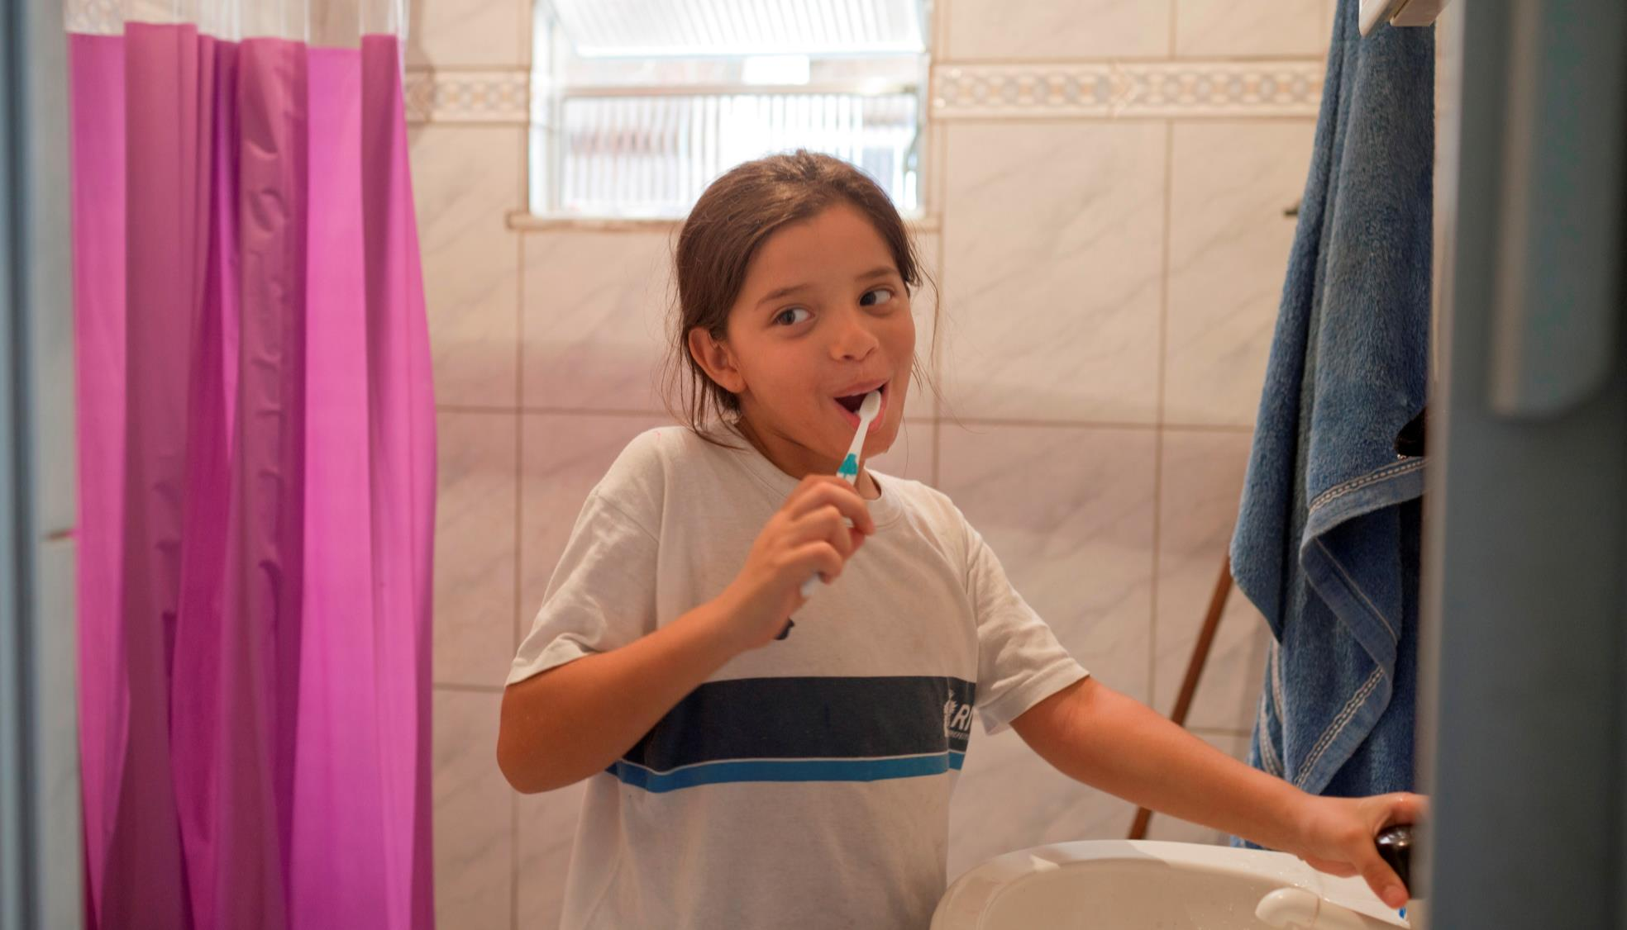
Notes:
Brushing teeth
Samira brushes her teeth before bedtime.
Samira: “In the evenings, after dinner, I brush my teeth and then go to sleep. Our bathroom is quite small. We have a shower, a sink and a toilet. To flush the toilet, we have to use a hose and we can’t put any toilet paper down it because it blocks the pipes.”
Photo Credit: Lianne Milton/Panos/ActionAid

Slide 14
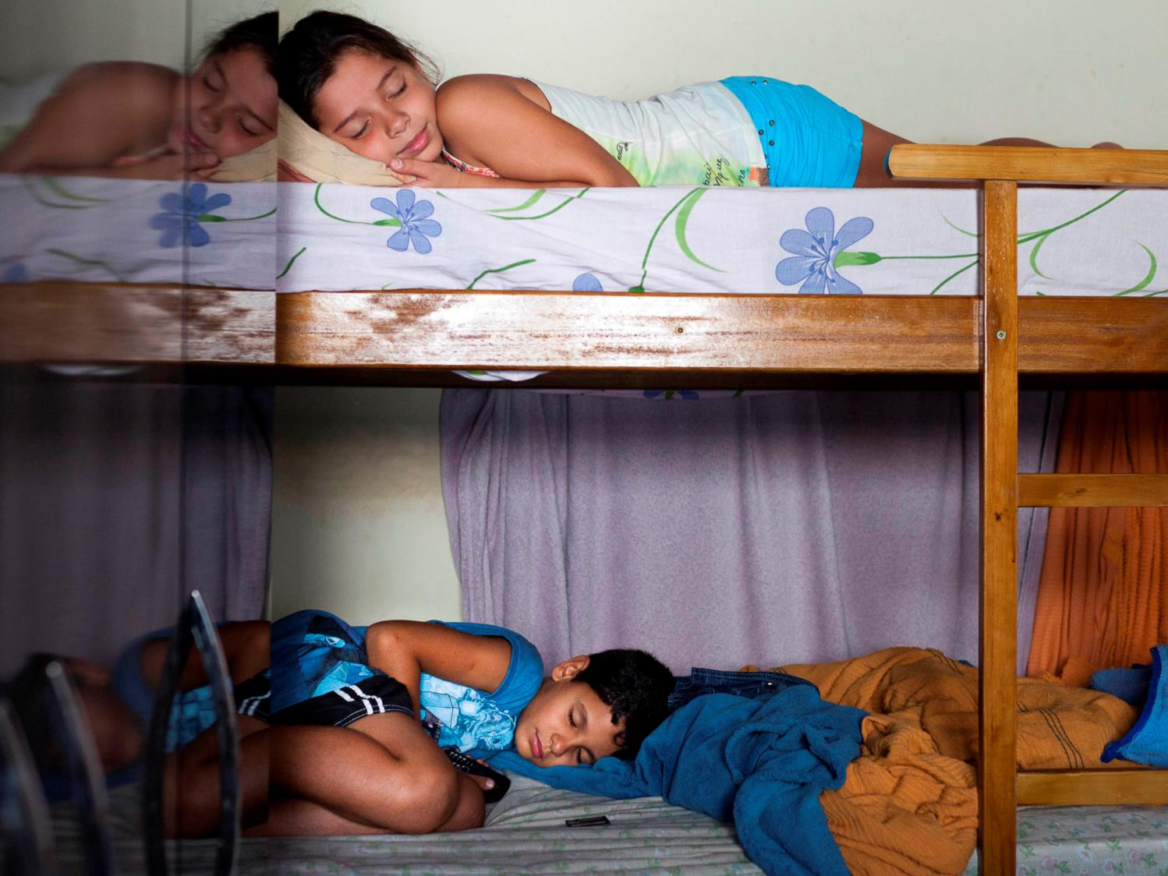
Notes:
Bedtime
Samir and Samira are asleep in their bunk-beds. They share their bedroom with their older sister and step-brother.
Photo Credit: Lianne Milton/Panos/ActionAid

