Slide 1

Noson rhieni Hydref 2021 Parents evening 2021

Slide 2

Staff yr adran
Dosbarth /Class 3/4S – Mrs S Stephens
Dosbarth /Class 3/4T– Miss Thomas
Dosbarth / Class 3/4E- Miss Elliott
Cynorthwywyr/Teaching assistants-Mrs H Payne, Mr T Rees and Mrs D Lewis.

Slide 3
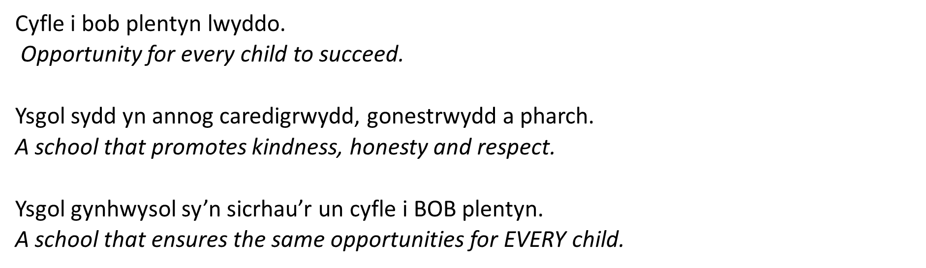
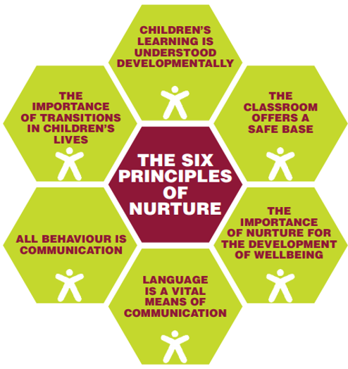

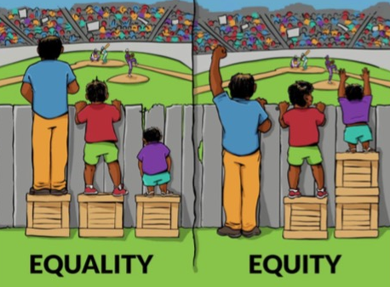
Ethos a Gweledigaeth

Slide 4
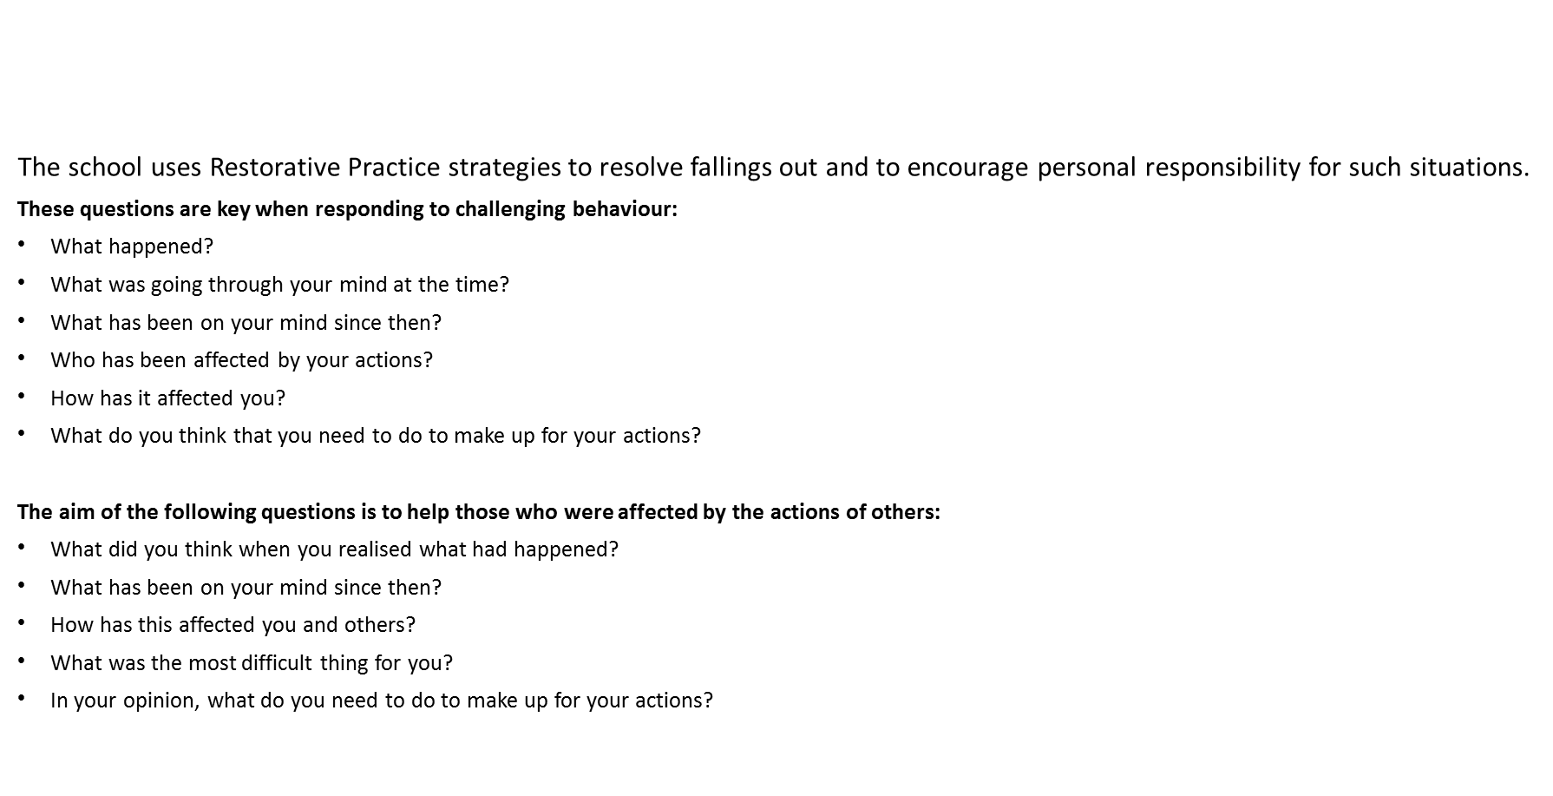
Behaviour and Anti-bullying Policies

Slide 5

Disgyblaeth a Gwrth fwlio
Mae’r ysgol yn defnyddio strategaethau Arfer Adferol er mwyn ceisio datrys sefyllfa o gwmpo mas ac yn annog cyfrifoldeb personol am sefyllfaoedd o’r fath.
Mae’r cwestiynau canlynol yn ddibynadwy wrth ymateb i ymddygiad heriol:
Beth ddigwyddodd?
Beth oedd ar dy feddwl ar y pryd?
Beth sydd wedi bod ar dy feddwl ers hynny?
Pwy sydd wedi cael eu heffeithio gan dy weithredoedd di?
Ym mha ffordd mae hyn wedi effeithio arnat ti?
Beth wyt ti’n meddwl sydd angen i ti ei wneud i wneud yn iawn am y gweithredoedd yma?
Bwriad y cwestiynau canlynol yw helpu’r rhai hynny a niweidiwyd gan weithredoedd pobl eraill:
Beth oeddet ti’n meddwl pan sylweddolaist ti beth oedd wedi digwydd?
Beth sydd wedi bod ar dy feddwl ers hynny?
Sut mae hyn wedi effeithio arnat ti a phobl eraill?
Beth oedd y peth anoddaf i ti?
Yn dy farn di, beth sydd angen digwydd i wneud yn iawn am y gweithredoedd yma?

Slide 6
Covid 19
Mesurau Diogelu COVID-19 Safety Measures
Children will be learning within their class bubbles, break and lunchtimes.
Increased ventilation- open doors and windows during sessions, more outdoor lessons.
Increased hand washing- Upon entry, after activities etc.
Parental collection provision- one-way system, designated collection areas etc
Staggered collection at the end of the day, to help with social distancing.

Slide 7
Covid 19
Mesurau Diogelu COVID-19 Safety Measures
Bydd plant yn dysgu o fewn eu swigod dosbarth lle bynnag posib.
Mwy o awyr iach - drysau a ffenestri agored yn ystod sesiynau, mwy o wersi tu allan ( lle bod modd).
Mwy o olchi dwylo - ar ôl mynediad i’r adeilad, ar ôl gweithgareddau, cyn cinio, ar ôl pesychu/ chwythu trwyn ayb
Cinio yn cael ei fwyta yn y dosbarth.
Amser casglu gwahanol ar ddiwedd y dydd, i gynorthwyo cadw pellter cymdeithasol.

Slide 8

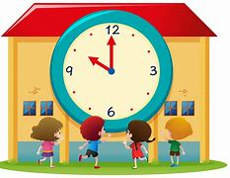
Trefn y Dydd/ Daily Timetable
O dan yr amgylchiadau presenol.... / Under the current circumstances….
Mae’r ysgol yn cychwyn i Flwyddyn 3 a 4 rhwng 8:45 y.b. – 9:05 y.b. Gofynnwn i chi sicrhau bod eich plentyn wedi cyrraedd yr ysgol yn brydlon. School starts between 8:45 – 9:05 am for the Year 3/4 classes. We ask that you ensure your child arrives at school on time.
Gofynnwn i chi sicrhau eich bod yn casglu eich plentyn am 3:10 y.p wrth y brif glwyd. We kindly ask that you collect your child at 3.10pm at the main gate please.
*Os fydd newid i drefniadau arferol casglu eich plentyn gofynnwn yn garedig i chi gysylltu â’r swyddfa neu anfon lythyr i gadarnhau’r trefniadau. If there is a change to your child’s usual circumstances with regards to collection from school we kindly ask that you inform the office or notify us by letter to confirm the arragments*

Slide 9
Gwaith dosbarth / Classwork
Cynllunio fel adran er mwyn cysondeb / Planning as a department for consistency
Gwaith wedi’i wahaniaethu / Differentiated Work
Llais y plentyn yn bwydo mewn i’r thema /Childrens’ voice contributes to planning

Slide 10
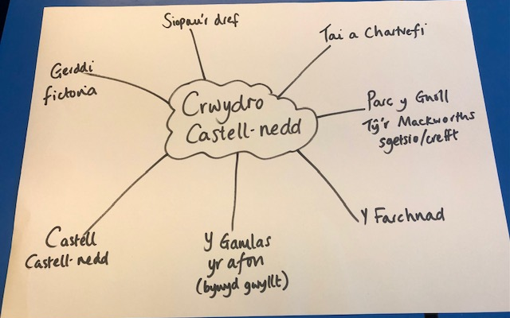
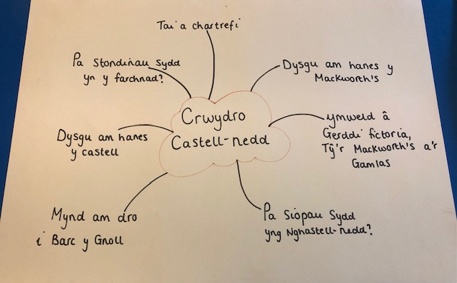
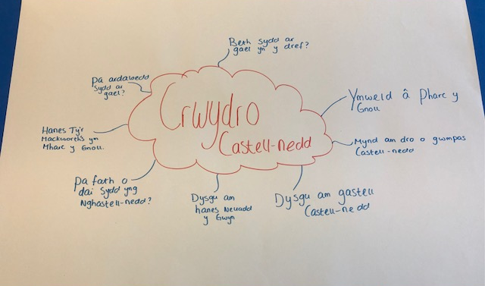
Thema: Crwydro Castell-nedd / Exploring Neath

Slide 11
Parc y Gnoll
Braslunio, siarcol a pheintio
Dysgu am nodweddion yr Hydref
Dysgu am hanes Tŷ’r Mackworth’s ym Mharc y Gnoll
Castell Castell-nedd / Afon / Camlas
Gwaith ymchwil i hanes y castell
Braslunio’r Castell
Dyfrliwio lluniau’r Castell
Edrych ar fywyd gwyllt yn y dwr
Adeiladu castell, pontydd a thirnodau eraill
Y Crydd
Ymweld â Siop y Crydd
Dysgu stori y Coblynnod a’r Crydd
Dyblu pris esgidiau
Creu graffiau esgidau
Dysgu sut i glymu lasys
Gwnïo
Tai a Chartrefi
Edrych ar wahanol mathau o dai
Adeiladu tai allan o jync
Cymharu tai

Slide 12
Ieithoedd, Llythrennedd a Chyfathrebu
Gwrando ac ymateb i amrywiaeth o straeon.
Grwpiau darllen dan arweiniad.
Ysgrifennu dwyn i gof, llythyron a ffeil ffeithiau.
Ymchwilio i’r ardal leol.
Defnyddio rhaglen ffoneg Letters and Sounds (Saesneg) a Popat (Cymraeg).
Ymarfer ffurfio llythrennau gan ddefnyddio gwahanol offer.
Ymarfer darllen a sillafu geiriau allweddol.
Darllen a dysgu stori ‘Y Coblynnod a’r Crydd’ yn ôl arddull Pie Corbett.
Chwarae gêmau gwahanol, megis ‘Guess who?’ a ‘Rwy’n gweld’ i fwydo patrymau iaith newydd.
Trafod y dyddiad a’r tywydd yn ddyddiol (Dyddiau’r wythnos, misoedd y flwyddyn a’r rhifolion).
Languages, Literacy and Communication
Listen and respond to a variety of stories.
Daily guided reading groups.
Write recounts, letters and fact files.
Research into the local area.
Follow the following phonics programmes: Letters and Sounds in English and Popat in Welsh.
Practise handwriting.
To practise reading and writing key words.
Read and learn the story ‘The elves and the shoe maker’ using the Pie Corbett method.
Play a variety of games, such as ‘Guess who?’ and ‘I spy’ to learn language patterns.
Discuss the weather and date, daily (Days of the week, months of the year and numerals – Cyntaf / First, Second / Ail, Third / Trydydd).

Slide 13
Mathemateg a Rhifedd
Darllen, ysgrifennu ac adnabod rhifau hyd at 1,000 a thu hwnt.
Adolygu y 4 rheol.
Un yn fwy/llai, 10 yn fwy/llai, 100 yn fwy /llai.
Trefnu rhifau.
Adolygu eilrifau ac odrifau.
Talgrynnu rhifau i’r 10, 100 a 1,000 agosaf.
Darllen y cloc i’r 5 munud agosaf ar gloc analog a digidol.
Dysgu dyddiau’r wythnos, misoedd y flwyddyn a’r tymhorau yn y Gymraeg a’r Saesneg.
Rhagfynegi a mesur hyd a màs gan ddefnyddio unedau safonol.
Mathematics and Numeracy
Read, write and interpret numbers up to 1,000 and beyond.
Revise the 4 operations.
1 more/less, 10 more/10 less, 100 more/100 less.
Order and sequence numbers.
Revise odd /even numbers.
Estimate and round numbers to the nearest 10/100/1,000.
Tell the time to the nearest 5 minutes on a digital and analogue clock.
To learn the days of the week, the months of the year and the seasons in Welsh and in English.
Estimate and measure length and mass using appropriate standard units.
Revise times tables.

Slide 14
Digital competency
Create a poster to raise awareness of online dangers e.g. not sharing passwords and understanding that sharing information online shares a digital footprint.
I can use digital technology to communicate and connect with others locally.
Sign in to Hwb independently and use a variety of JIT programmes.
Learn how to research safely on-line.

Slide 15


Darllen / Reading
Llyfrau mewn yn gyson/ Bring reading books regularly.
Llyfrau darllen- newid pan fo’n briodol / Pupils will have access to both English and Welsh reading books.
Darllen grwp, sgiliau darllen, ymchwil, darllen a deall, asesiadau / Group reading, reading skills and strategies, research, comprehension, assessments.
Mae copi o’r 100 o eiriau cyntaf yn gymraeg a Saesneg ar ein gwefan. Ar y wefan hefyd mae’r geiriau wedi eu rhannu mewn i rhestrau o 10 ar y tro. Bydd eich plentyn yn gweithio ar un rhestr ar y tro yn yr ysgol gan symud ymlaen pan fyddant yn eu darllen a sillafu yn hyderus heb orfod adeiladu llythrennau. A copy of the first 100 words in welsh can be found on our website. we have also provided those words in lists of 10 at a time. Your child will work on one list at a time in school, moving on when they read and spell the ten words confidently, without having to build each letter or sound individually.

Slide 16

Mathemateg Fawr/Big Maths
Bydd y plant yn cymryd rhan mewn sesiynau Mathemateg Fawr er mwyn cryfhau a datblygu sgiliau rhif. Byddant yn mwynhau cwis bob Dydd Gwener yn seiliedig ar y gwaith hwn. Byddwn yn danfon y gwaith hwn adref yn ystod yr wythnos ganlynol gyda gwaith targed wedi’i cylchu.
Children will take part in daily Big Maths sessions to strengthen and develop number skills. Every Friday they will enjoy a quiz based on this work. We will send the sheets home during the following week and will have circled work which we will be targeting in school.
https://www.topmarks.co.uk/Search.aspx?q=100+square+splat
https://www.ictgames.com/mobilePage/hundredSq/index.html
https://ttrockstars.com/
https://play.numbots.com/#/intro

Slide 17



Learning and practising Times Tables Facts
Your child will Your child’s Numbots login details also allow them to log in to TimesTablesRocks online. Here they can practise their times tables facts.
The programme automatically generates the tables facts that your child needs to practise so they should not be given questions on tables that they have not yet started. It is important that they work through the questions themselves since it will generate facts too difficult for them if someone else has answered correctly facts that they themselves didn’t know.
When they reach a certain level the programme will generate division facts too.
Children can practise in the ‘garage’ where they earn coins that they can spend in the shop. They can buy items for their avatar.
They can also play against children in the class, the school and in other schools.
Tables facts can also be practised on J2Blast on J2E on HWB.
Hit the Button can be played online and can also be downloaded as an app.
To practise tables facts, go to the menu and select ‘Times Tables’ and then the table that you want to practise.

Slide 18

Addysg Gorfforol
Gall gwers Addysg Gorfforol ddigwydd unrhyw ddiwrnod ar hyn o bryd oherwydd tywydd ac amserlen y Neuadd.
P.E sessions can currently take place on any day of the week because of restrictions regarding the weather and the hall timetable.
Gall y plant cadw treinyrs yn yr ysgol. Children can keep trainers in school.

Slide 19

Trydar/Twitter
Mae gan Uned 3/4 gyfrif Trydar caëedig: @bl3a4_cnedd. A fyddech gystal â danfon eich enw defnyddiwr i’r ysgol cyn ceisio ymuno fel ein bod yn gwybod pwy ydych chi cyn derbyn eich cais.
Uned 3/4 has a closed Twitter group. The username is @bl3a4_cnedd. Please send your Twitter handle in to school before requesting to follow so that we know who you are before accepting your request.

Slide 20
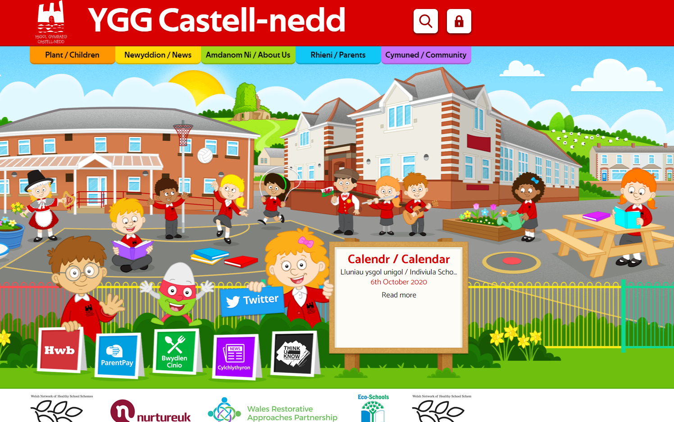
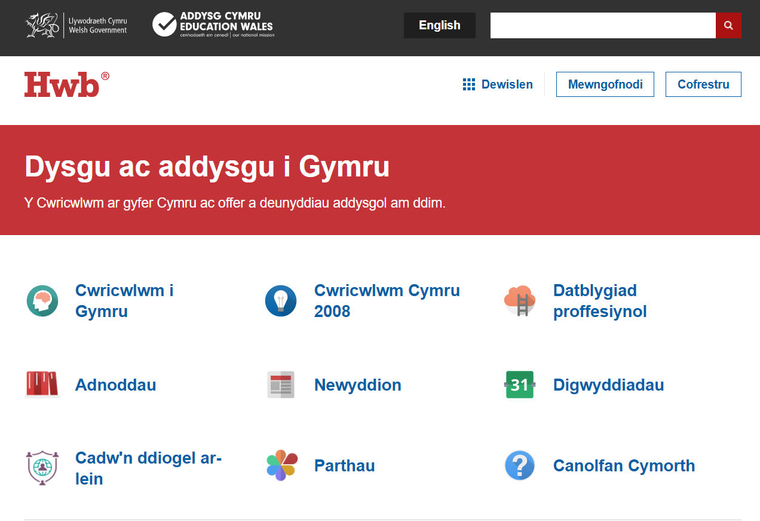
Gwefannau defnyddiol / Useful websites

Slide 21
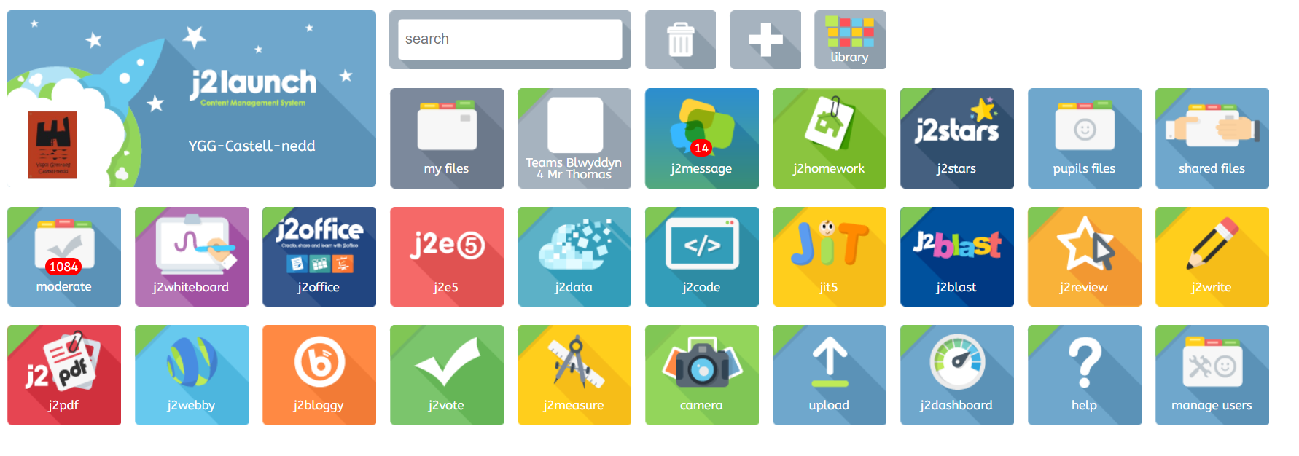
Gwefannau defnyddiol / Useful websites

Slide 22

Gwersi Cerdd/Music Lessons
Blwyddyn 4 – cost o £4.50 y wers-Parentpay
Year 4 -£4.50 per lesson via Parentpay
Plant yn derbyn gwers pob dydd Mawrth. Music lessons are held on a Tuesday.
Blwyddyn 3 am ddim.
Year 3 will receive free lessons.
Cofiwch eich offeryn!
Remember your instrument!

Slide 23

Diolch yn fawr!

