Slide 1

Noson rhieni Hydref 2022 Parents evening 2022

Slide 2

Staff yr adran
Dosbarth /Class 4/5S - Mrs S Stephens
Dosbarth /Class 4/5A- Mrs Asher
Dosbarth / Class 4/5H- Mr Hinton
Cynorthwywyr/Teaching assistants-Mrs M Kingdom, Mrs L Thomas, Mr O Williams a Miss E John.

Slide 3
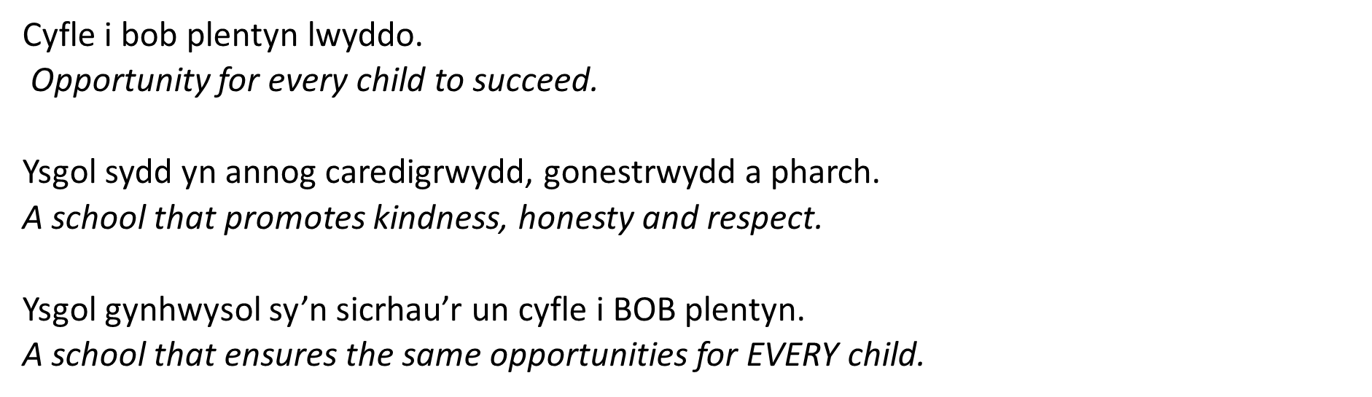


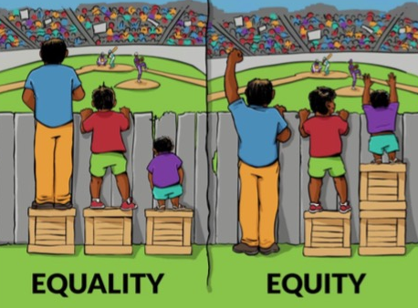
Ethos a Gweledigaeth

Slide 4
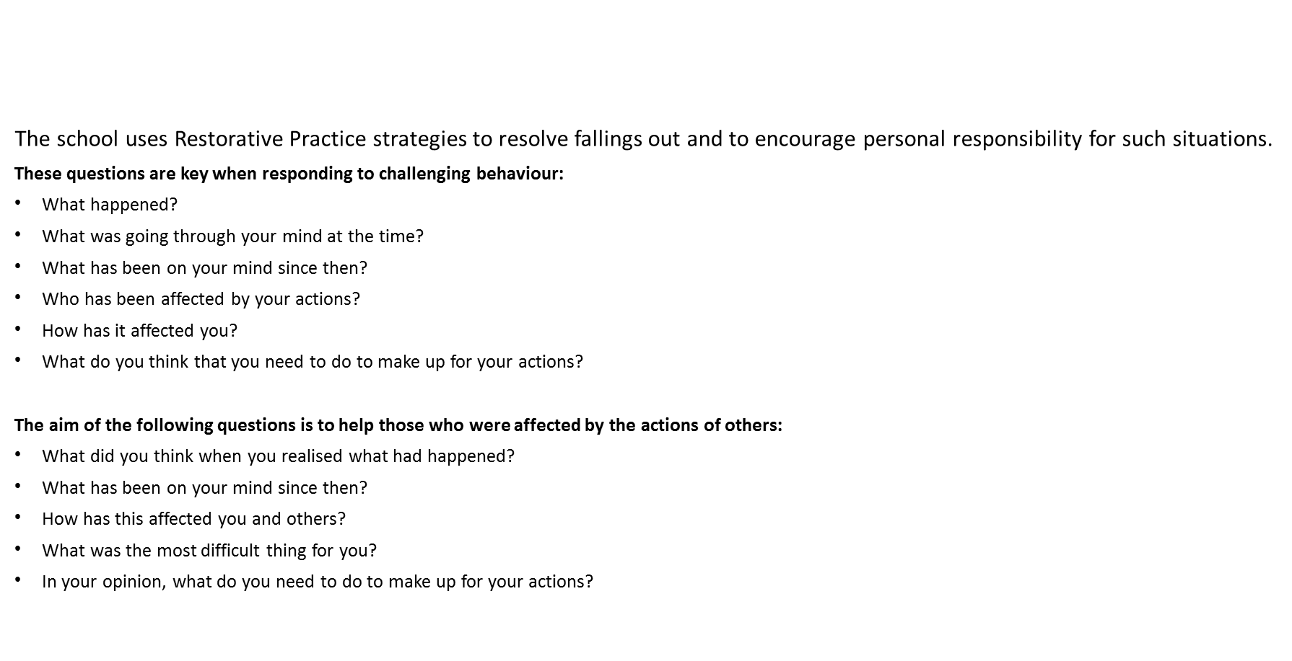
Behaviour and Anti-bullying Policies

Slide 5

Disgyblaeth a Gwrth fwlio
Mae’r ysgol yn defnyddio strategaethau Arfer Adferol er mwyn ceisio datrys sefyllfa o gwmpo mas ac yn annog cyfrifoldeb personol am sefyllfaoedd o’r fath.
Mae’r cwestiynau canlynol yn ddibynadwy wrth ymateb i ymddygiad heriol:
Beth ddigwyddodd?
Beth oedd ar dy feddwl ar y pryd?
Beth sydd wedi bod ar dy feddwl ers hynny?
Pwy sydd wedi cael eu heffeithio gan dy weithredoedd di?
Ym mha ffordd mae hyn wedi effeithio arnat ti?
Beth wyt ti’n meddwl sydd angen i ti ei wneud i wneud yn iawn am y gweithredoedd yma?
Bwriad y cwestiynau canlynol yw helpu’r rhai hynny a niweidiwyd gan weithredoedd pobl eraill:
Beth oeddet ti’n meddwl pan sylweddolaist ti beth oedd wedi digwydd?
Beth sydd wedi bod ar dy feddwl ers hynny?
Sut mae hyn wedi effeithio arnat ti a phobl eraill?
Beth oedd y peth anoddaf i ti?
Yn dy farn di, beth sydd angen digwydd i wneud yn iawn am y gweithredoedd yma?

Slide 6

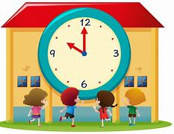
Trefn y Dydd/ Daily Timetable
Mae’r ysgol yn cychwyn i Flwyddyn 4 a 5 am 8:50. Gofynnwn i chi sicrhau bod eich plentyn wedi cyrraedd yr ysgol yn brydlon. School starts at 8;50 am for the Year 4/5 classes. We ask that you ensure your child arrives at school on time.
Gofynnwn i chi sicrhau eich bod yn casglu eich plentyn am 3:20 y.p wrth y glwyd briodol. We kindly ask that you collect your child at 3.20pm please.
*Os fydd newid i drefniadau arferol casglu eich plentyn gofynnwn yn garedig i chi gysylltu â’r swyddfa neu anfon lythyr i gadarnhau’r trefniadau. If there is a change to your child’s usual circumstances with regards to collection from school we kindly ask that you inform the office or notify us by letter to confirm the arragments*

Slide 7
Meddyginiaeth/ Medication
Nid oes hawl gydag athrawon i rhoi meddyginiaeth i blant heb fod rhiant wedi llenwi ffurflen gyda manylion yn y swyddfa.

Slide 8
Ieithoedd, Llythrennedd a Chyfathrebu
Gwrando ac ymateb i amrywiaeth o straeon.
Grwpiau darllen dan arweiniad.
Ysgrifennu dwyn i gof, llythyron a ffeil ffeithiau.
Defnyddio rhaglen ffoneg Letters and Sounds (Saesneg) a Popat (Cymraeg).
Ymarfer ffurfio llythrennau gan ddefnyddio gwahanol offer.
Ymarfer darllen a sillafu geiriau allweddol.
Darllen a dysgu stori ‘Gelert’ yn ôl arddull Pie Corbett.
Chwarae gêmau gwahanol, megis ‘Guess who?’ a ‘Rwy’n gweld’ i fwydo patrymau iaith newydd.
Trafod y dyddiad a’r tywydd yn ddyddiol (Dyddiau’r wythnos, misoedd y flwyddyn a’r rhifolion).
Languages, Literacy and Communication
Listen and respond to a variety of stories.
Daily guided reading groups.
Write recounts, letters and fact files.
Follow the following phonics programmes: Letters and Sounds in English and Popat in Welsh.
Practise handwriting.
To practise reading and writing key words.
Read and learn the story ‘Gelert’ using the Pie Corbett method.
Play a variety of games, such as ‘Guess who?’ and ‘I spy’ to learn language patterns.
Discuss the weather and date, daily (Days of the week, months of the year and numerals – Cyntaf / First, Second / Ail, Third / Trydydd).

Slide 9
Mathemateg a Rhifedd
Darllen, ysgrifennu ac adnabod rhifau hyd at 1,000 a thu hwnt gan gynnwys ffracsiynau a degolion.
Adolygu y 4 rheol.
Un yn fwy/llai, 10 yn fwy/llai, 100 yn fwy /llai.
Trefnu rhifau.
Adolygu eilrifau ac odrifau.
Talgrynnu rhifau i’r 10, 100 a 1,000 agosaf.
Darllen y cloc i’r 5 munud agosaf ar gloc analog a digidol.
Dysgu dyddiau’r wythnos, misoedd y flwyddyn a’r tymhorau yn y Gymraeg a’r Saesneg.
Rhagfynegi a mesur hyd a màs gan ddefnyddio unedau safonol.
Rwy’n gallu dangos dealltwriaeth o incwm a gwariant, ac rwy’n gallu cymhwyso fy sgiliau cyfrifo i archwilio elw a cholled.
Mathematics and Numeracy
Read, write and interpret numbers up to 1,000 and beyond including fractions and decimals.
Revise the 4 operations.
1 more/less, 10 more/10 less, 100 more/100 less.
Order and sequence numbers.
Revise odd /even numbers.
Estimate and round numbers to the nearest 10/100/1,000.
Tell the time to the nearest minute on a digital and analogue clock.
To learn the days of the week, the months of the year and the seasons in Welsh and in English.
Estimate and measure length and mass using appropriate standard units.
Demonstrate an understanding of income and expenditure, and apply calculations to explore profit and loss
Revise times tables.

Slide 10
Digital competency
This Area provides a range of opportunities to develop a diverse set of digital competencies, recognising their cross-curricular nature and application. Contributions in this Area can include capturing and interrogating data, recognising and evaluating computational processes, designing and expressing learners’ thinking using digital devices and systems. Learners’ use of a range of digital technologies and software applications is also implicit in a number of the descriptions of learning in this Area, which complement similar opportunities to develop these skills in other Areas.

Slide 11


Darllen / Reading
Llyfrau mewn yn gyson/ Bring reading books regularly.
Llyfrau darllen- newid pan fo’n briodol / Pupils will have access to both English and Welsh reading books.
Darllen grwp, sgiliau darllen, ymchwil, darllen a deall, asesiadau / Group reading, reading skills and strategies, research, comprehension, assessments.

Slide 12

Mathemateg Fawr/Big Maths
Bydd y plant yn cymryd rhan mewn sesiynau Mathemateg Fawr er mwyn cryfhau a datblygu sgiliau rhif. Byddant yn mwynhau cwis bob Dydd Gwener yn seiliedig ar y gwaith hwn. Byddwn yn danfon y gwaith hwn adref a bydd y plant yn cael cyfle i weithio ar ei targedau.
Children will take part in daily Big Maths sessions to strengthen and develop number skills. Every Friday they will enjoy a quiz based on this work. We will send the sheets home and the children will work on their targets.
https://www.topmarks.co.uk/Search.aspx?q=100+square+splat
https://www.ictgames.com/mobilePage/hundredSq/index.html
https://ttrockstars.com/
https://play.numbots.com/#/intro

Slide 13



Learning and practising Times Tables Facts
Your child will Your child’s Numbots login details also allow them to log in to TimesTablesRocks online. Here they can practise their times tables facts.
The programme automatically generates the tables facts that your child needs to practise so they should not be given questions on tables that they have not yet started. It is important that they work through the questions themselves since it will generate facts too difficult for them if someone else has answered correctly facts that they themselves didn’t know.
When they reach a certain level the programme will generate division facts too.
Children can practise in the ‘garage’ where they earn coins that they can spend in the shop. They can buy items for their avatar.
They can also play against children in the class, the school and in other schools.
Tables facts can also be practised on J2Blast on J2E on HWB.
Hit the Button can be played online and can also be downloaded as an app.
To practise tables facts, go to the menu and select ‘Times Tables’ and then the table that you want to practise.

Slide 14

Trydar/Twitter
Mae gan Uned 4/5 gyfrif Trydar caeedig: @cnedd_bl4a5. A fyddech gystal â danfon eich enw defnyddiwr i’r ysgol cyn ceisio ymuno fel ein bod yn gwybod pwy ydych chi cyn derbyn eich cais.
Uned 4/5 has a closed Twitter group. The username is @cnedd_bl4a5. Please send your Twitter handle in to school before requesting to follow so that we know who you are before accepting your request.

Slide 15

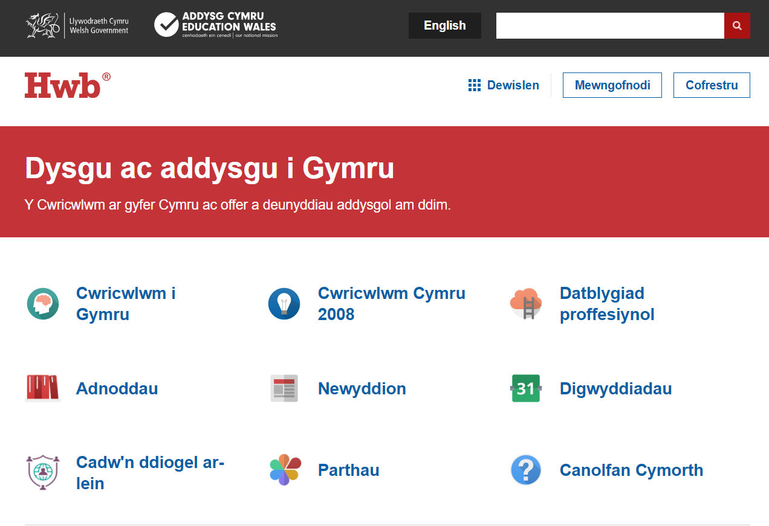
Gwefannau defnyddiol / Useful websites

Slide 16

Gwefannau defnyddiol / Useful websites

Slide 17

Addysg Gorfforol
Mae gwers Addysg Gorfforol ar ddydd Mercher ac ar ddydd Iau .
P.E sessions are on a Wednesday and Thursday .
Hefyd byddwn yn manteisio ar y defnydd o’r cyrtiau tenis.
Gall y plant gadw dillad ymarfer corff ac esgidiau ymarfer corff yn eu loceri.
Children can keep PE kit i.e. red or white t-shirt and black shorts, leggings /joggers and trainers in their lockers.

Slide 18

Gwersi Cerdd/Music Lessons
Blwyddyn 4/5 – cost o £4.50 y wers-Parentpay
Year 4/5 -£4.50 per lesson via Parentpay
Bydd eisiau talu am yr hanner tymor o flaen llaw.
Payments are required half termly in advance.
Plant yn derbyn gwers pob dydd Mawrth. Music lessons are held on a Tuesday.
Cofiwch eich offeryn!
Remember your instrument!

Slide 19
Cwrs Preswyl/ Residential
Mae cyfle i blant 4/5 i fynychu cwrs preswyl yn Llangrannog ar Fehefin 7-9 fed 2023. Bydd y cwrs yn dridiau ac yn cynnwys gweithgareddau amrywiol e.e. marchogaeth ceffyl, sgïo ac yn y blaen . Pris y cwrs yw £156. Bydd modd talu’n llawn neu randaliadau trwy Parent Pay.
The children have the opportunity to attend a residential course at Llangrannog, June 7th- 9th. It is a three day course which includes all activities i.e. horse riding , skiing etc. The total cost is £156. Payments can be made in full or in instalments via Parent Pay.

Slide 20

Diolch yn fawr!

