Slide 1



Croeso
i’r
Derbyn

Slide 2

Staff yr Adran
Derbyn Ph – Mrs C Phillips
Derbyn R – Miss N Rees
Cynorthwywyr / Teaching Assisstants –
Mrs J. Canfield Miss S. Hunt
Mrs R. Leyshon
Miss C. Floyd

Slide 3

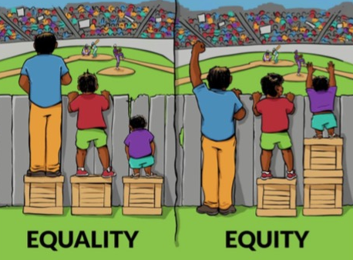

Ethos a Gweledigaeth
Ethos a Gweledigaeth
Cyfle i bob plentyn lwyddo / Opportunity for every
child to succeed.
Ysgol sydd yn annog Cymreictod, caredigrwydd, gonestrwydd, annibyniaeth a pharch / A school that proud of our Welsh heritage, kindness, honesty, independence and respect.
Ysgol gynhwysol sy’n sicrhau’r un cyfle i BOB plentyn / A school that ensures the same opportunities for EVERY child.

Slide 4

Ethos a
Disgyblaeth a Gwrth Fwlio
Mae’r ysgol yn defnyddio strategaethau Arfer Adferol er mwyn ceisio datrys sefyllfa o gwmpo mas ac yn annog cyfrifoldeb personol am sefyllfaoedd o’r fath.
Mae’r cwestiynau canlynol yn ddibynadwy wrth ymateb i ymddygiad heriol:
Beth ddigwyddodd?
Beth oedd ar dy feddwl ar y pryd?
Beth sydd wedi bod ar dy feddwl ers hynny?
Pwy sydd wedi cael eu heffeithio gan dy weithredoedd di?
Ym mha ffordd mae hyn wedi effeithio arnat ti?
Beth wyt ti’n meddwl sydd angen i ti ei wneud i wneud yn iawn am y gweithredoedd yma?
Bwriad y cwestiynau canlynol yw helpu’r rhai hynny a niweidiwyd gan weithredoedd pobl eraill:
Beth oeddet ti’n meddwl pan sylweddolaist ti beth oedd wedi digwydd?
Beth sydd wedi bod ar dy feddwl ers hynny?
Sut mae hyn wedi effeithio arnat ti a phobl eraill?
Beth oedd y peth anoddaf i ti?
Yn dy farn di, beth sydd angen digwydd i wneud yn iawn am y gweithredoedd yma?

Slide 5
Ethos a
Behaviour and Anti-bullying Policies
Restorative Practice
The school uses Restorative Practice strategies to resolve fallings out and to encourage personal responsibility to such situations.
These questions are key when responding to challenging behaviour:
What happened?
What was going through your mind at the time?
What has been on your mind since then?
Who has been affected by your actions?
How has it affected you?
What do you think that you need to do to make up for your actions?
The aim of the following questions is to help those who were affected by the actions of others:
What did you think when you realised what had happened?
What has been on your mind since then?
How has this affected you and others?
What was the most difficult thing for you?
In your opinion, what do you need to do to make up for your actions?

Slide 6

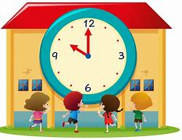
Trefn y Dydd/ Daily Timetable
Mae’r ysgol yn cychwyn i’r Derbyn am 8:40 y.b. Gofynnwn i chi sicrhau bod eich plentyn wedi cyrraedd yr ysgol yn brydlon. School starts between 8:40 am for the Reception classes. We ask that you ensure your child arrives at school on time.
Gofynnwn i chi sicrhau eich bod yn casglu eich plentyn am 3:00 y.p wrth y brif glwyd. We kindly ask that you collect your child at 3pm at the main gate please.
*Os fydd newid i drefniadau arferol casglu eich plentyn gofynnwn yn garedig i chi gysylltu â’r swyddfa neu anfon lythyr i gadarnhau’r trefniadau.
If there is a change to your child’s usual circumstances with regards to collection from school we kindly ask that you inform the office or notify us by letter to confirm the arrangements.*

Slide 7





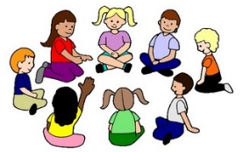

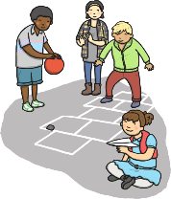


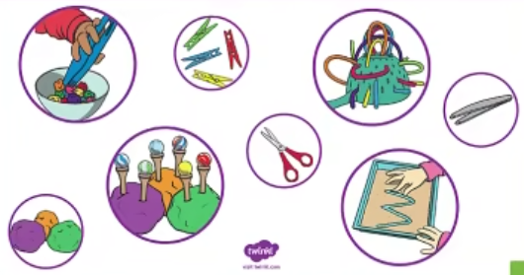









Trefn y Dydd/ Daily Timetable
Amser carped
Amser Cylch
Thema
Amser cinio
Amser chwarae
Sesiwn Sgiliau
Ysgol Goed
Amser stori
Amser mynd adref
Sesiwn ganu
Ymarfer corff

Slide 8
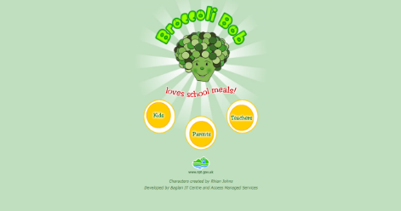


Ffrwyth a Chinio / Fruit and Lunch
Mae hawl gan blant y Derbyn gael cinio ysgol am ddim. Croeso i’r plant ddod â phecyn bwyd os ydyn nhw’n dymuno. / Reception children are entitled to a free school lunch. The children are more than welcome to bring a packed lunch if they wish.
http://www.broccolibob.co.uk/
        Mae croeso i’r plant ddod ag un darn o ffrwyth i’r ysgol i gael fel eu byrbryd yn ystod y dydd. Gofynnwn yn garedig bod y ffrwyth yn cael eu cadw mewn potyn sydd wedi cael eu labeli’n glir ag enw eich plentyn.
The children are welcome to bring one piece of fruit to have as a snack during the day. Can we kindly request that the fruit is
clearly labelled with your child’s name
or is stored in a labelled box.

Slide 9
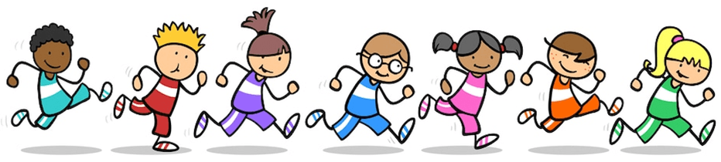
Gofynnwn i’r plant ddod i’r ysgol yn ddyddiol mewn esgidiau a dillad sy’n addas ar gyfer gwneud ymarfer corff – e.e. trainyrs a trowsus loncian/leggings neu i ddod a sgidiau i newid ond ni fyddant yn newid eu dillad.
We ask that children come to school daily dressed in comfortable clothes that are appropriate for doing P.E - e.g. trainers, joggers/leggings or to bring a pair of trainers to change into but they will not be changing into PE kit.
Ymarfer Corff/ Physical Education
Ymgylchiadau Cyffredinol / General Circumstances
Gofynnwn i’r plant ddod i’r ysgol ar ddiwrnodau ymarfer corff mewn esgidiau a dillad sy’n addas – e.e. trainyrs a trowsus loncian/leggings.
We ask that children come to school on P.E days in comfortable and appropriate clothes - e.g. trainers, joggers/leggings.
Ymgylchiadau presennol / Current Circumstances
-Dosbarth Mrs Phillips – Dydd Iau
-Dosbarth Miss Rees – Dydd Iau

Slide 10


Cysyniad Ysgol Gyfan : Caredigrwydd
Cynllunio fel adran er mwyn sicrhau cysondeb/ Planning as a
department for consistency.
Llais y plentyn yn bwydo mewn i’r thema / Childrens’ voice contributes to planning.
Dylanwad disgybl / Pupil influenced.
Straeon /Stories
Gwiwerod Gwirion Bost – Pwysleisio’r pwysigrwydd o rannu a chyfeillgarwch/ Emphasising the importance of sharing and friendships.
Sut alla i greu Enfys? – Sut i fodeli cariad a charedigrwydd i’n teuluoedd, ffrindiau a’r gymuned. / Modelling love and kindness with family, friends and the community.
Ysgogi Trafodaeth Adre’ /Topics of Conversations at Home
Priodweddau ffrind da / The qualities of a good friend.
Y pwysigrwydd o rannu a bod yn garedig / The importance of sharing and kindness.

Slide 11
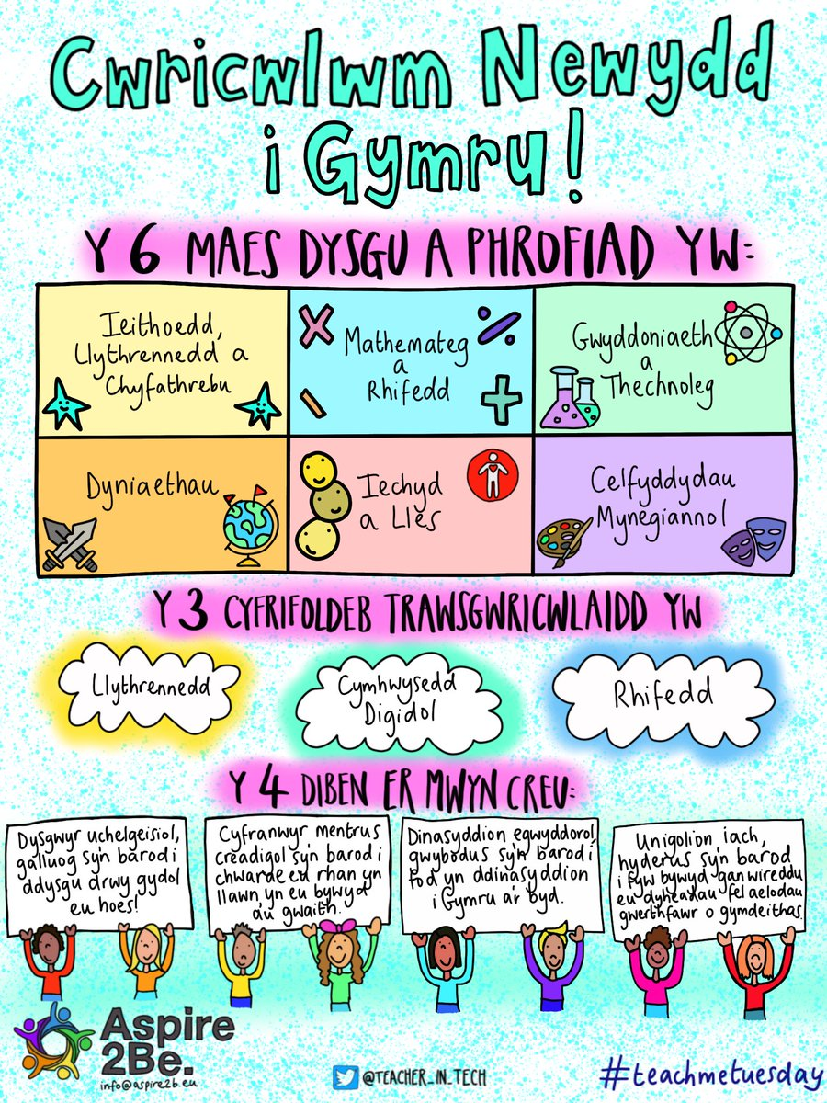

Cwricwlwm Newydd /New Curriculum.

Slide 12
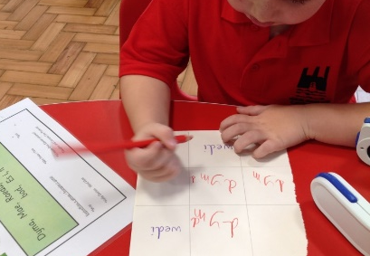
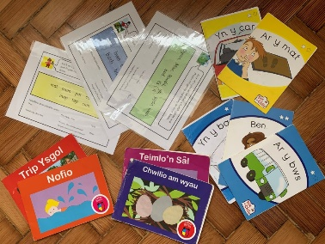
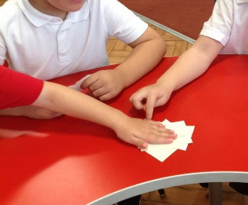

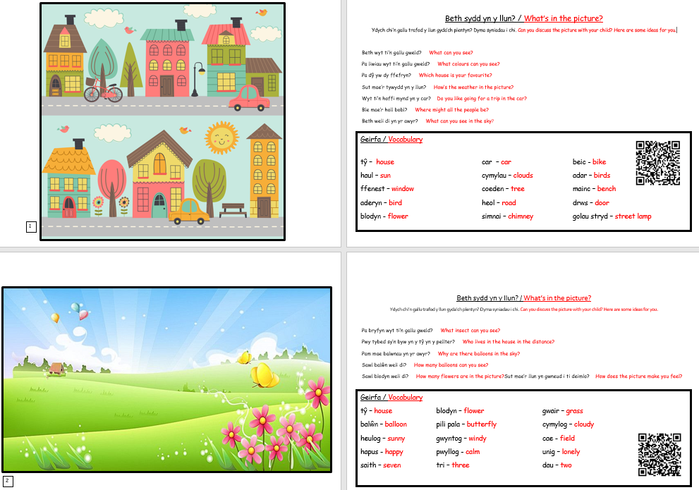
Tasgau Darllen/
Reading Tasks

Slide 13
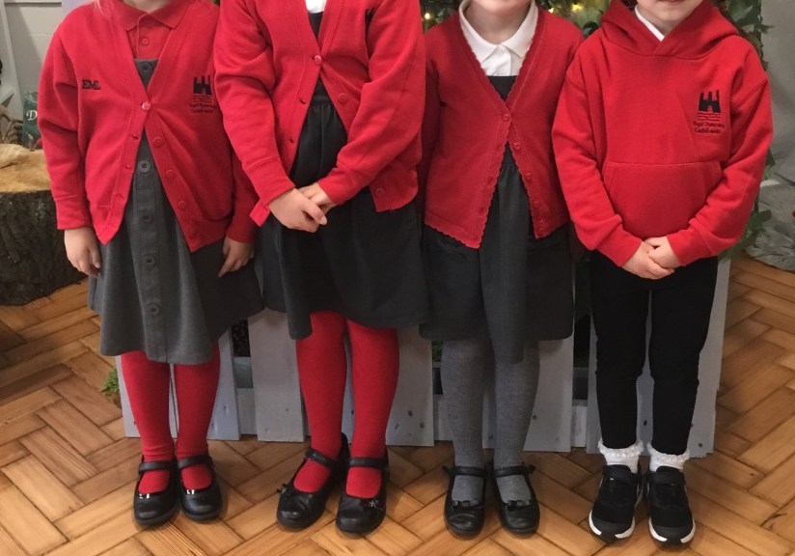
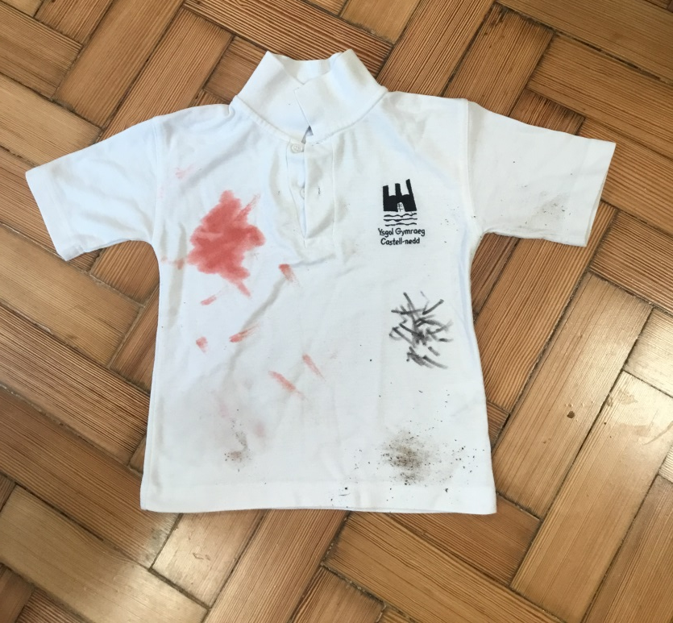
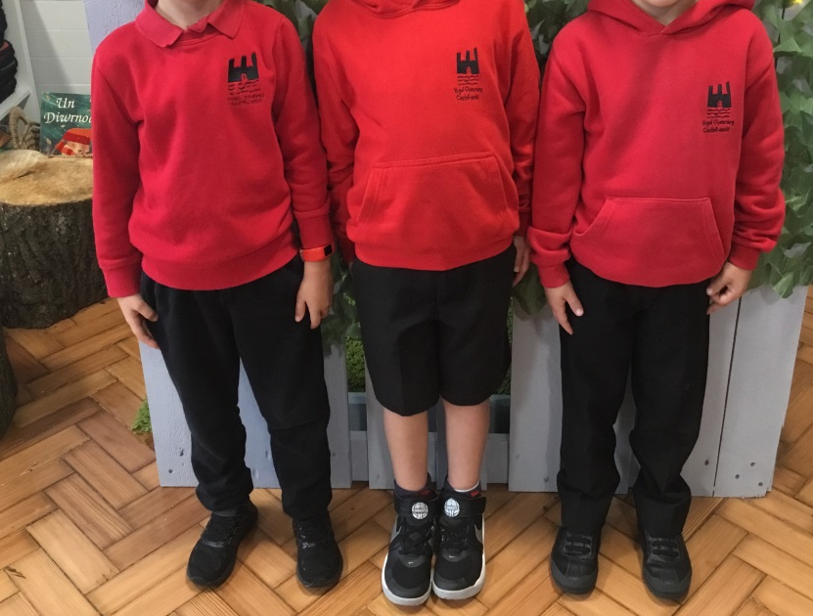
Gwisg Ysgol/Schoool Uniform
“Rwy’n flin mae fy nghrys yn frwnt ond mae’n dangos fy mod yn dysgu / I’m sorry that my shirt got dirty but it shows I’ve been learning!”

Slide 14

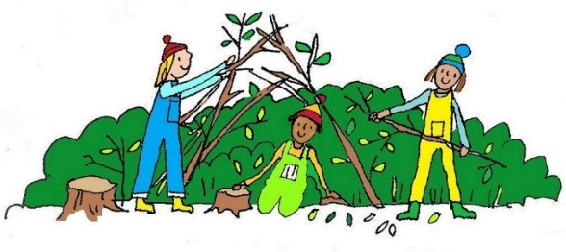
Sesiynau Ysgol Goed / Forest School Sessions
Prif bwriad Ysgol Goed yw i annog plant i fwynhau, gwerthfawrogi
a chwilota yn y byd natur.
Mae’n cynnig cyfleoedd i blant ddatblygu eu strwythur holistaidd ac i asesu a rheoli risg yn annibynnol. Yn ganolog i hyn mae’r amgylchedd, drwy brofi’r tymhorau a rhyfeddodau’r byd natur o’u cwmpas. Magu hyder a pharch at bobl a natur yw ein nod a rhoi’r cyfle i bob plentyn lwyddo.
The main aim of Forest School is to encourage children to enjoy, appreciate and explore the natural environment.
The approach promotes the children’s holistic development and to confidently assess and manage risks independently. Central to all of this is the environment. Children experience the seasons, the wonders of nature and the world around them. Forest School’s aim is to boost children’s self-confidence and respect to themselves, others and nature and to ensure they know how it feels to succeed.

Slide 15


Tudalen Trydar/ Twitter Page
Mae gan y dosbarthiadau Derbyn gyfrif Trydar caëedig: @derbyn_cnedd. A fyddech gystal â danfon eich enw defnyddiwr i’r ysgol cyn ceisio ymuno fel ein bod yn gwybod pwy ydych chi cyn derbyn eich cais.
The Reception classes have a closed Twitter group. The username is @derbyn_cnedd. Please send your Twitter handle in to school before requesting to follow so that we know who you are before accepting your request.
@cnedd_Derbyn

Slide 16

Cyswllt rhieni / Parental contact
Cofiwch fod ein drws o hyd ar agor!
Mae gennym bolisi ‘drws agored.’
Ar hyn o bryd rydym ar gael ar ddiwedd y dydd neu ar gael am sgwrs dros y ffôn i drafod unrhyw faterion sydd yn eich poeni.
Gallwch drefnu apwyntiad os yn angenrheidiol ar amser sydd yn gyfleus i chi ac i’r ysgol.
Peidiwch â cholli cwsg - dewch am sgwrs!
Remember our door is always open!
We have an ‘open door’ policy. We are usually available at the end of the day to discuss any matters that may concern you.
If you wish to discuss anything regarding your child, please don't hesitate
to contact the school and have a discussion over the phone.
A problem shared is a problem halved!

Slide 17
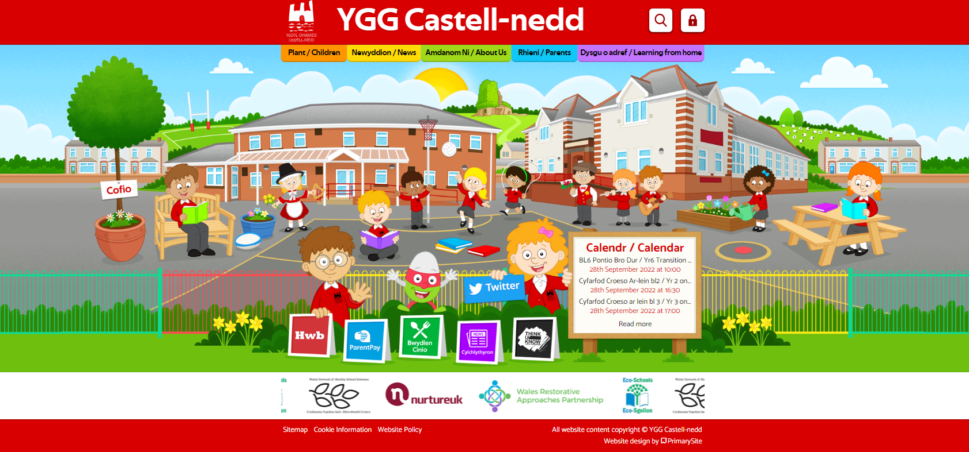
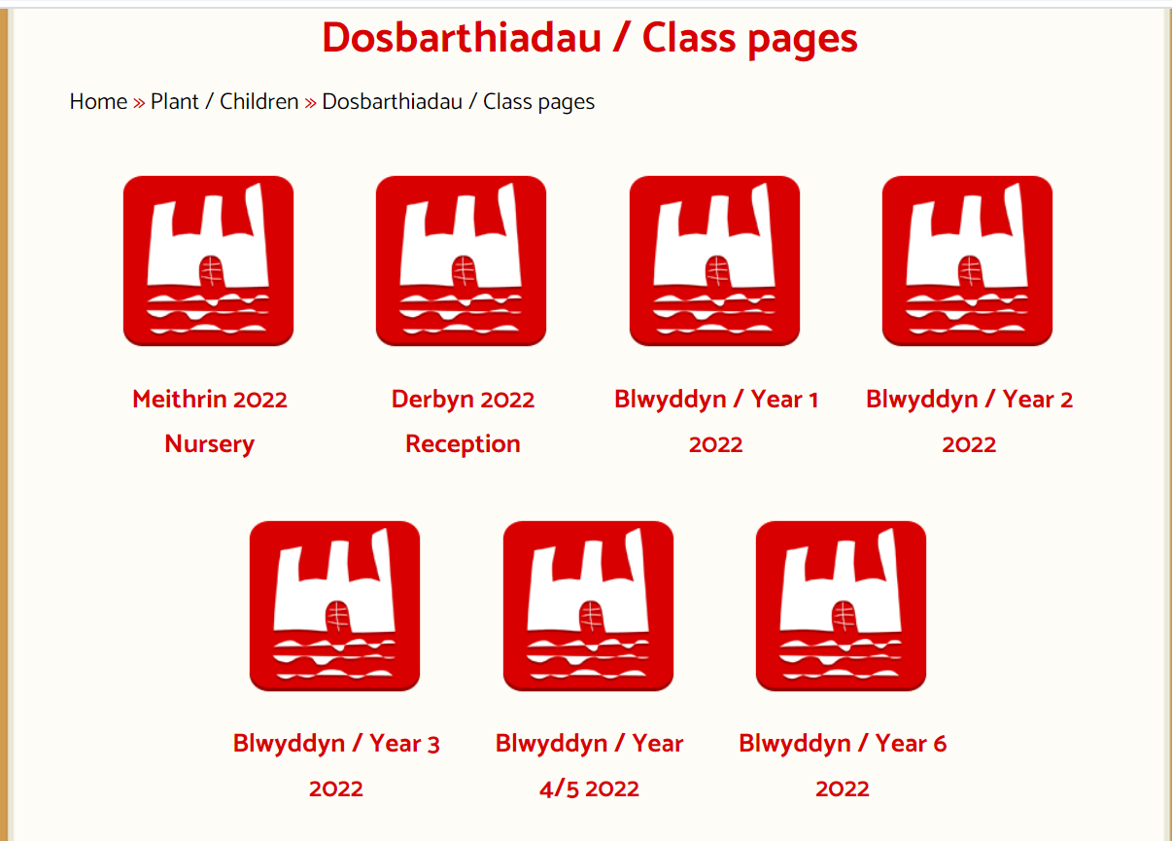
Gwefannau Defnyddiol / Useful Websites
www.yggcastellnedd.co.uk

Slide 18

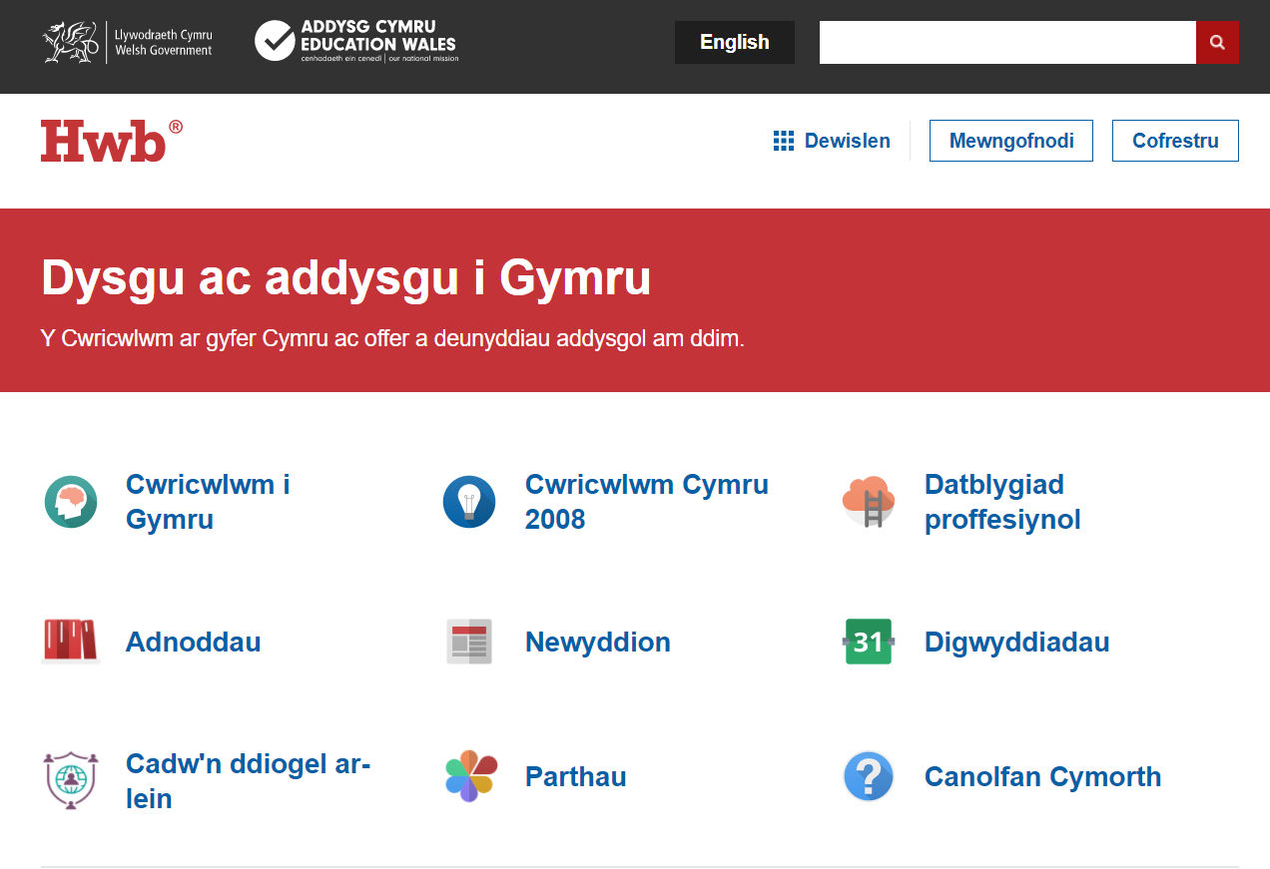

Gwefannau Defnyddiol / Useful Websites

Slide 19
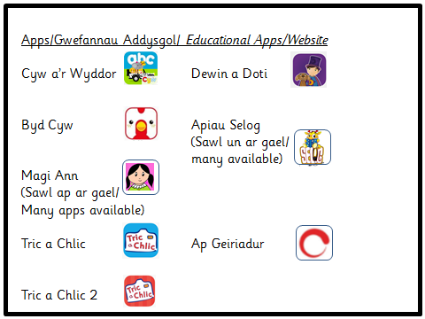



Slide 20
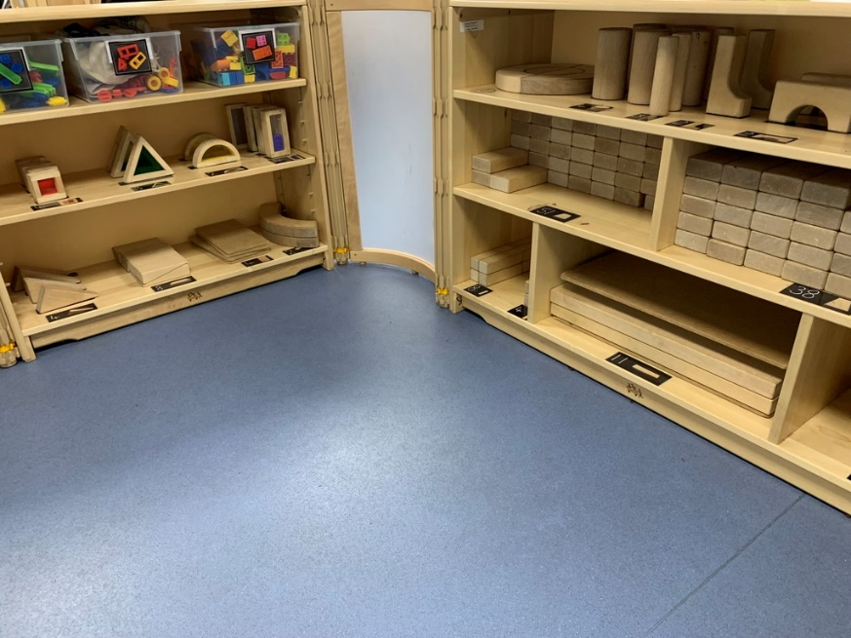
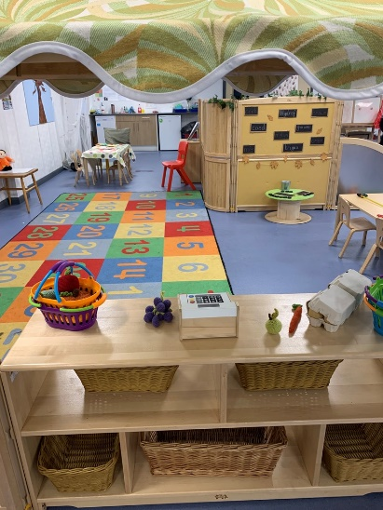
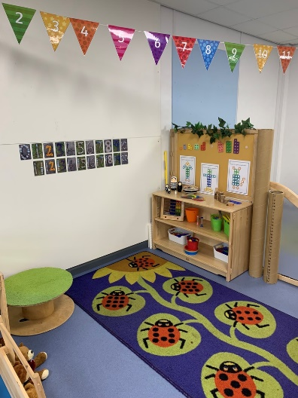
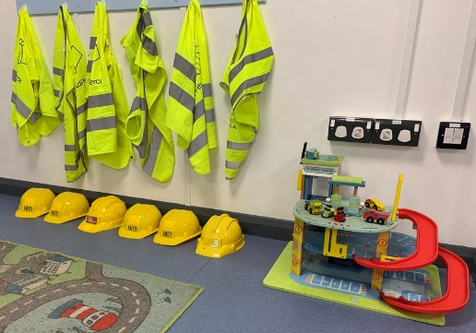
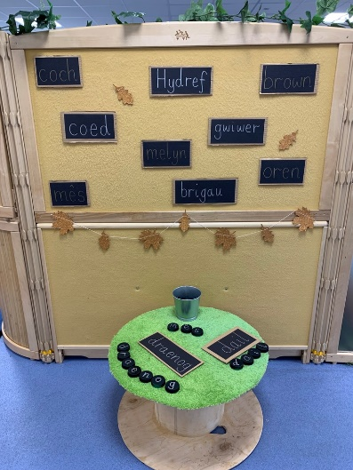
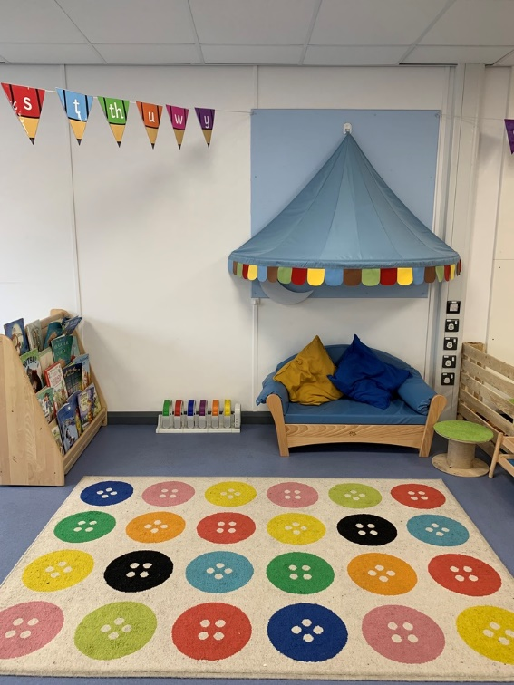
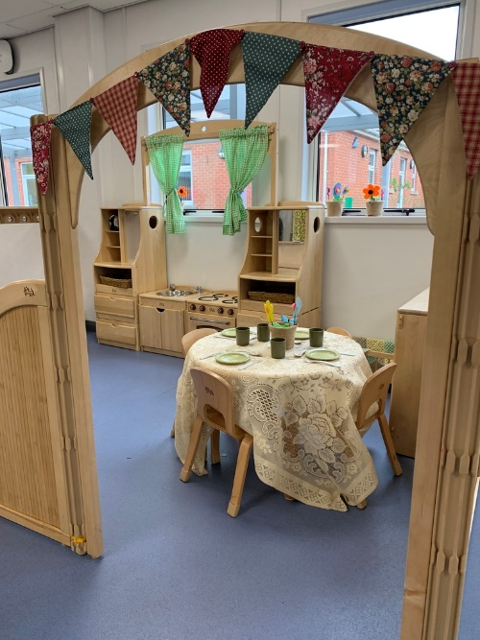
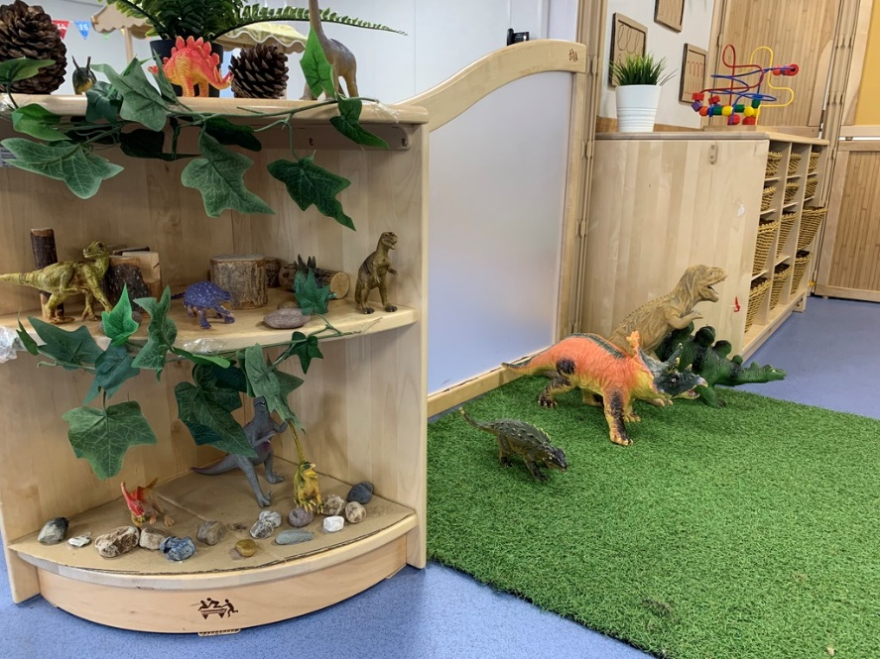
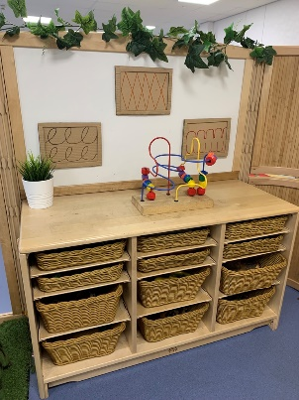
Yr Ystafell Ddosbarth /The Classroom

Slide 21

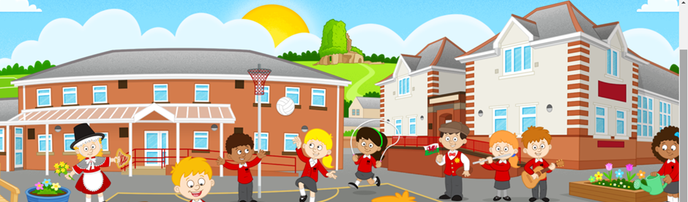
Diolch!
Unrhyw gwestiynau?

