Slide 1



Croeso
i
Flwyddyn 1

Slide 2
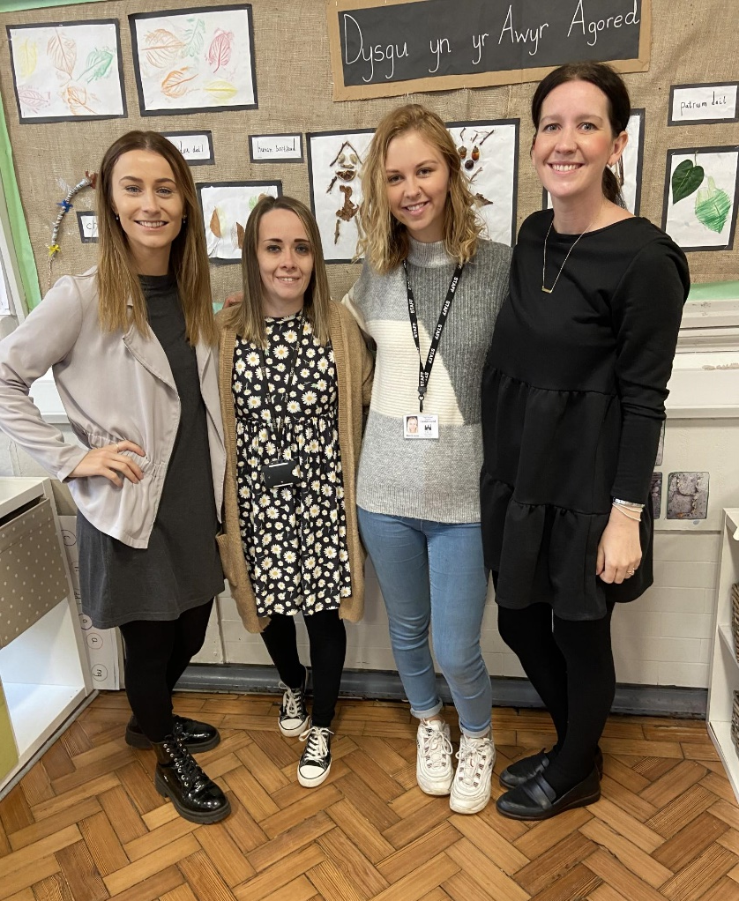
Staff yr Adran
Blwyddyn 1H – Miss A Harris
Blwyddyn 1R-M – Mrs C Rees-Morgan
Conorthwywyr / Teaching Assisstants –
Miss C Blank a Miss C Jones

Slide 3


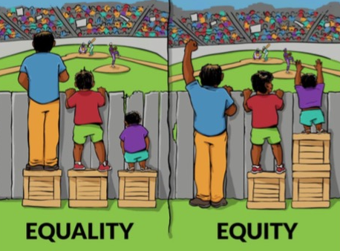

Ethos a Gweledigaeth
Ethos a Gweledigaeth
Cyfle i bob plentyn lwyddo / Opportunity for every
child to succeed.
Ysgol sydd yn annog Cymreictod, caredigrwydd, gonestrwydd, annibyniaeth a pharch / A school that’s proud of our Welsh heritage, kindness, honesty, independence and respect.
Ysgol gynhwysol sy’n sicrhau’r un cyfle i BOB plentyn / A school that ensures the same opportunities for EVERY child.

Slide 4

Ethos a
Disgyblaeth a Gwrth Fwlio
Mae’r ysgol yn defnyddio strategaethau Arfer Adferol er mwyn ceisio datrys sefyllfa o gwmpo mas ac yn annog cyfrifoldeb personol am sefyllfaoedd o’r fath.
Mae’r cwestiynau canlynol yn ddibynadwy wrth ymateb i ymddygiad heriol:
Beth ddigwyddodd?
Beth oedd ar dy feddwl ar y pryd?
Beth sydd wedi bod ar dy feddwl ers hynny?
Pwy sydd wedi cael eu heffeithio gan dy weithredoedd di?
Ym mha ffordd mae hyn wedi effeithio arnat ti?
Beth wyt ti’n meddwl sydd angen i ti ei wneud i wneud yn iawn am y gweithredoedd yma?
Bwriad y cwestiynau canlynol yw helpu’r rhai hynny a niweidiwyd gan weithredoedd pobl eraill:
Beth oeddet ti’n meddwl pan sylweddolaist ti beth oedd wedi digwydd?
Beth sydd wedi bod ar dy feddwl ers hynny?
Sut mae hyn wedi effeithio arnat ti a phobl eraill?
Beth oedd y peth anoddaf i ti?
Yn dy farn di, beth sydd angen digwydd i wneud yn iawn am y gweithredoedd yma?

Slide 5
Ethos a
Behaviour and Anti-bullying Policies
Restorative Practice
The school uses Restorative Practice strategies to resolve fallings out and to encourage personal responsibility to such situations.
These questions are key when responding to challenging behaviour:
What happened?
What was going through your mind at the time?
What has been on your mind since then?
Who has been affected by your actions?
How has it affected you?
What do you think that you need to do to make up for your actions?
The aim of the following questions is to help those who were affected by the actions of others:
What did you think when you realised what had happened?
What has been on your mind since then?
How has this affected you and others?
What was the most difficult thing for you?
In your opinion, what do you need to do to make up for your actions?

Slide 6


Trefn y Dydd/ Daily Timetable
Mae’r ysgol yn cychwyn i Flwyddyn 1 am 8:45 y.b. Gofynnwn i chi sicrhau bod eich plentyn wedi cyrraedd yr ysgol yn brydlon. School starts for Year 1 at 8:45am. We ask that you ensure your child arrives at school on time.
Gofynnwn i chi sicrhau eich bod yn casglu eich plentyn am 3:00 y.p wrth y glwyd cefn. We kindly ask that you collect your child at 3pm at the back gate.
*Os fydd newid i drefniadau arferol casglu eich plentyn gofynnwn yn garedig i chi gysylltu â’r swyddfa neu anfon lythyr i gadarnhau’r trefniadau.
If there is a change to your child’s usual circumstances with regards to collection from school we kindly ask that you inform the office or notify us by letter to confirm the arrangements*

Slide 7




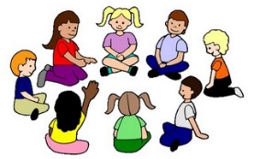
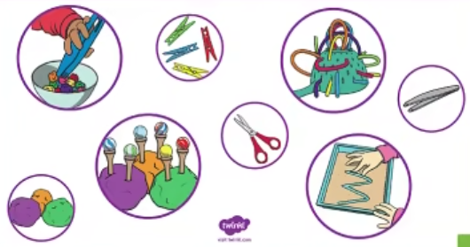
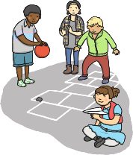












Trefn y Dydd/ Daily Timetable
Amser Cylch
Sesiwn Sgiliau
Amser chwarae
Thema
Amser cinio
Mynd am dro
Amser stori
Amser mynd adref
Sesiwn ganu
Ymarfer corff

Slide 8
Meddyginiaeth / Medicine
Os oes angen meddyginiaeth ar eich plentyn yn ystod y dydd a dydych chi ddim yn gallu dod i’r ysgol i’w rhoi i’ch plentyn bydd angen llenwi ffurflen o’r swyddfa. Cedwir y feddyginiaeth yn y swyddfa gyda’r ffurflen. Mae copi o’r ffurflen ar wefan yr ysgol hefyd.
If your child needs medication during the day and you are unable to come to school to give it to your child you will need to fill in a form from the office. The medication is kept in the office with the form. There is also a copy of the form on the school’s website.

Slide 9
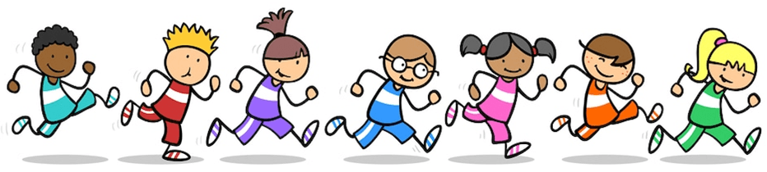
Gofynnwn i’r plant ddod i’r ysgol yn ddyddiol mewn esgidiau a dillad sy’n addas ar gyfer gwneud ymarfer corff – e.e. trainyrs a trowsus loncian/leggings neu i ddod a sgidiau i newid ond ni fyddant yn newid eu dillad.
We ask that children come to school daily dressed in comfortable clothes that are appropriate for doing P.E - e.g. trainers, joggers/leggings or to bring a pair of trainers to change into but they will not be changing into PE kit.
Ymarfer Corff/ Physical Education
Ymgylchiadau Cyffredinol / General Circumstances
Gofynnwn i’r plant ddod i’r ysgol mewn gwisg ysgol (fel arfer) ar ddiwrnodau ymarfer corff. Mi fydd y plant yn newid mewn i’w gwisgoedd ymarfer corff cyn y sesiwn.
We ask that children come to school on P.E days in school uniform (as normal). The children will be changing into their P.E kits in school.
Ymgylchiadau presennol / Current Circumstances
-Dosbarth Miss Harris – Dydd Llun / Monday
-Dosbarth Mrs Rees-Morgan – Dydd Llun / Monday

Slide 10


Cysyniad Ysgol Gyfan : Caredigrwydd
Cynllunio fel adran er mwyn sicrhau cysondeb / Planning as a department for consistency.
Llais y plentyn yn bwydo mewn i’r thema / Childrens’ voice contributes to planning.
Dylanwad disgybl / Pupil influenced
Straeon / Stories
*Mae’n iawn i fod yn wahanol/ It’s ok to be different
Dysgu am garedigrwydd tuag at ein hun / Learn about kindness towards ourselves and others.
*Wyt ti wedi llenwi bwced heddiw? / Have you filled a bucket today?
Pwysleisio’r pwysigrwydd o fod yn garedig tuag at eraill wrth rannu ac ati / Emphasising the importance of being kind towards others by sharing.

Slide 11
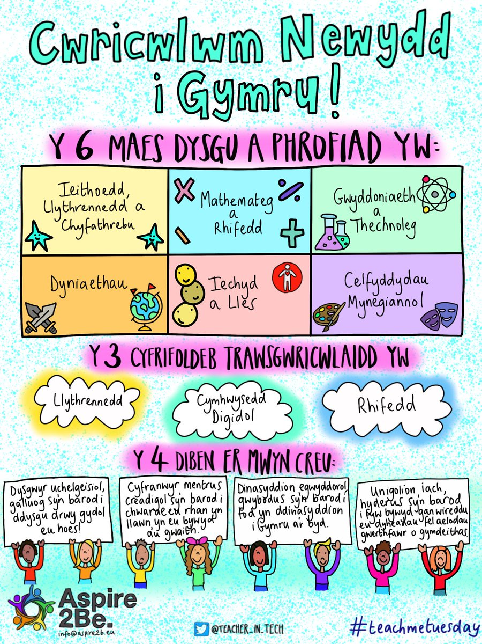

Cwricwlwm Newydd /New Curriculum.

Slide 12
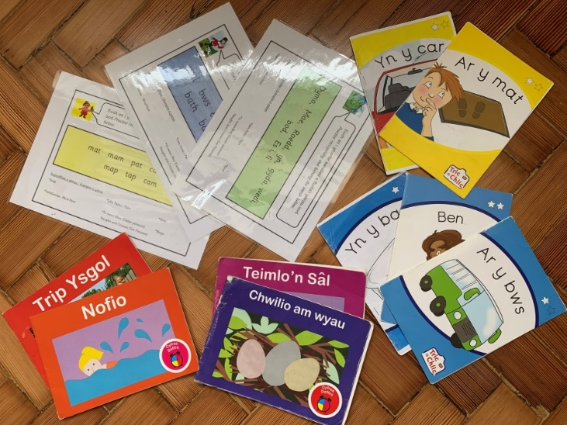
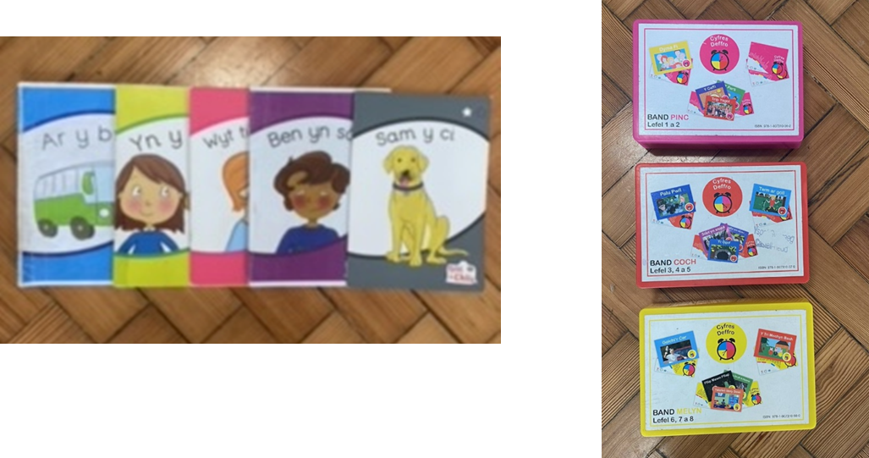
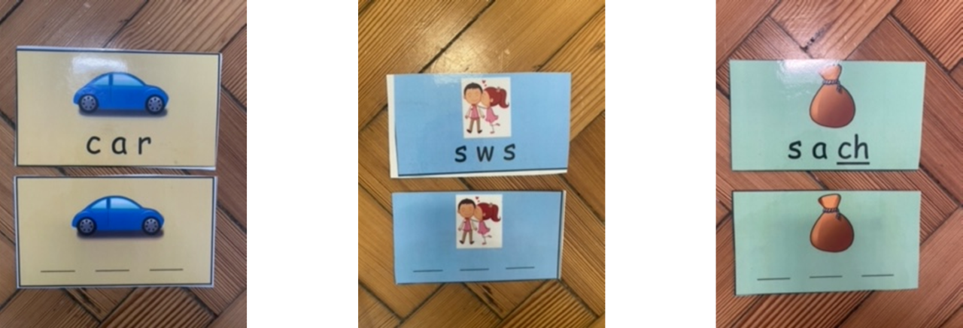
Darllen yn y tŷ / Reading at home

Slide 13
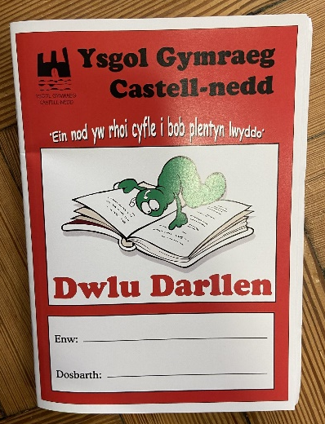

Slide 14
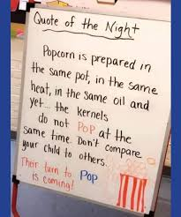

Slide 15
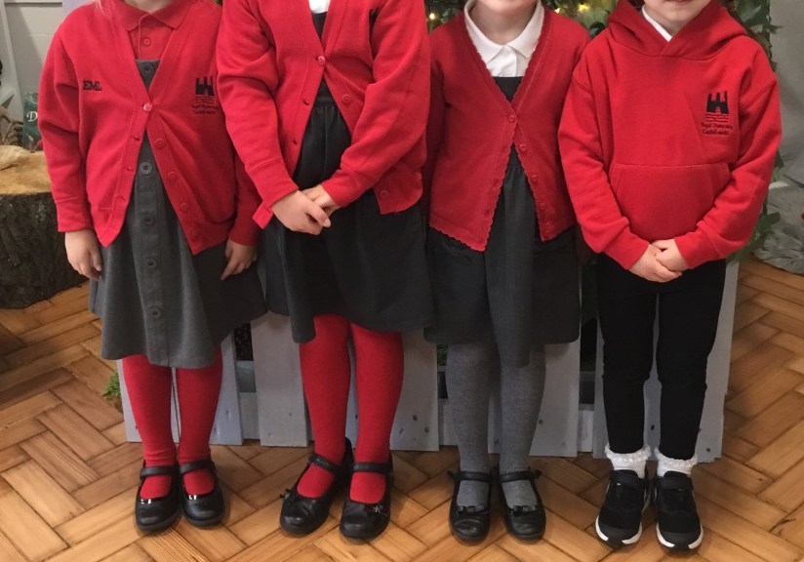
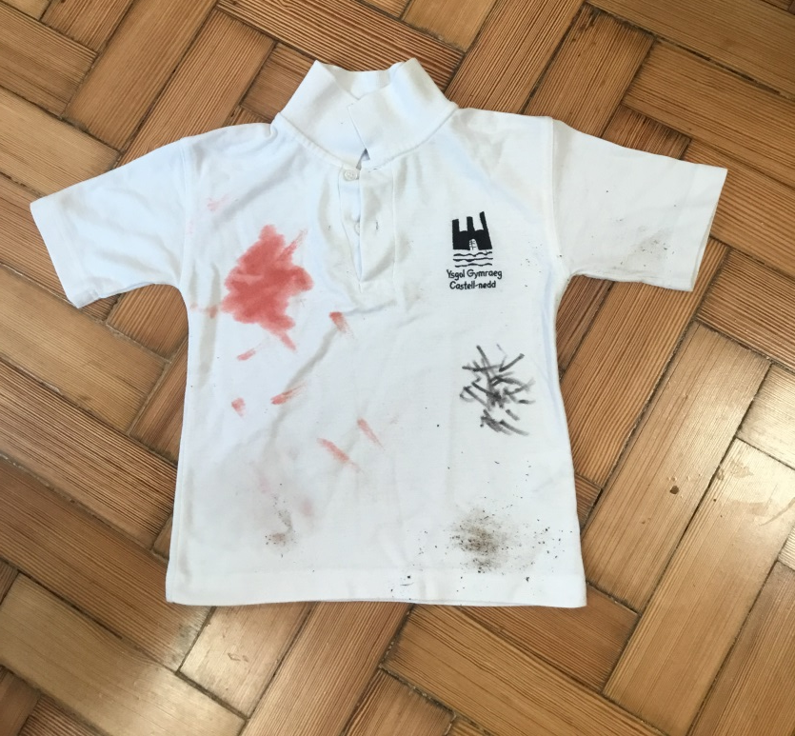
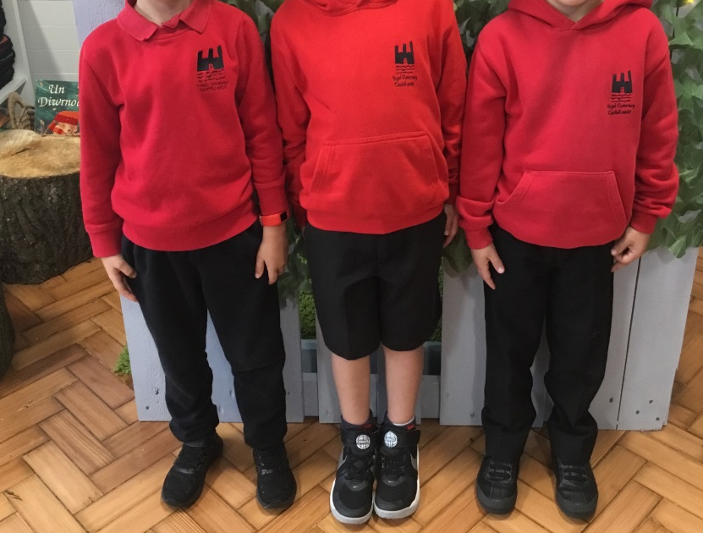
Gwisg Ysgol/School Uniform
Rwy’n flin mae fy nghrys yn frwnt ond mae’n dangos fy mod yn dysgu / I’m sorry that my shirt got dirty but it shows I’ve been learning!

Slide 16
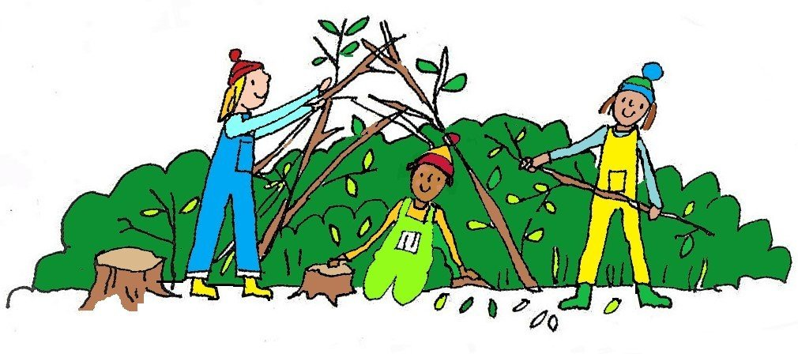
Sesiynau Ysgol Goed / Forest School Sessions
Prif bwriad Ysgol Goed yw i annog plant i fwynhau, gwerthfawrogi a chwilota yn y byd natur. Mae’n cynnig cyfleoedd i blant ddatblygu eu strwythur holistaidd ac i asesu a rheoli risg yn annibynnol. Yn ganolog i hyn mae’r amgylchedd drwy brofi’r tymhorau a rhyfeddodau’r byd natur o’u cwmpas. Magu hyder a pharch at bobl a natur yw ein nod a rhoi’r cyfle i bob plentyn lwyddo.
The main aim of Forest School is to encourage children to enjoy, appreciate and explore the natural environment. The approach promotes the children’s holistic development and to confidently assess and manage risks independently. Central to all of this is the environment. Children experience the seasons, the wonders of nature and the world around them. Forest School’s aim is to boost children’s self-confidence and respect to themselves, others and nature and to ensure they know how it feels to succeed.

Slide 17


Tudalen Trydar/ Twitter Page
Mae gan y dosbarthiadau Blwyddyn 1 gyfrif Trydar caëedig: @cnedd_bl1. A fyddech gystal â danfon eich enw defnyddiwr i’r ysgol cyn ceisio ymuno fel ein bod yn gwybod pwy ydych chi cyn derbyn eich cais.
The Year 1 classes have a closed Twitter group. The username is @cnedd_bl1. Please send your Twitter handle in to school before requesting to follow so that we know who you are before accepting your request.
@cnedd_bl1

Slide 18

Cyswllt rhieni / Parental contact
Cofiwch fod ein drws o hyd ar agor!
Mae gennym bolisi ‘drws agored.’
Ar hyn o bryd rydym ar gael ar ddiwedd y dydd neu ar gael am sgwrs dros y ffôn i drafod unrhyw faterion sydd yn eich poeni.
Gallwch drefnu apwyntiad os yn angenrheidiol ar amser sydd yn gyfleus i chi ac i’r ysgol.
Peidiwch â cholli cwsg - dewch am sgwrs!
Remember our door is always open!
We have an ‘open door’ policy. We are usually available at the end of the day to discuss any matters that may concern you.
If you wish to discuss anything regarding your child, please don't hesitate
to contact the school and have a discussion over the phone.
A problem shared is a problem halved!

Slide 19
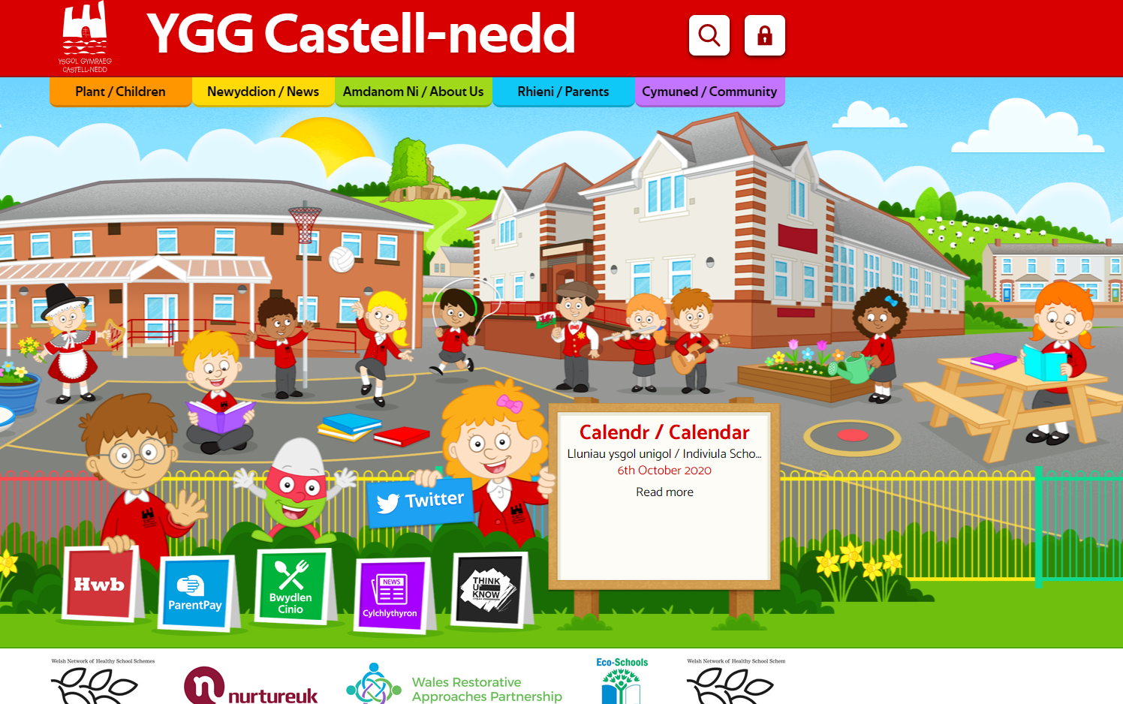
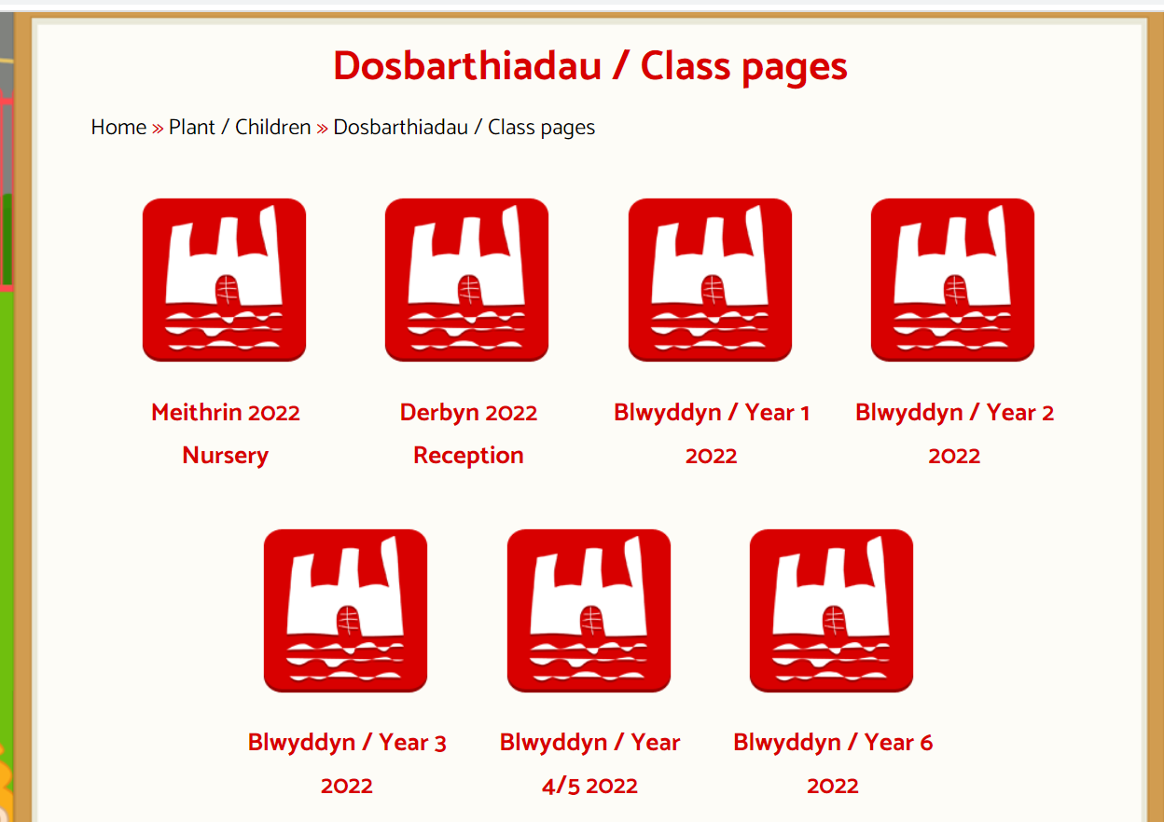
Gwefannau Defnyddiol / Useful Websites
www.yggcastellnedd.co.uk

Slide 20

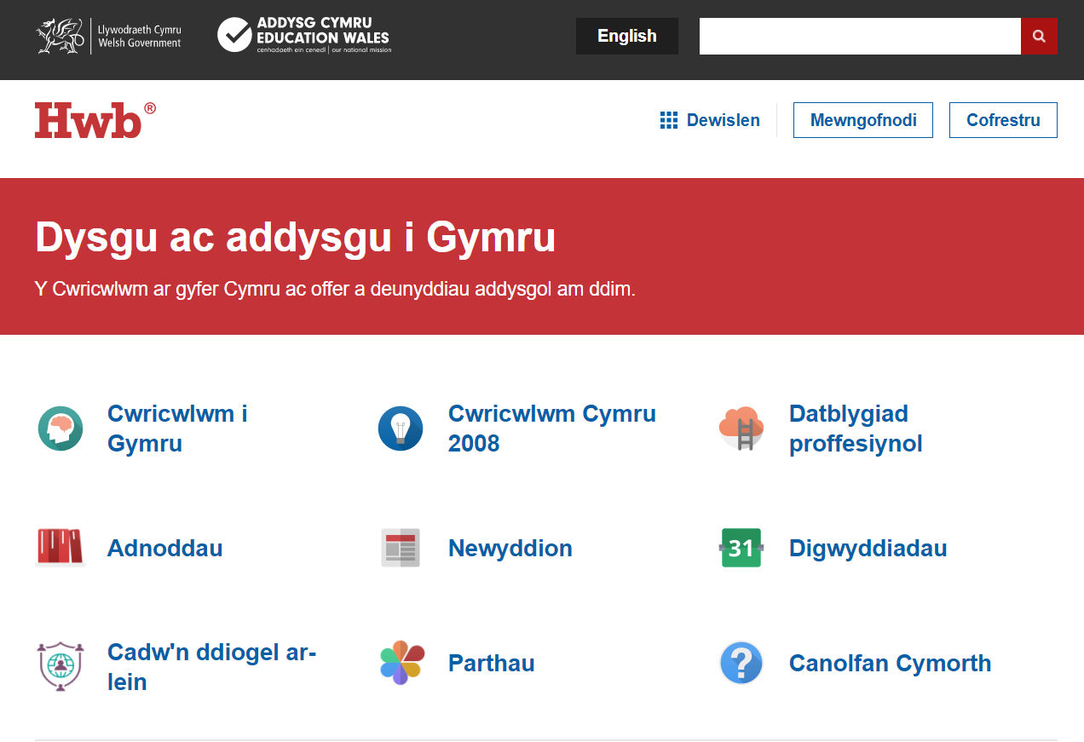

Gwefannau Defnyddiol / Useful Websites

Slide 21
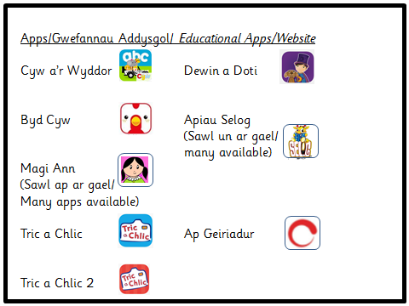


Slide 22
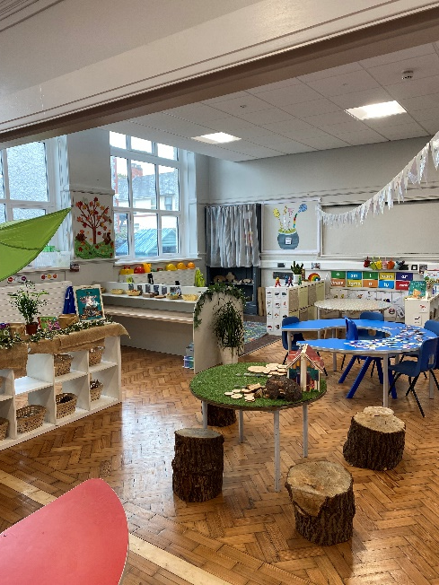
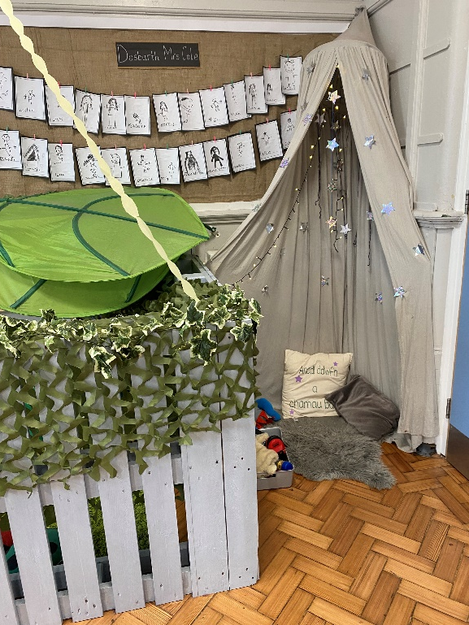
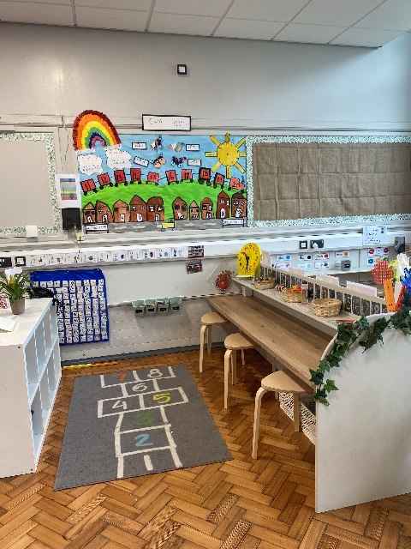
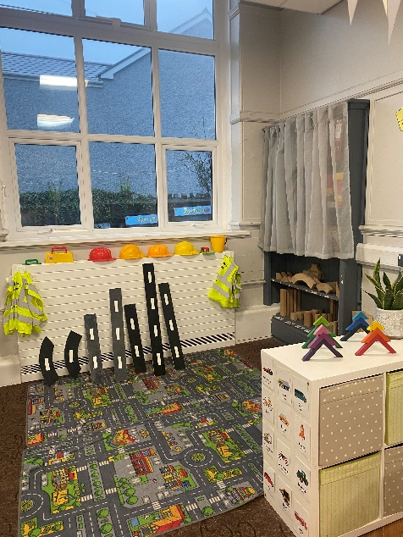
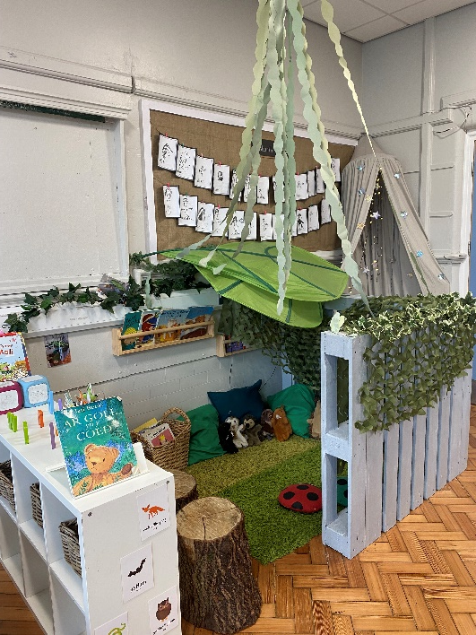
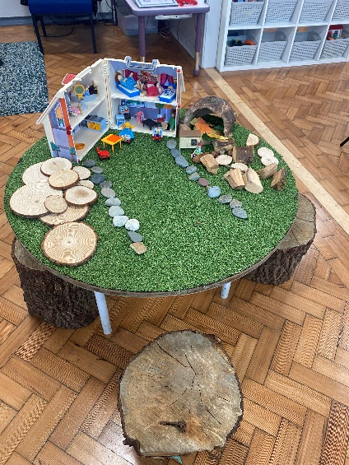
Yr Ystafell Ddosbarth /The Classroom

Slide 23
Yr Ystafell Ddosbarth /The Classroom
https://www.j2e.com/ygg-castell-nedd/AnwenHarris/IMG_7006.MOV/

Slide 24
Diolch!
Unrhyw gwestiynau?

