Slide 1



Croeso
i noson groesawu
Blwyddyn 2

Slide 2
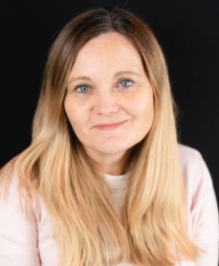
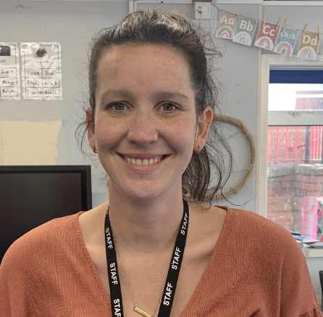
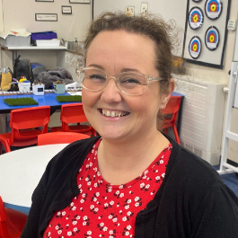
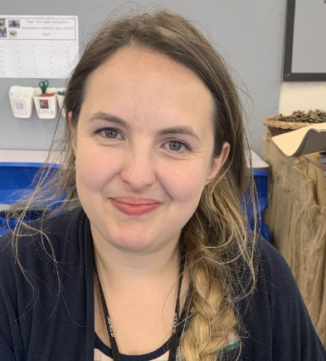
Mrs H Payne
Staff yr adran
Dosbarth /Class 2C – Mrs J Cox
Dosbarth /Class 2J – Mrs C Rees-Morgan
Cynorthwywyr/Teaching assistants:
Miss S Hunt Miss N Perkins

Slide 3

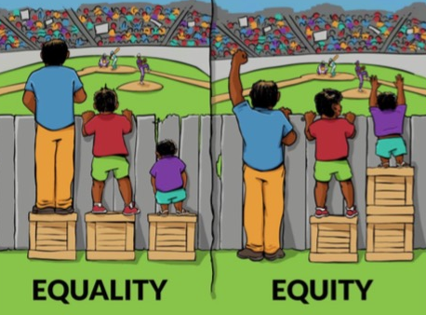

Ethos a Gweledigaeth
Cyfle i bob plentyn lwyddo / Opportunity for every
child to succeed.
Ysgol sydd yn annog Cymreictod, caredigrwydd, gonestrwydd, annibyniaeth a pharch / A school that promotes Welshness, kindness, honesty, independence and respect.
Ysgol gynhwysol sy’n sicrhau’r un cyfle i BOB plentyn / A school that ensures the same opportunities for EVERY child.

Slide 4

Disgyblaeth a Gwrth fwlio
Mae’r ysgol yn defnyddio strategaethau Arfer Adferol er mwyn ceisio datrys sefyllfa o gwmpo mas ac yn annog cyfrifoldeb personol am sefyllfaoedd o’r fath.
Mae’r cwestiynau canlynol yn ddibynadwy wrth ymateb i ymddygiad heriol:
Beth ddigwyddodd?
Beth oedd ar dy feddwl ar y pryd?
Beth sydd wedi bod ar dy feddwl ers hynny?
Pwy sydd wedi cael eu heffeithio gan dy weithredoedd di?
Ym mha ffordd mae hyn wedi effeithio arnat ti?
Beth wyt ti’n meddwl sydd angen i ti ei wneud i wneud yn iawn am y gweithredoedd yma?
Bwriad y cwestiynau canlynol yw helpu’r rhai hynny a niweidiwyd gan weithredoedd pobl eraill:
Beth oeddet ti’n meddwl pan sylweddolaist ti beth oedd wedi digwydd?
Beth sydd wedi bod ar dy feddwl ers hynny?
Sut mae hyn wedi effeithio arnat ti a phobl eraill?
Beth oedd y peth anoddaf i ti?
Yn dy farn di, beth sydd angen digwydd i wneud yn iawn am y gweithredoedd yma?

Slide 5
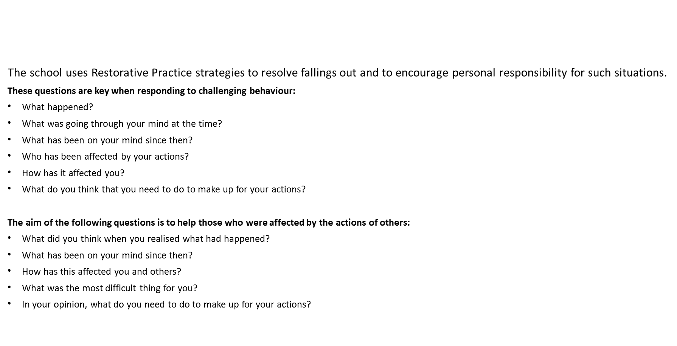
Behaviour and Anti-bullying Policies

Slide 6

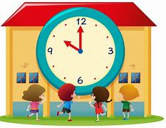
Trefn y Dydd/ Daily Timetable
Mae’r ysgol yn cychwyn i Flwyddyn 2 am 8.45y.b. Gofynnwn i chi sicrhau bod eich plentyn wedi cyrraedd yr ysgol yn brydlon. School starts at 8.45 – am for the Year 2 classes. We ask that you ensure your child arrives at school on time.
Gofynnwn i chi sicrhau eich bod yn casglu eich plentyn am 3.05y.p wrth y brif glwyd. We kindly ask that you collect your child at at the main gate please.
*Os fydd newid i drefniadau arferol casglu eich plentyn gofynnwn yn garedig i chi gysylltu â’r swyddfa neu anfon lythyr i gadarnhau’r trefniadau. If there is a change to your child’s usual circumstances with regards to collection from school we kindly ask that you inform the office or notify us by letter to confirm the arrangements.

Slide 7





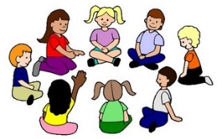

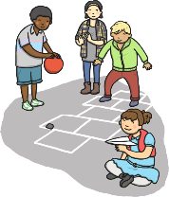


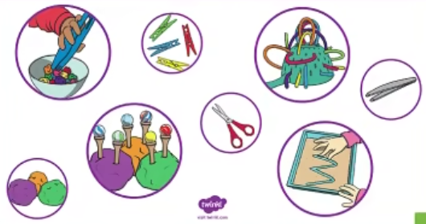









Trefn y Dydd/ Daily Timetable
Amser carped
Amser Cylch
Thema
Amser cinio
Amser chwarae
Sesiwn Sgiliau
Ysgol Goed
Amser stori
Amser mynd adref
Sesiwn ganu
Ymarfer corff

Slide 8

Gwaith dosbarth / Classwork
Cynllunio fel adran er mwyn cysondeb / Planning as a department for consistency
Cysyniadau / concepts
Gwaith wedi’i wahaniaethu / Differentiated Work
Llais y plentyn yn bwydo mewn i’r cynllunio /Childrens’ voice contributes to planning
Pupil influenced

Slide 9
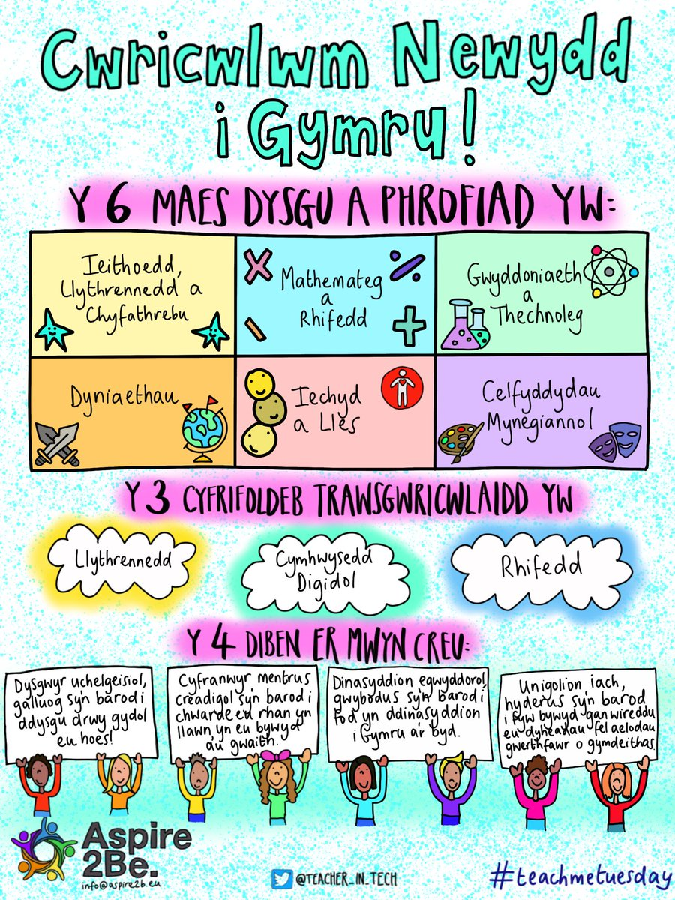


Slide 10


Slide 11
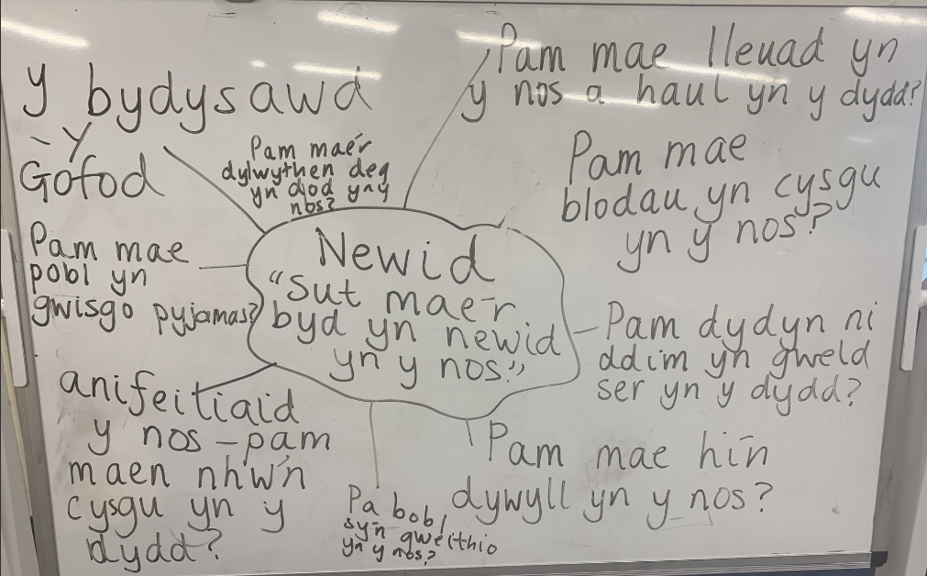
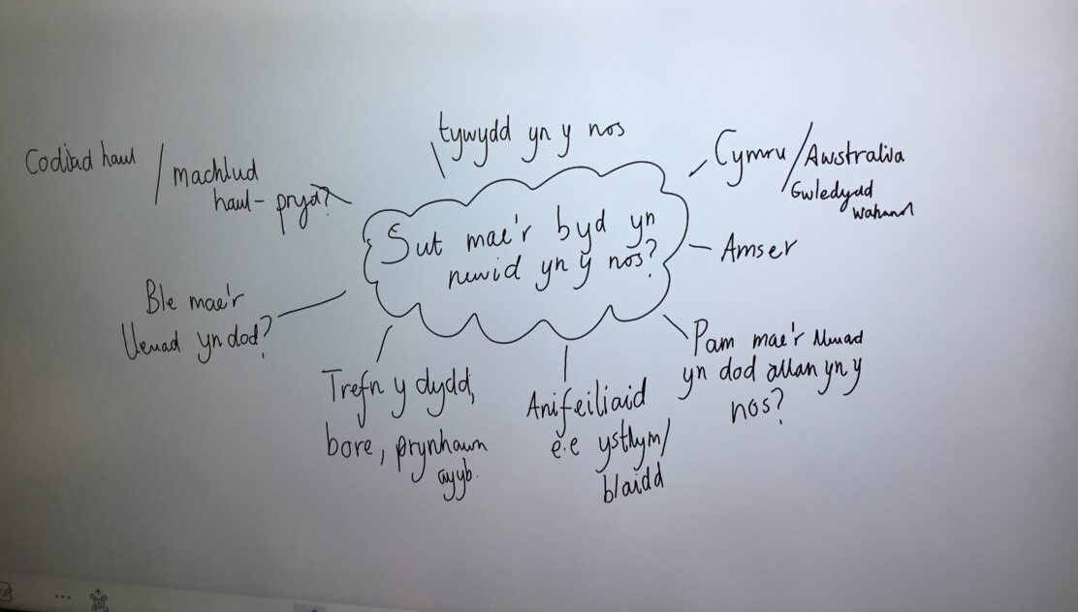
Cysyniad/Concept: Newid/Change

Slide 12


Darllen / Reading
Llyfrau mewn yn gyson gyda’r llyfrnod a’r llyfr cofnod darllen/ Bring reading books regularly with the reading record book and bookmark.
Llyfrau darllen- newid pan fo’n briodol / Reading books changed when returned.
Mae copi o’r 100 o eiriau cyntaf yn gymraeg ar ein gwefan. Ar y wefan hefyd mae’r geiriau wedi eu rhannu mewn i rhestrau o 10 ar y tro. Bydd eich plentyn yn gweithio ar un rhestr ar y tro yn yr ysgol gan symud ymlaen pan fyddant yn eu darllen a sillafu yn hyderus heb orfod adeiladu llythrennau. A copy of the first 100 words in welsh can be found on our website. we have also provided those words in lists of 10 at a time. Your child will work on one list at a time in school, moving on when they read and spell the ten words confidently, without having to build each letter or sound individually.

Slide 13
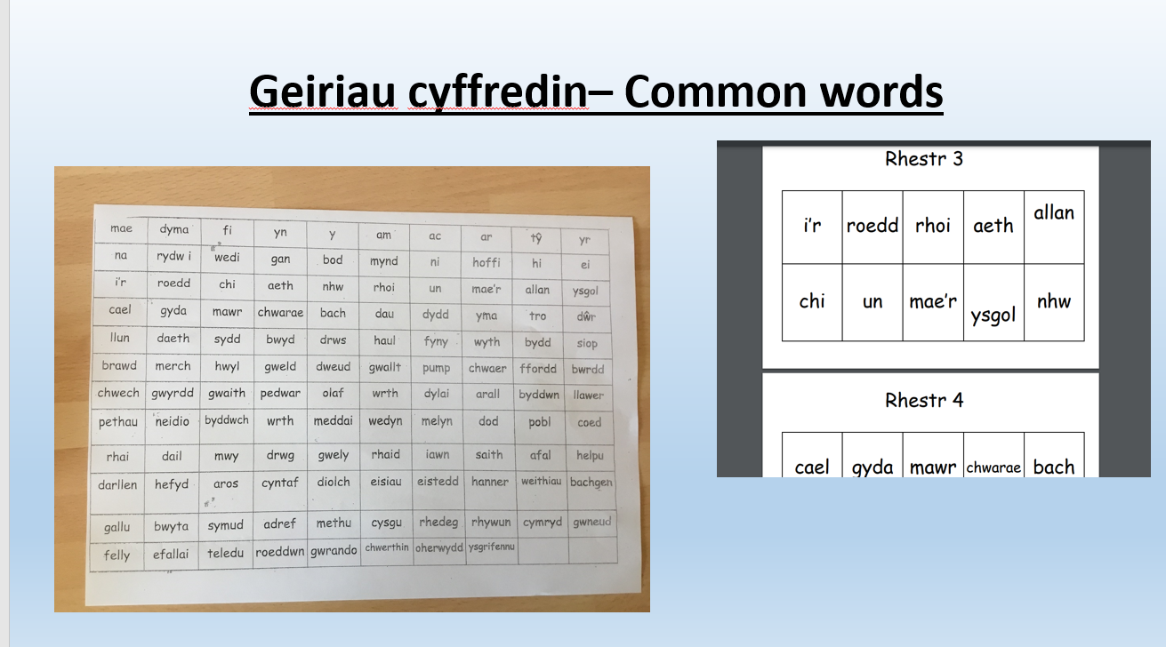

Slide 14

Mathemateg Fawr/Big Maths
Bydd y plant yn cymryd rhan mewn sesiynau Mathemateg Fawr er mwyn cryfhau a datblygu sgiliau rhif. Byddant yn mwynhau cwis bob Dydd Gwener yn seiliedig ar y gwaith hwn. Byddwn yn danfon y gwaith hwn adref yn ystod yr wythnos ganlynol gyda gwaith targed wedi’i cylchu.
Children will take part in daily Big Maths sessions to strengthen and develop number skills. Every Friday they will enjoy a quiz based on this work. We will send the sheets home during the following week and will have circled work which we will be targeting in school.
https://www.topmarks.co.uk/Search.aspx?q=100+square+splat
https://www.ictgames.com/mobilePage/hundredSq/index.html
https://ttrockstars.com/
https://play.numbots.com/#/intro

Slide 15




Learning and practising Times Tables Facts
Your child will Your child’s Numbots login details also allow them to log in to TimesTablesRocks online. Here they can practise their times tables facts.
The programme automatically generates the tables facts that your child needs to practise so they should not be given questions on tables that they have not yet started. It is important that they work through the questions themselves since it will generate facts too difficult for them if someone else has answered correctly facts that they themselves didn’t know.
When they reach a certain level the programme will generate division facts too.
Children can practise in the ‘garage’ where they earn coins that they can spend in the shop. They can buy items for their avatar.
They can also play against children in the class, the school and in other schools.
Tables facts can also be practised on J2Blast on J2E on HWB.
Hit the Button can be played online and can also be downloaded as an app.
To practise tables facts, go to the menu and select ‘Times Tables’ and then the table that you want to practise.

Slide 16

Addysg Gorfforol
Bydd angen dod gwisgo gwisg ymarfer corff ac esgidiau addas ar y diwrnod priodol./ Children will need to wear p.e. kit and shoes on the appropriate day.
-Dosbarth Mrs Cox –Dydd Gwener.
-Dosbarth Mrs Rees-Morgan – Dydd Llun

Slide 17
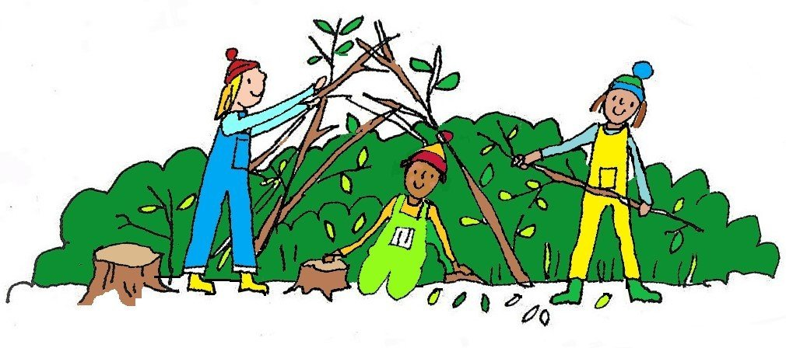
Sesiynau Ysgol Goed / Forest School Sessions - Dydd Mercher/Wednesdays
Prif bwriad Ysgol Goed yw i annog plant i fwynhau, gwerthfawrogi a chwilota yn y byd natur. Mae’n cynnig cyfleoedd i blant ddatblygu eu strwythur holistaidd ac i asesu a rheoli risg yn annibynnol. Yn ganolog i hyn mae’r amgylchedd drwy brofi’r tymhorau a rhyfeddodau’r byd natur o’u cwmpas. Magu hyder a pharch at bobl a natur yw ein nod a rhoi’r cyfle i bob plentyn lwyddo.
The main aim of Forest School is to encourage children to enjoy, appreciate and explore the natural environment. The approach promotes the children’s holistic development and to confidently assess and manage risks independently. Central to all of this is the environment. Children experience the seasons, the wonders of nature and the world around them. Forest School’s aim is to boost children’s self-confidence and respect to themselves, others and nature and to ensure they know how it feels to succeed.

Slide 18

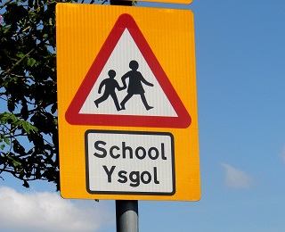

Dydd Mercher/Wednesdays

Slide 19
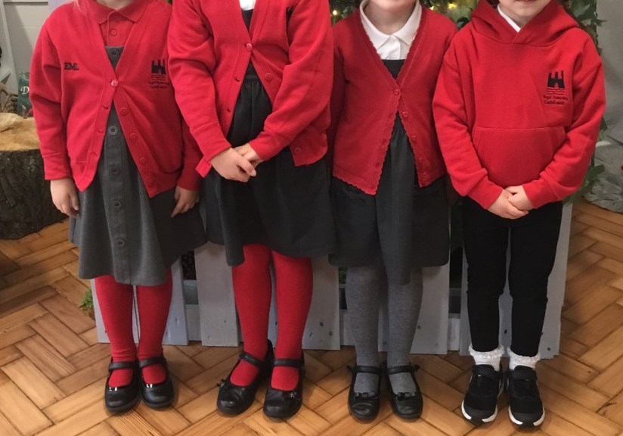
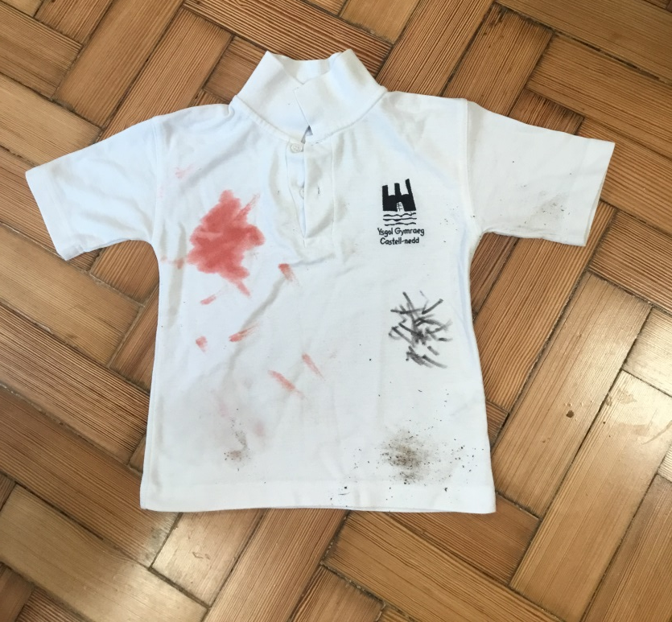
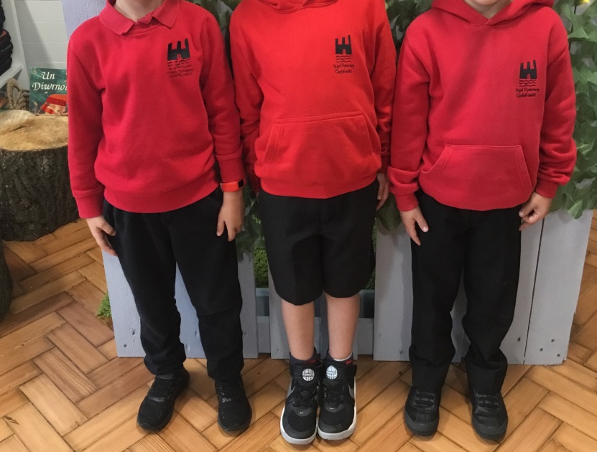
Gwisg Ysgol/Schoool Uniform
Rwy’n flin mae fy nghrys yn frwnt ond mae’n dangos fy mod yn dysgu / I’m sorry that my shirt got dirty but it shows I’ve been learning!
Mae angen labelu pob eitem sydd yn eiddo i’ch plentyn gydag enw.
Please label all belongings with your child’s name.

Slide 20

Trydar/Twitter
Mae gan Blwyddyn 2 gyfrif Trydar caëedig: @cnedd_bl2. A fyddech gystal â danfon eich enw defnyddiwr i’r ysgol cyn ceisio ymuno fel ein bod yn gwybod pwy ydych chi cyn derbyn eich cais.
Blwyddyn 2 has a closed Twitter group. The username is @cnedd_bl2. Please send your Twitter handle in to school before requesting to follow so that we know who you are before accepting your request.
@cnedd_bl2

Slide 21

Ffrwythau/Fruit
Mae croeso i’ch plentyn ddod â darn o ffrwyth i’r ysgol i fwynhau yn ystod amser chwarae..
Your child is welcome to bring a piece of fruit to school to enjoy at break time..

Slide 22
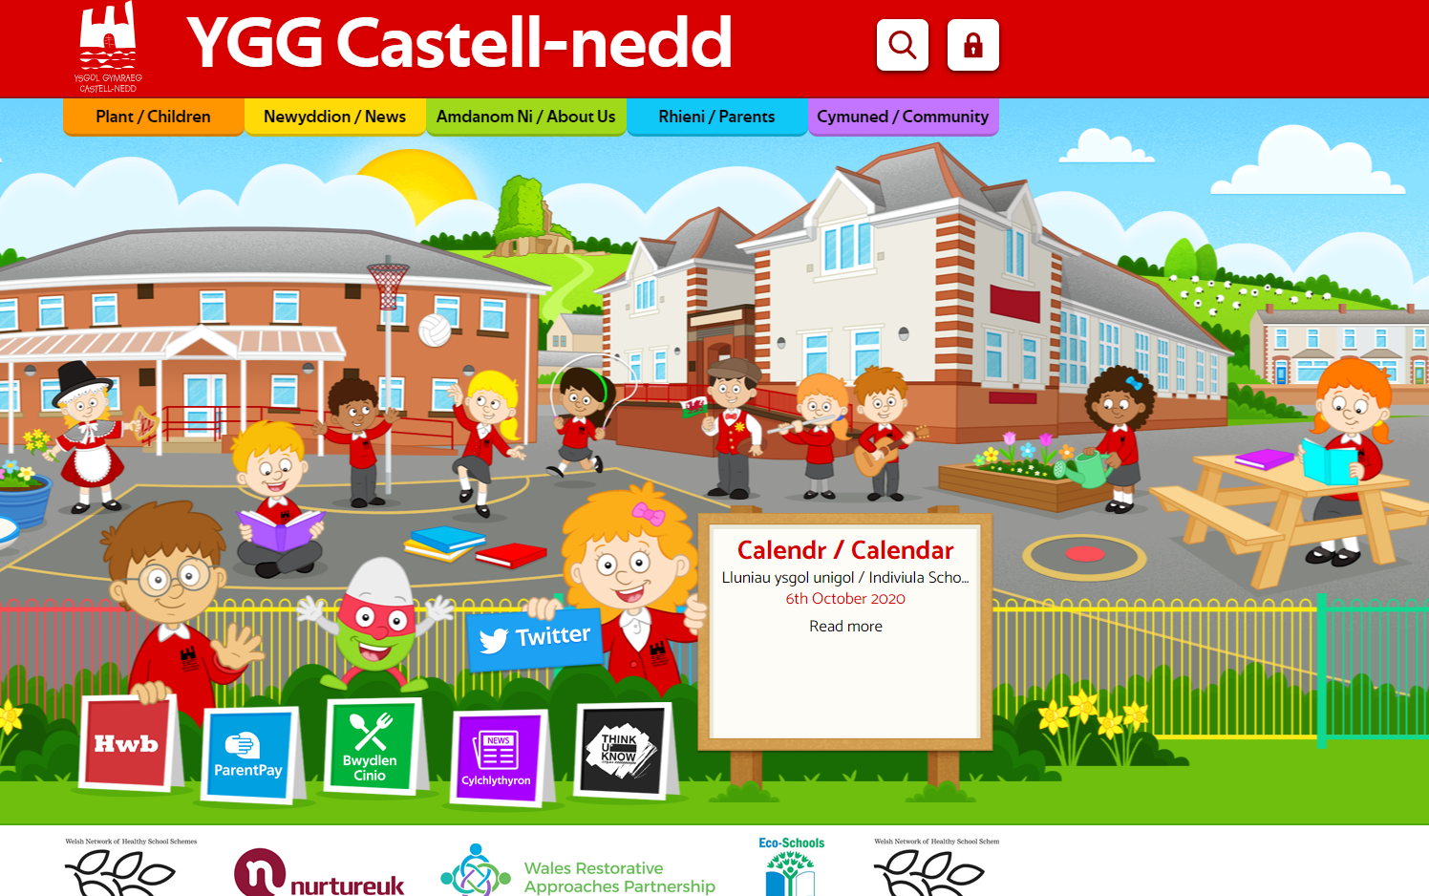
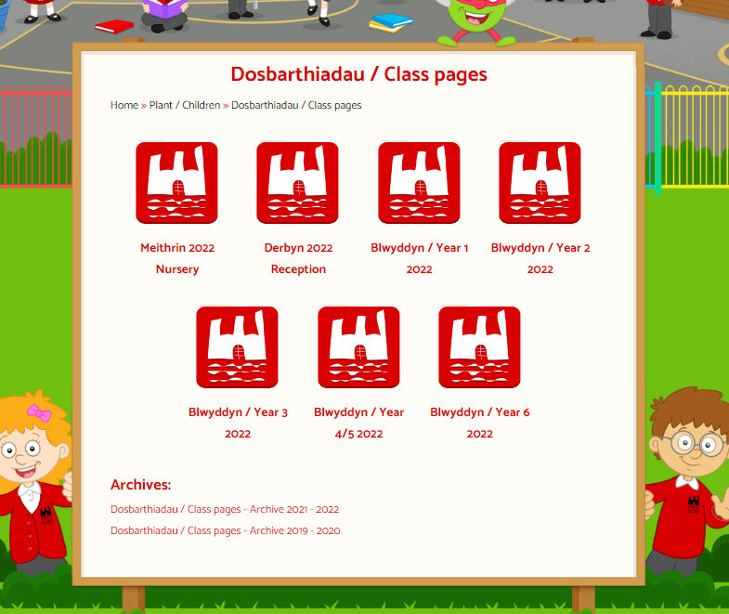
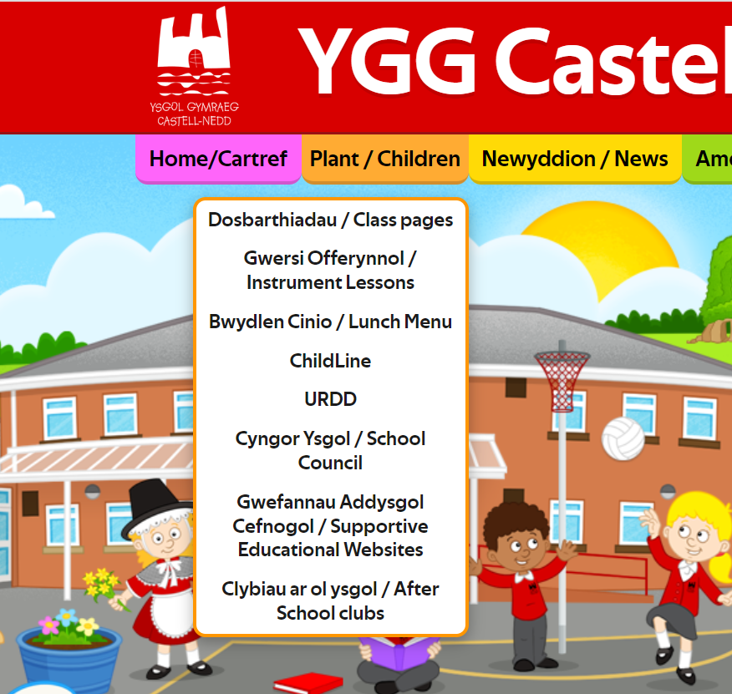
Gwefannau defnyddiol / Useful websites

Slide 23
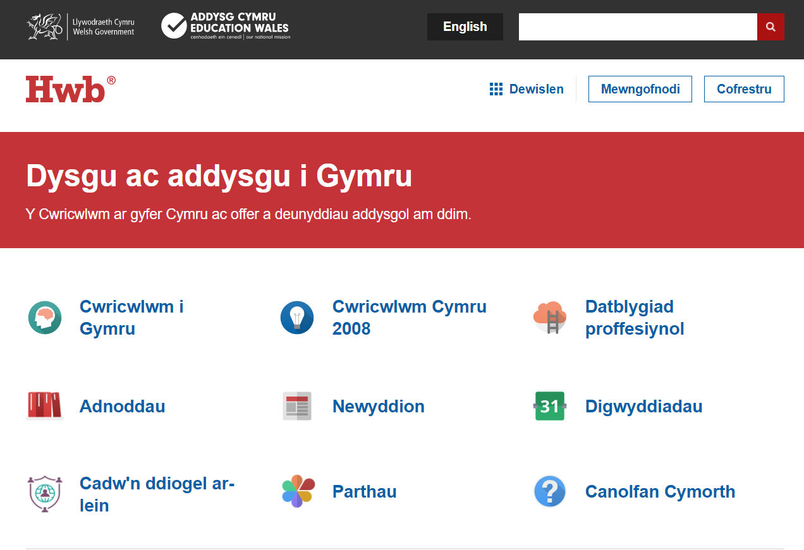
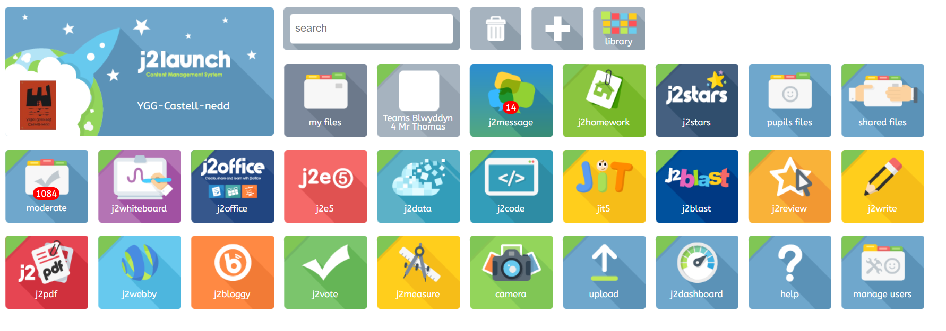
Gwefannau defnyddiol / Useful websites

Slide 24
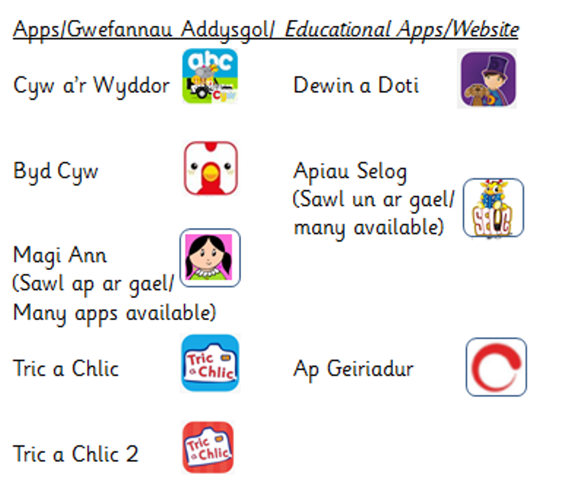

Slide 25
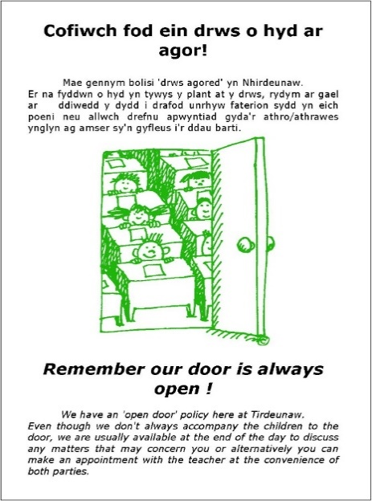
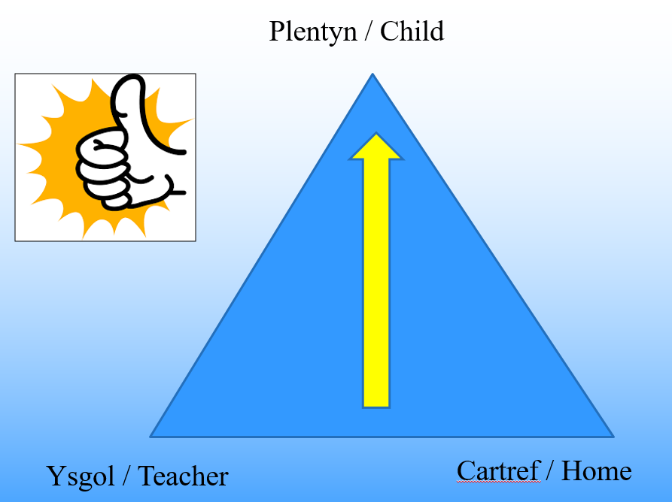
Cyswllt rhieni / Parental contact
Remember our door is always open!
We have an ‘open door’ policy. We are usually available at the end of the day to discuss any matters that may concern you.
However, if you wish to discuss anything regarding your child, please don't hesitate to contact the school and have a discussion over the phone.
A problem shared is a problem halved!
Cofiwch fod ein drws o hyd ar agor!
Mae gennym bolisi ‘drws agored.’
Rydymar gael ar ddiwedd y dydd i gael sgwrs dros y ffon i drafod unrhyw faterion sydd yn eich poeni.
Gallwch drefnu apwyntiad os yn angenrheidiol ar amser sydd yn gyfleus i chi ac i’r ysgol.
Peidiwch â cholli cwsg - dewch am sgwrs!

Slide 26


